Slide 1
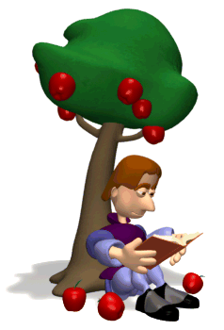
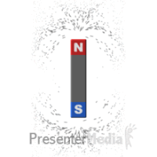
CLASS 8 SCIENCE FORCE AND PRESSURE MODULE 2 ON TYPES OF FORCES
Mrs.Geeta Gupta
A.E.C.S. 1
Mumbai

Slide 2
KINDS OF FORCES

Slide 3
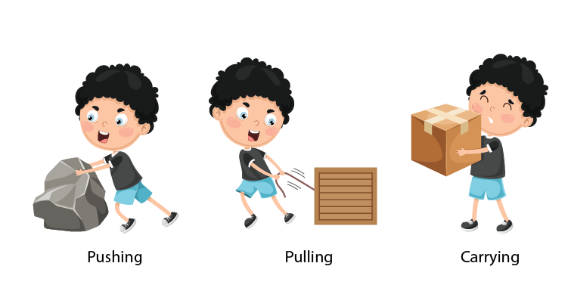
Contact forces
Forces that require a touch or contact to be applied are known as contact forces. E.g: Muscular forces, frictional forces

Slide 4
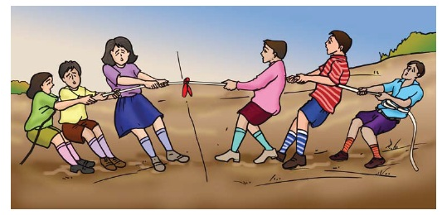
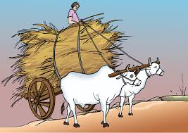
Muscular Force
The force that comes into play because of the action of muscles is called muscular force. For example:
Human beings use muscular force in order to walk.
The expansion and contraction of lungs is because of muscular force
Animals can also exhibit muscular forces; that's why they can move from one place to another
Muscular Force applied in Tug-of-War
Muscular Force applied by Animals

Slide 5
Frictional force
The force that opposes the relative motion between two surfaces.
Acts between the surface of the two bodies in contact.
Type of contact force.

Slide 6
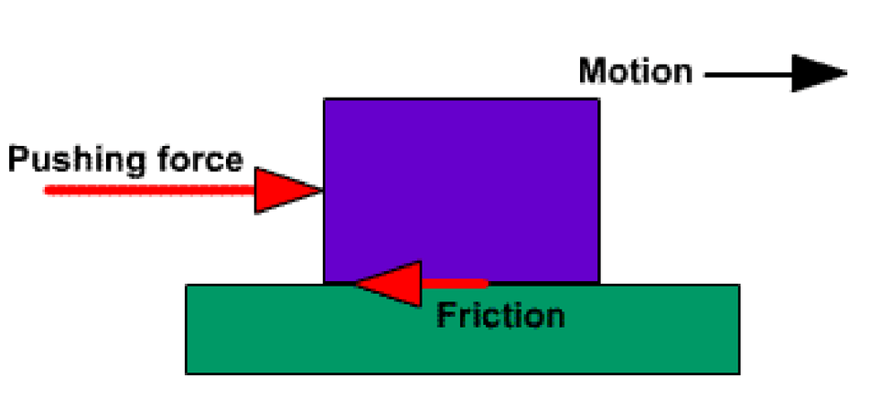
Force of Friction acting upon a moving object

Slide 8
NON CONTACT FORCES
Forces that do not need a contact, or that have their influence without a touch.
Example: magnetic force, electrostatic force, gravitational force.

Slide 10
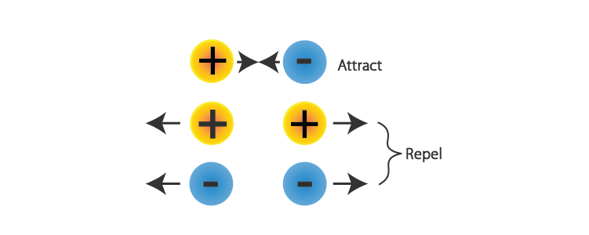
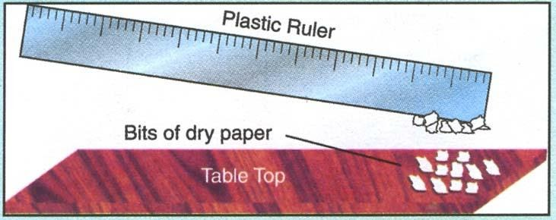
Electrostatic force
The force of attraction or repulsion experienced by a charged body from another charged body in the same vicinity is known as Electrostatic Force.

Slide 11
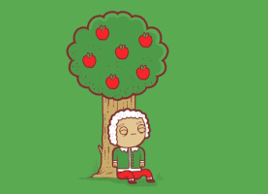
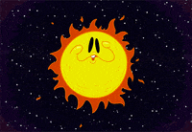

Slide 12
Gravitational force
The attractive force that a body experience towards the centre of the earth is called the force of gravity due to earth.
Property of the universe, every object attracts or exerts a force on every other object.

Slide 13
2 forces acting together

Slide 14
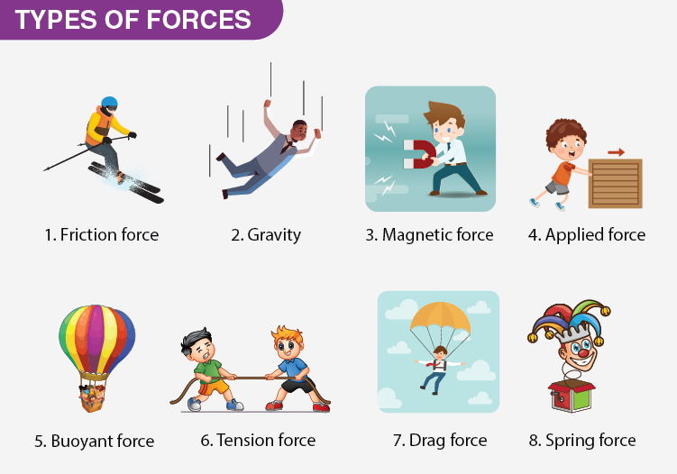
Title Layout
Classify the following forces as contact or non contact forces
Subtitle

Slide 15
