Slide 1
TRANSPORTATION IN ANIMALS AND PLANTS
MODULE 3\3
PREPARED BY : - MITA SAHA
TGT (SS)
A.E.C.S..-1
JADUGUDA

Slide 2
TRANSPORTATION IN ANIMALS AND PLANTS
MODULE 3 / 3
TRANSPORT OF SUBSTANCE IN PLANTS
Plants absorb water and minerals by the roots from the soil. The roots have
root hairs. The root hair increase the surface area of the root for the absorption
of water and mineral nutrients dissolved in water .
The root hair is in contact with the water present between the soil particles .

Slide 3
VASCULAR TISSUE
Plants have pipe like vessels to transport water and nutrients from the soil. The vessels are made of special cells , forming the vascular tissue .
The tissue is a group of cells that perform specialized function in an organism.
Vascular tissue is divided into two types
Xylem
Phloem

Slide 4
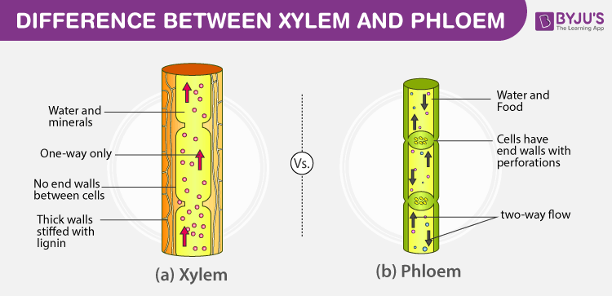

Slide 5
XYLEM
The vascular tissues for the transport of water and nutrients in the plants
are called xylem .
Xylem forms a continuous network of channels that connect s roots to
the leaves through the stem and branches and thus transport water
to the entire plant
PHLOEM
The leaves synthesise food for the plant
.
The food has to be transported to all parts of the plant. This is done
by the vascular tissue called the phloem.
Thus . xylem and phloem transport substances in the plants.

Slide 6
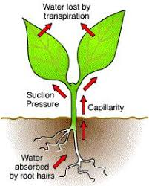
TRANSPIRATION

Slide 7
TRANSPIRATION
Plants release a lot of water by the process of transpiration through
the stomata present on the surface of the leaves .
The evaporation of water from leaves generates a suction pull, which
can pull water to great heights in the tall trees and called
as “Transpirational pull”
.
Transpiration also cools the plants .

Slide 8
THANK YOU
HAVE A NICE DAY

