Slide 1
GEOGRAPHY
LESSON 2
LAND, SOIL, WATER, NATURAL VEGETATION AND WILD LIFE RESOURCES(MODULE:2)

Slide 2
What is soil? –
The thin layer of grainy substance covering the surface of the earth is called soil

Slide 3
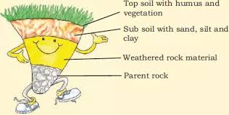

Slide 4
The soil formation depends up on 5 factors.
parent rock: means the rock from which the soil is formed it decides colour, texture ,chemical property ,mineral, permeability.
Relief: relief means topography height of land; slope determine accumulation of soil.
Flora , fauna and micro organism affect the rate of humus formation.

Slide 5
Climate; temperature, rainfall influence the rate of weathering and humus formation
Time: Determines thickness of soil profile.

Slide 6
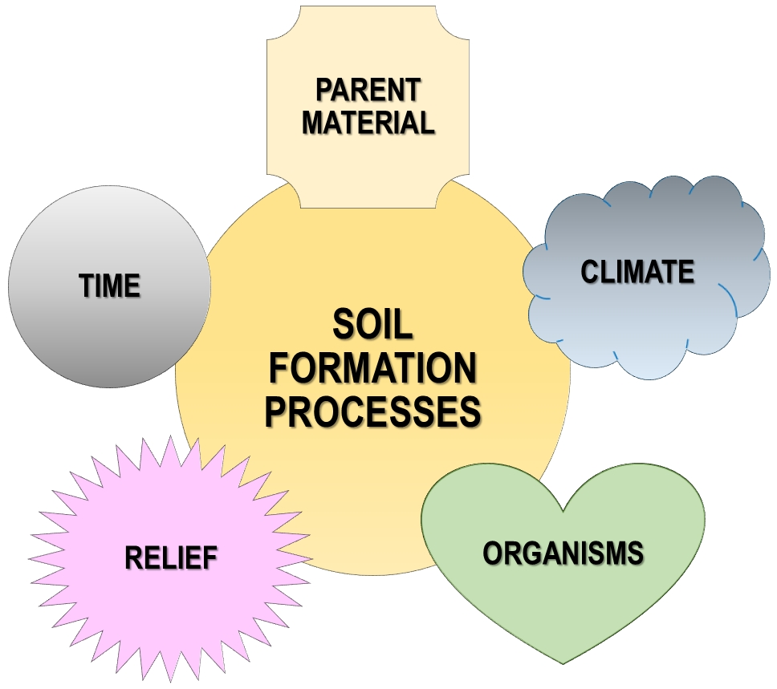

Slide 7
The reasons for land degradation are
deforestation
overgrazing
overuse of chemical fertilizers or pesticides
rain wash
landslides and floods.

Slide 8
There are various methods to conserve soil. They are
1.Mulching: The bare ground between plant is covered with a layer of organic matter like straw

Slide 9
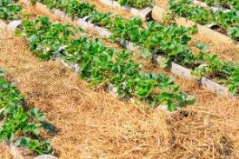

Slide 10
2.Contour barriers: Stones grass and soil are used to build barriers

Slide 12
Rockdams; Rocks are piled up to slow down the flow of water

Slide 14
Terrace farming: Broad flat steps or terraces are made on the steep slopes so that flat surfaces available to grow crops.

Slide 15
Intercropping: Different crops are grown in alternate rows and sown at different times to protect the soil from rain wash.

Slide 16
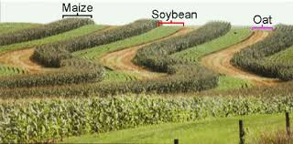

Slide 17
Contour ploughing: Ploughing parallel to the contours of a hill slope to form a natural barrier for water to flow down the slope.

Slide 18
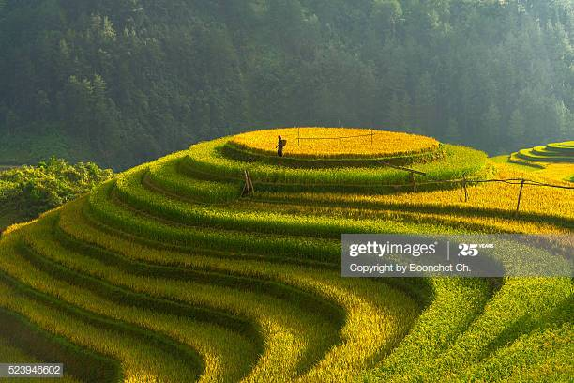

Slide 19
Shelter belts: In coastal areas, rows of trees are planted to check wind movement to protect soil cover

Slide 20
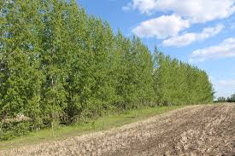

Slide 21
WATER
We know that 70 percentage of earth's surface is covered with water. It is therefore appropriately called the water planet or blue planet. The ocean covers two third of the earth surface. But ocean water is saline or salty, which cannot be used for human consumption. Freshwater accounts only 2.7 %. Nearly 70% of this freshwater occurs as ice sheets and glaciers. Due to their location they are inaccessible. Only one percentage of freshwater is available for human use.

Slide 22
the uses of water.
Water is used for various purposes like
personal use
agriculture,
industry,
generating electricity.

Slide 23
Reasons for the shortage of water
increase in population
rising demand for food and cash crops
, increasing urbanization.

Slide 24
Many countries are facing the problem of water scarcity. We have to think various ways to conserve water since is a very important resource. There are various ways to conserve water

Slide 25
Important methods of water conservation are
Increase the forest and other vegetation cover
Rainwater harvesting
Lining canals used for irrigating field.
Sprinkler system and
Drip irrigation or trickle irrigation

Slide 26
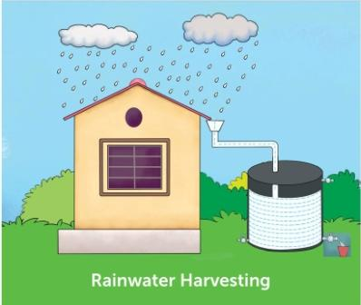

Slide 27
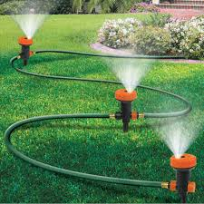

Slide 28
