Slide 1
CIVICS
LESSON 6
Understanding our criminaL justice system(MODULE:1)

Slide 2
The main contents of this chapter are
* Key players in criminal justice system
* The role of Police in investigating a crime
* Fundamental rights of an arrested person

Slide 3
* DK Basu guidelines
*What is an FIR?
*The role of the Public Prosecutor
*The role of the Judge
* What is a fair trial?

Slide 4
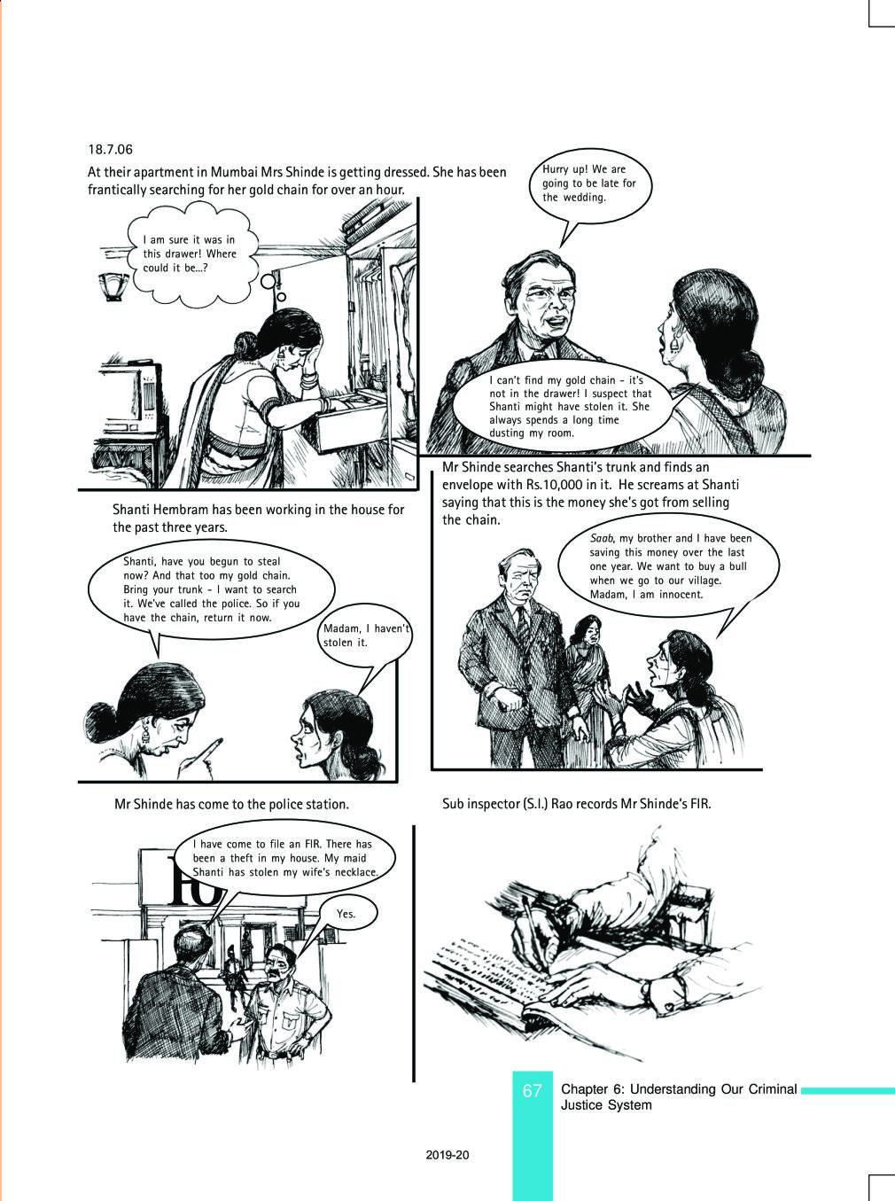

Slide 5
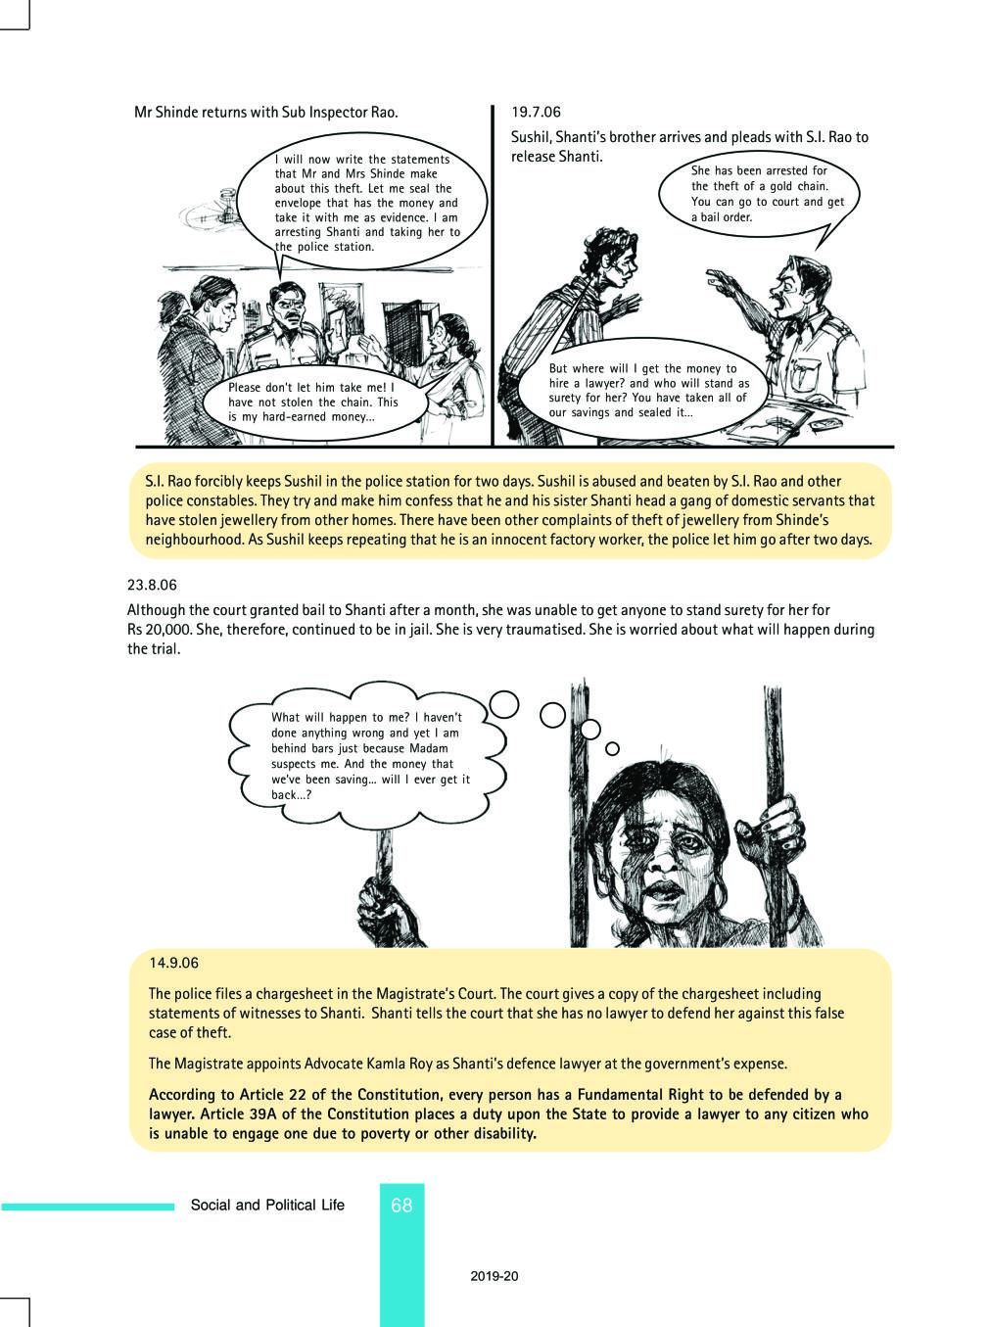

Slide 6
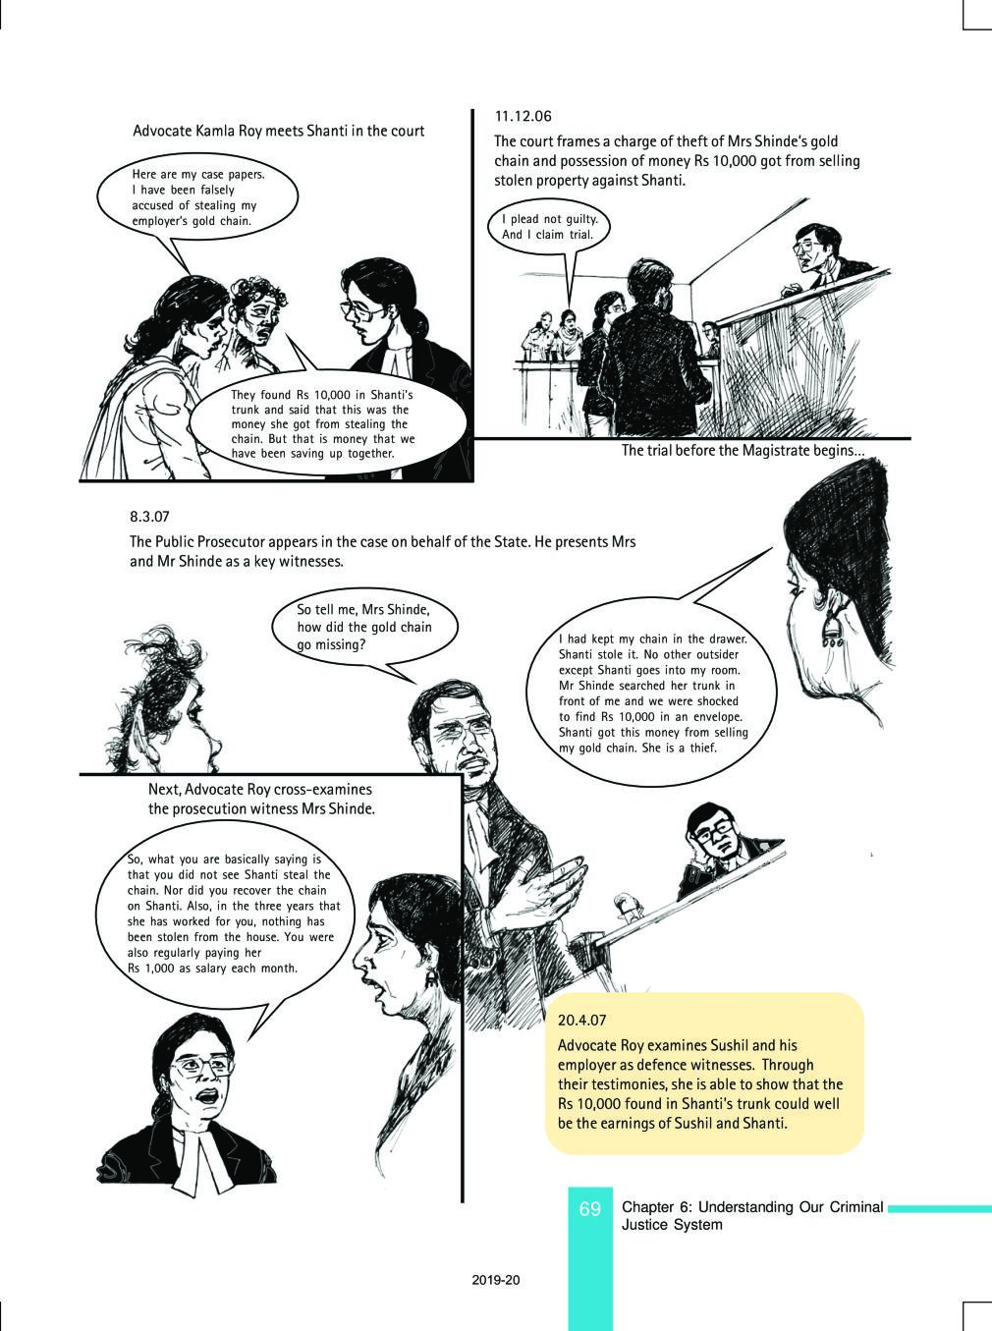

Slide 8
The four key players in the criminal system
the Police
the Public Prosecutor
the defence lawyer and
the judge

Slide 9
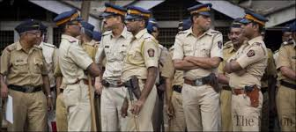

Slide 10
What is the role of Police in investigating a crime?
One important function of the police is to investigate any complaint about the commission of a crime.
An investigation includes recording statements of witnesses and collecting different kinds of evidence

Slide 11
On the basis of the Investigation, the police are required to form an opinion.
If the police think that the evidence points to the guilt of the accused person, then they file a charge sheet in the court.
It is not the job of the police to decide whether a person is guilty or not.

Slide 12
Article 22 of the constitution and criminal law guarantee to every arrested person the following fundamental rights
*The right to be informed at the time of arrest of the offence for which the person is being arrested
*The right to be presented before a magistrate within 24 hours of arrest.
*The right not to be ill-treated or tortured during arrest or in custody.
*Confessions made in the police custody cannot be used as evidence against the accused
*A boy under 15 years of age and women cannot be called to the police station only for questioning.

