Slide 1
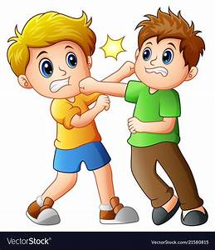
LESSON-6, THE FIGHT
-RUSKIN BOND
MODULE -2/2

Slide 2

RECAP OF MODULE-1
1. Ranji had been less than a month in Rajpur. He had not yet made any friends there and used to roam alone.
2. Rajpur was a semi hill station and there were hills and forests on all sides of it. He used to roam alone in these places.
3. He discovers a pool in the forest and plunges into it for a swim. The water in the pool was very clear. It came there from a cluster of rocks.

Slide 3
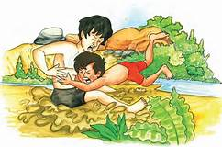
There is serious trouble between him and someone else over who had the right to the pool. A fight ensues.
The first round ends in a draw.

Slide 4
KEYPOINTS OF THE STORY
1. When Ranji got home, he found it difficult to explain the cuts and bruises all over his body.
2. His mother ordered him to stay in the house for the rest of the day.
3. However, he slipped in the evening to the market and had a lemonade and jalebis.
4. When he had finished the lemonade, he saw the other boy coming down the road. Both of them scowled at each other.

Slide 5
5. The next day Ranji reached the pool unwillingly, as he felt weak and knew he would be beaten in another fight. Yet, he didn’t want to refuse the challenge and be mistaken for a timid boy.
6. At the pool, the other boy asked Ranji to come to his side of the pool. He taunted him saying that he could not swim the length of the pool.
7. Ranji accepted the challenge and dived straight into the water. He surfaced on the other side without a splash. The other boy was highly surprised.

Slide 6
8. Being impressed from Ranji the other boy asked Ranji to teach him how to dive.
9. Ranji explained him how to dive. The other boy asked Ranji to teach him every day.
10. At the end the two boys became friends and told their names to each other. Suraj, the other boy proposed a deal that if Ranji taught him diving; he would make Ranji a Pahelwan like him. Both of them referred the pool as their pool and said that nobody else can come there without their permission.

Slide 7
WORD MEANING
Claimants- one who claims
Bruises- injuries
Conceal- hide
Solace- comfort or consolation
Adversary- rival, opponent
Impulse- instinct
Scowled – looked angrily
Ferocity – fierceness

Slide 8
WORD MEANINGS
Sore- painful
Acquiesce- accept quietly
Splash- sound of falling into water
Trending water- keeping oneself upright in deep water by moving the feet
Conceded- admitted
Unflinching- looking straight at each other
Limpid - clear

Slide 9


MORAL OF THE STORY
Fighting is not the only way of resolving differences of opinion. This can be done in a friendly way through talks and a spirit of accommodation. Accepting the other’s point of view while retaining yours is quite important. We can agree to disagree.

