Slide 1

ENGLISH SUPPLEMENTARY – CLASS VIII
CHAPTER - 8
ss

Slide 2
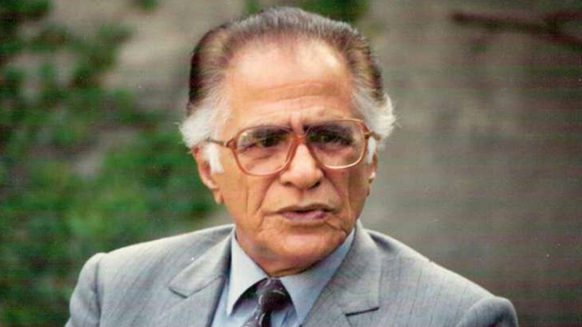
ABOUT THE AUTHOR
Ahmed Nadeem Qasmi
Pakistani poet, journalist, literary critic, short story writer etc.
Has written more than 50 books
Is considered second only to Prem Chand.

Slide 3
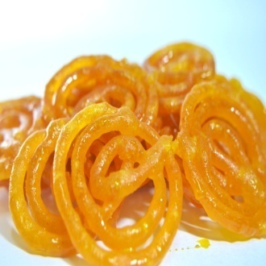
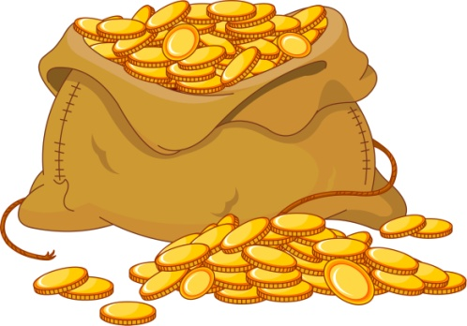
SUMMARY OF THE CHAPTER
PART 1
An honest boy is on his way to school carrying money in his pocket to pay the school fees.
The sight of crisp, syrupy jalebis in the market excites him and the coins in his pocket begin to speak to him.
After a long debate with himself, he yields to the sweet temptation.

Slide 4
PART 2
He eats a heap of jalebis, and shares the rest with all the children in the neighbourhood.
Though penniless now, he feels no less important than the Governor Saheb.
The real problem at hand is payment of school fees on time as the scholarship money gets postponed by a month.

Slide 5
PART 3
Remorseful and scared, he runs away from school and sits near the Railway Station and prays to God for monetary help.
He prays harder when there is no response from God
Finally, his parents come to know of his actions.
Later in life it dawns on him the difference between fanciful and factual.

Slide 6

TAKE FROM THE STORY
GOD HELPS THOSE WHO HELP THEMSELVES
HARD WORK PAYS NOT HARDLY WORKING
MISTAKES ARE A STEPPING STONES TO SUCCESS

Slide 7
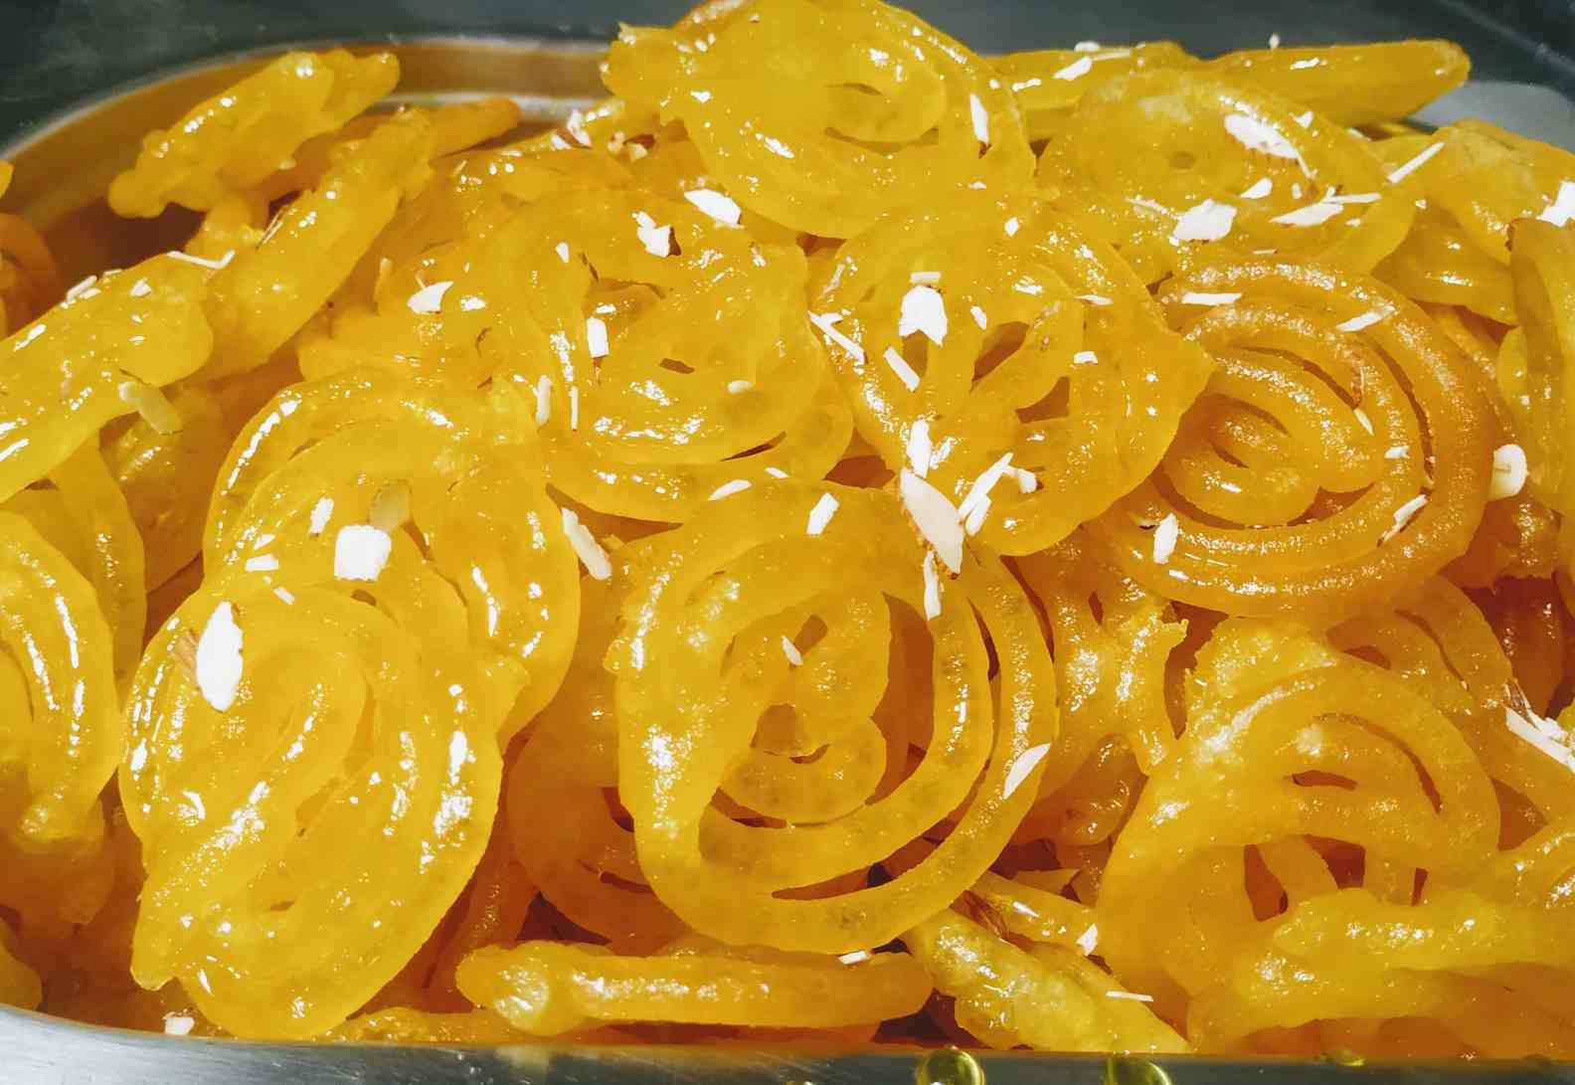
JALEBIS
A finger licking, mouth watering treat.
Jalibi is a sweet popular in Persia and countries of the Indian Subcontinent such as India, Pakistan, Nepal, and Bangladesh. It is made by deep-frying batter in pretzel or circular shapes, which are then soaked in syrup. It can be rightly said Jalebi is a sweet for all occasion. A wonder that comes in circle all dripping with juicy sugar.

Slide 8


