Slide 1


Class VIII (English)
Honey Dew
(Textbook)
This is Jody's Fawn
-by Marjorie
Kinnon Rawlings

Slide 2
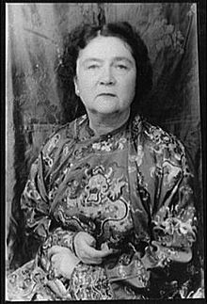
About the Author
Marjorie Kinnan Rawlings (August 8, 1896 – December 14, 1953) was an American author who lived in rural Florida and wrote novels with rural themes and settings. Her best known work,The Yearling , about a boy who adopts an orphaned fawn, won a Pulitzer Prize for fiction in 1939. The movie version of The Yearling, came out in 1946 and starred iconic actor Gregory Peck and Jane Wyman, who both were nominated for Academy Awards.

Slide 3

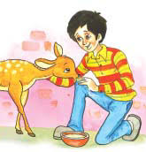
Introduction
"This is Jody's Fawn" is a very touching story that tells about a little child and his consciousness. It revolves around the emotion of the little child, Jody, who has a sensitive mind that is unable to forget a doe's sacrifice to save his father's life. The lesson takes you through Jody's Journey, from finding the fawn till taking it home with him. Now here goes summery of the story ''This is Jody's Fawn''.

Slide 4
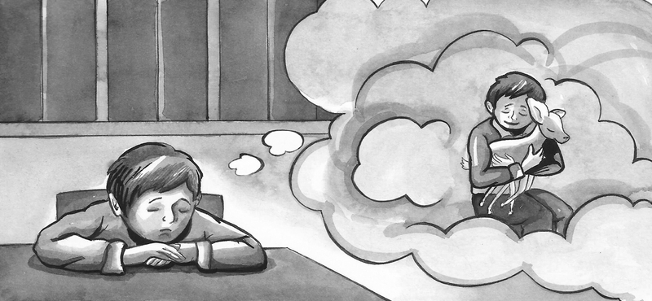
In this story, Jody's father is bitten by a rattlesnake. He quickly kills a doe and uses its heart and liver to draw out the poison. Jody wonders what will happen to the little fawn left without its mother.

Slide 5
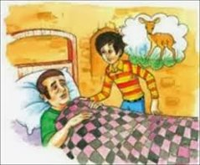
The thought of fawn kept on haunting Jody's mind. He quietly went to his father's bed-side. He asked him how he was feeling. Then he asked him to think about the fawn. He asked him to permit him to bring the fawn home. Jody wanted to raise him. First the father ignored it but when Jody insisted him reminding him of his duty, the father agreed. He allowed Jody to bring the fawn home. He asked him to tell his mother about it before going to bring the fawn in.

Slide 6
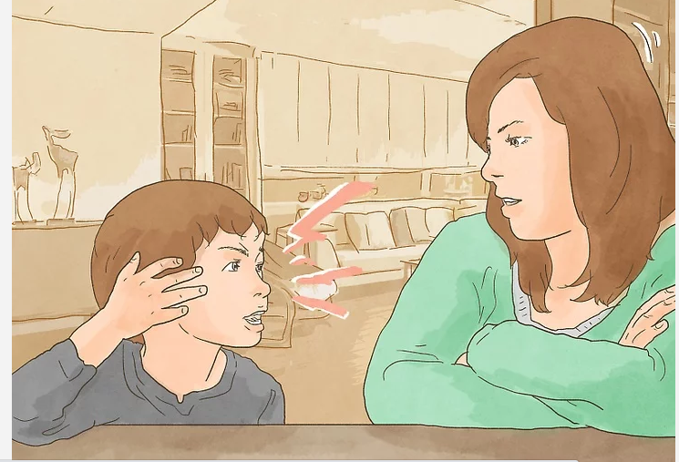
Jody came to his mother and sat down very quietly. The mother was pouring coffee in the cup. She was taken aback when Jody talked of bringing the fawn home. Seeing the mother reluctant, Jody told what his father had said. He said that Penny had said it would be ungrateful to leave the fawn to starve.

Slide 7
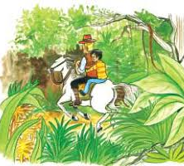
Dr Wilson also supported Jody saying nothing in this world comes quite free. He meant that they must pay some price for having taken the life of doe. Here the price was to raise the fawn. Mill-wheel offered to take Jody on his horse to the forest.

Slide 8
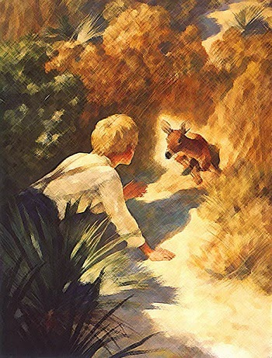
Jody went with Mill-Wheel on his horse assuring his mother to reach home by dinner. After sometime they reached closer to the place where his father was bitten. Jody wanted go on further all alone because he didn’t want Mill- Wheel to see his disappointment if they failed in finding the fawn. Contrarily, if he found the fawn, he wanted to experience the joy of it all alone as he felt that their meeting would be intense, full of emotion and thus, personal. Thus, assuring Mill-wheel of his knowledge of directions and his ability to take care of himself, he moves on.

Slide 9
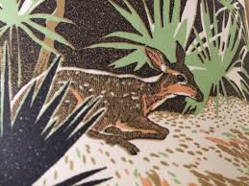
When Jody reached the spot where his father was bitten, he found buzzards hovering over the carcass of the dead doe. He also found footprints of cats and for a moment he feared for the life of the fawn. After an intense search he finally found the fawn behind a bush. Jody noticed that the fawn was shivering and was distrustful. He tried to calm the fawn and tried to establish some kind of understanding with him.

Slide 10
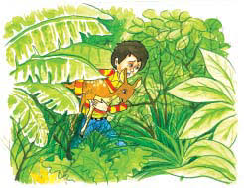
However, though the fawn allowed the proximity of Jody, he did not move. Jody then decided to carry the fawn all the way home. He first patted the fawn and then lightly lifted him. He went around the area where his father was bitten and where lay the carcass of the fawn's mother, fearing that the scent of his mother would make the fawn restless. He had to step often for breaks as himself being little he was severely struggling with the weight of the fawn and the vines and bushes that lay on his path. Though, Jody's arms had started hurting, he carried on his journey. He even managed to win the fawn's trust, who gradually grew willing to follow him.

Slide 11
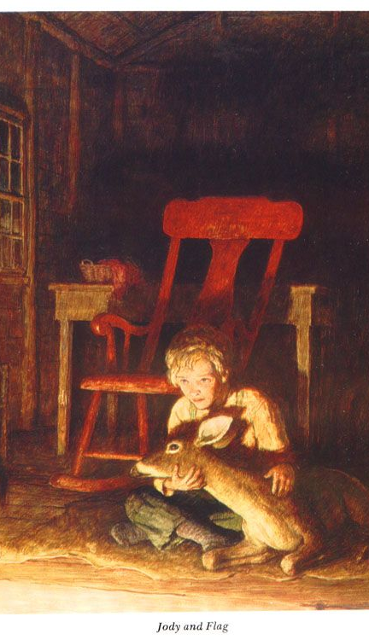
After a point, Jody felt such a grand connection with the fawn that all the struggle and pain he was going through no longer mattered. By and by they reached their destination. The fawn refused to go upstairs. Jody carried him to his father who expressed joy at seeing the fawn. Later, Jody lovingly fed him milk in the kitchen and enjoyed the fawn's trust and love for him.

Slide 12
This was the summary of 'This is Jody's Fawn', manifestation of a little boy's pure heart and pure emotions.

Slide 13
Difficult Meanings
Drift back to – to go back to
Dilated – enlarged
Leapt your head – stayed clam in difficult situation
Acorns – small brown nuts
Sidled back – walked back quiet
Abandoned – deserted place
Buzzard – a large bird
Carcass – dead body
Convulsion – shiver
Dangling – swinging
Romp – play
Ecstasy – great joy

Slide 14

Comprehension Check
Questions
1. What had happened to Jody's father?
2. How did the doe save Penny's life?
3. Why does Jody want to bring the Fawn home?
4. How does Jody know that the fawn is a male?
5. Jody didn't want Mill-wheel with him for two reasons. What were they?
6. Why was Mill-wheel afraid to leave Jody alone?
7. How did Jody bring the fawn back?
8. Jody was filled with emotion after he found the fawn. Can you find at least three words or phrases which show how he felt?
9. How did the deer drink milk from the ground?
10. Why didn't the fawn follow Jody up the steps as he had thought it would be?

Slide 15
Answers
Ans 1. A rattle snake had bitten Jody's father.
Ans 2. Doe's heart and liver were used to save Jody's father.
Ans 3. Jody wants to bring the fawn home because he doesn't want to leave it alone in the jungle.
Ans 4. The fawn has spots all in a line. It is a symbol of male fawn.
Ans 5. Jody did not want Mill-wheel with him for two reasons:
(i) if he did not find the fawn at the place he might feel sad and disheartened;
(ii) if he found the fawn there he would be very much emotional to meet it.
In both cases he did not want to share any of them with anyone else.

Slide 16
Ans 6. Mill-wheel was afraid of his feeling that Jody might get lost or bitten by a snake.
Ans 7. Jody got the fawn around the place where the doe was killed. He took the fawn in his arms and carried it home.
Ans 8. The words 'startled', 'tumbled backward' , 'delirious' - show Jody's emotion in the text.
Ans 9. Jody dipped his fingers below the level of milk and the fawn sucked his fingers.
Ans 10. The fawn was not able to follow Jody up steps due to its weak legs.

Slide 17

Assignment
Do you think it is right to kill an animal to save a human life? Write a brief paragraph.

Slide 18
Worksheet
1. What did Dr Wilson mean when he said, "Nothing in the world ever comes quite free"?
2. What helped Jody to know the directions in the forest?
3. Mention weather the following sentences are true or false
a) Jody was worried about his mother.
b) Dr Wilson supported Jody.
c) A male fawn has no spots at all.
d) The buzzard is a large bird.

Slide 19
4. Look into the dictionary and write down meanings of the following words.
Clearing
Endure
Adjacent
Clacked
Delirious
5. Give the antonyms of the following:
Unwilling
Impatient
Lifted
Whispered
6. Make a sentence using the following words.
Quivering
Ache
Sweat

Slide 20
Thank you
Neerja Tripathi
AECS – 1
Mumbai

