Slide 1
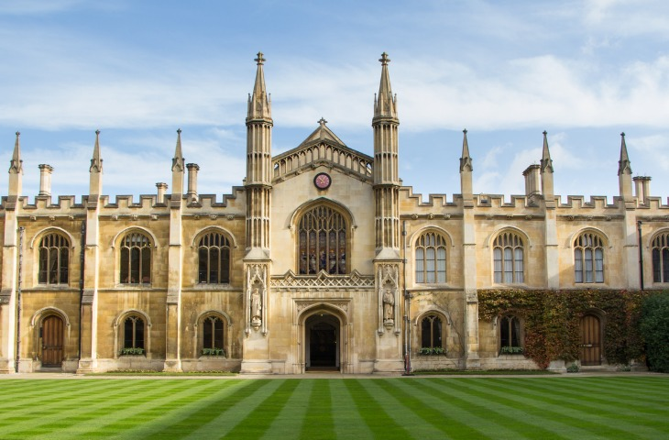
A Visit to Cambridge
By Firdaus Kanga
From Heaven on wheels

Slide 2
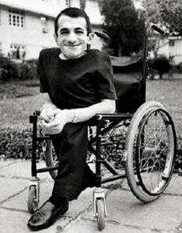
Introduction
This is an account of how a differently abled person meets one of the world’s greatest scientists and has a conversation with him which touches his heart.
Firdaus Kanga is a writer and a journalist who lives in Mumbai. He suffered from a bone disease. He had brittle bones which tended to break easily. He was confined to the wheelchair.

Slide 3
About Cambridge
For Kanga Cambridge stood for England. Cambridge is a city of learning. For centuries it has been the home to some of the greatest minds in human history. It is a place where people come to explore and understand.
It was founded in 1209. III. It was granted a royal charter in 1231 by Henry 111. It is the world’s fourth oldest surviving universities.

Slide 4
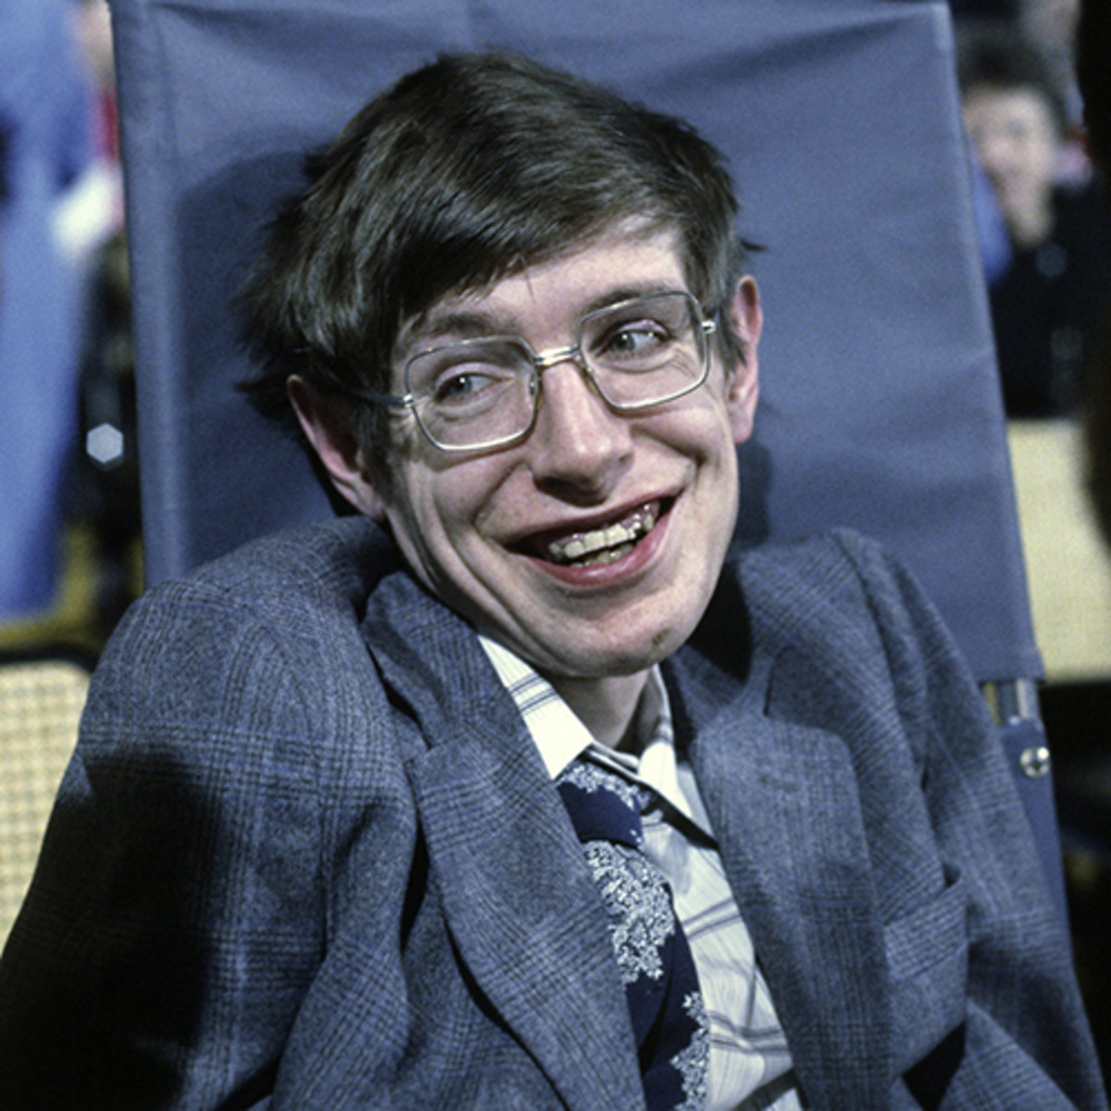
How Kanga met Hawkings
When Kanga was on a walking tour through Cambridge the guide mentioned of Stephan Hawking who was a poor disabled man, though he was a worthy successor to Issac Newton whose Chair he had at the university.
He was a brilliant astrophysicist but was completely paralysed. Kanga telephoned him and took some time to interview him.

Slide 5
About Hawkings
Stephen Hawking is the author of the book `A Brief History of Time.’ It is one of the biggest best-sellers ever. Hawkings was confined to a wheelchair and spoke by pressing the buttons of a computer. He had a body which was growing weaker and weaker day by day. As Kanga spoke to him he felt that he was talking to a still photograph.

Slide 6
Kanga’s meeting with Hawking
Hawking had given Kanga half an hour for the meeting. During the meeting Kanga asked him about how he felt about being disabled. Hawkings said that he hadn’t been brave. He had no choice. He was sitting opposite him and was trying to find words with the computer. His eyes were pale with exhaustion and his mind was buoyant with thougts. They came out in stiff phrases and sentences.

Slide 7
Kanga and Stephen Hawking exchanging thoughts
Stephen Hawking said that he finds it amusing when people patronise him. And he also finds it disturbing when somebody like Kanga disturbs him at his work.
Kanga found his first glimpse shocking. His head was twisted sideways into a slump and the torso shrunk inside the pale blue shirt. He had wasted legs. But his eyes seemed to speak
He was like a lantern that had only light inside. The walls were worn out.

Slide 8
Hawking as an inspiration to Kanga.
Kanga said that Hawkingshad been an inspiration to him and many other people. Hawking said it didn’t matter because when your body is a claustrophobic room and the walls are growing narrower day by day, it doesn’t matter much. You see people smiling outside with admiration to see that you are still breathing.

Slide 9
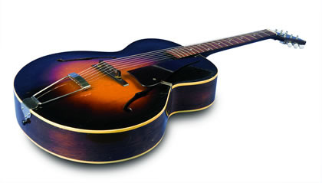
Hawking’s advice to the disabled
Hawking said that the disabled should do what they are good at. The disbaled Olympics is a waste of time.
The author remembered the years he had tried to play a Spanish guitar which was larger than himself and had gleefully unstinged it one night.

Slide 10
The ending of the meeting
Once the half an hour was over, he had to leave. Hawking showed him his garden. He rumbled through every inch.
While leaving Kanga could not kiss him or cry. He touched his shoulder and just wheeled back.
He had met an extraordinary person whom he would never forget. He was one of the most beautiful minds.

Slide 11
Meanings to learn.
extraordinary- very unusual
metaphor-a word or a phrase to show that something has the same qualities as the other
astrophysicist- a scholar of astrophysicist dealing with a branch of physics dealing with stars, planets and the outer space
propelled-push or drive forward
disembodied- separated from something

Slide 12
Meanings to learn -continued
disintegrating-breaking
exhaustion- tiredness
anguish- extreme suffering
buoyant-internsely active and vibrant
patronise-treat somebody in a way that shows that you think you are better
torso- upper part of the body
incandescence- inner glow

Slide 13
Meanings to learn -continued
inflecton- rise and fall of voice speaking
cliche- phrase of ided used so often that it loses its meaning
claustrophobic-very small and suffocating
gleefully-very happily
grinning- to give a broad smile so that you show your teeth
embodiment- a visible form or example.

