Slide 1
Class 8 English MODULE 1
LESSON 9: THE GREAT STONE FACE

Slide 2
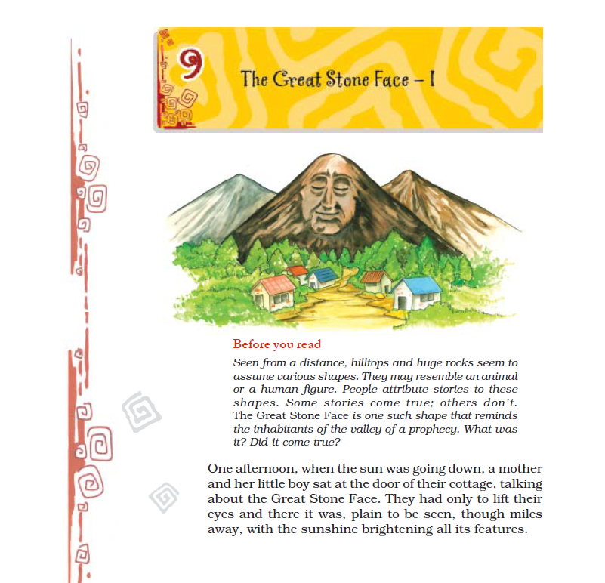

Slide 3
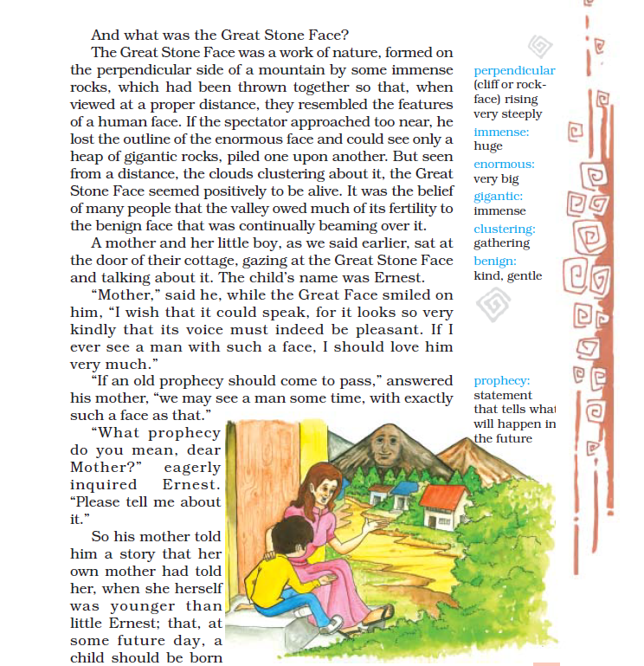

Slide 4
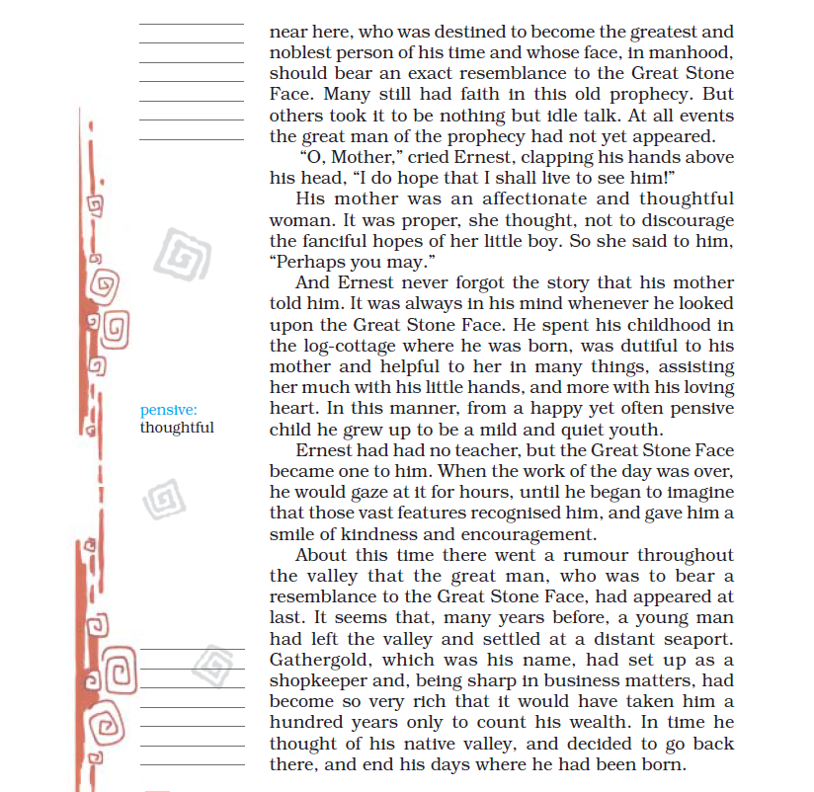

Slide 5
