Slide 1
ATOMIC ENERGY CENTRAL SCHOOL
MODULE NO.- 1/3
CHAPTER -6
HUMAN RESOURCES
SOCIAL SCIENCE- GEOGRAPHY
SHREEPARNA ACHARJEE
TGT SOC.SCI
AECS-1 TARAPUR

Slide 2
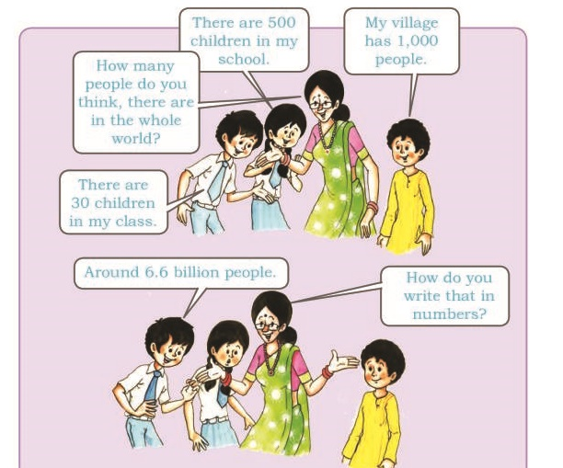
People are a nation’s greatest resource.
Nature’s bounty becomes significant only when people find it useful.
It is people with their demands and abilities that turn them into ‘resources’.
Hence, human resource is the ultimate resource.
Healthy, educated and motivated people develop resources as per their requirements.
Human resources like other resources are not equally distributed over the world.
They differ in their educational levels, age and sex.
Their numbers and characteristics also keep changing.

Slide 3
Human resources like other resources are not equally distributed over the world.
Human Resource differ in their
EDUCATIONAL
LEVELS
AGE
SEX
Their numbers and characteristics also keep changing.

Slide 4
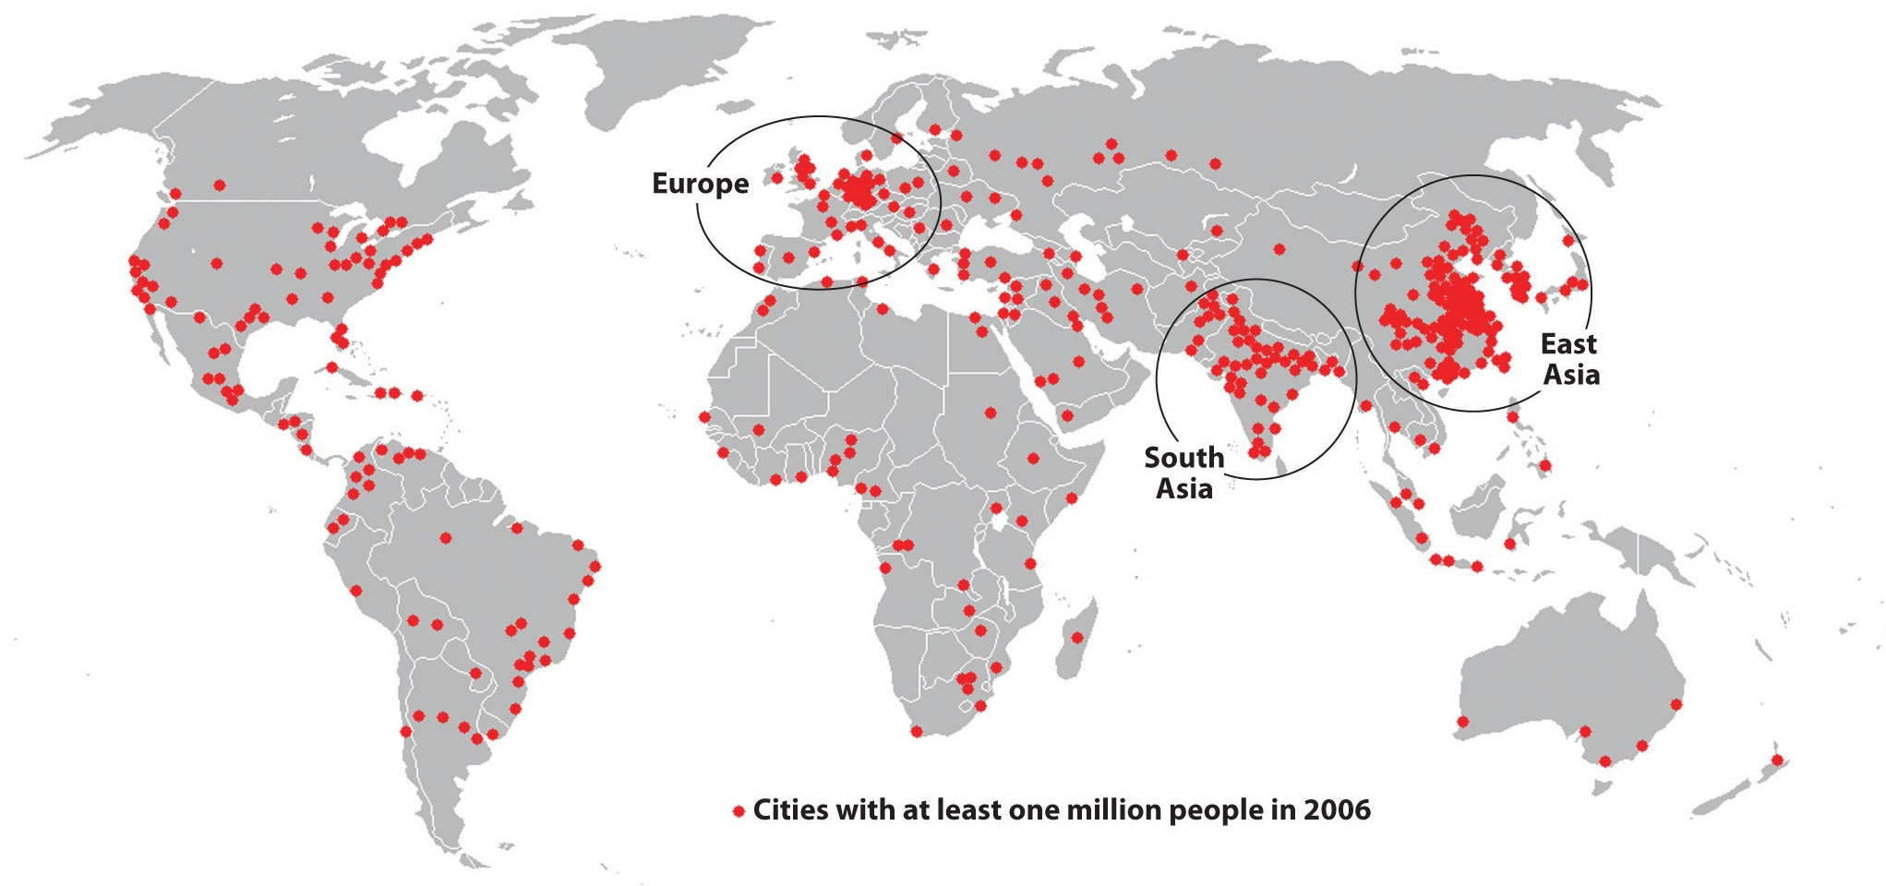
DISTRIBUTION OF POPULATION
The way in which people are spread across the earth surface is known as the pattern of population distribution.
More than 90 per cent of the world’s population lives in about 10 per cent of the land surface.
The distribution of population in the world is extremely uneven.

Slide 5
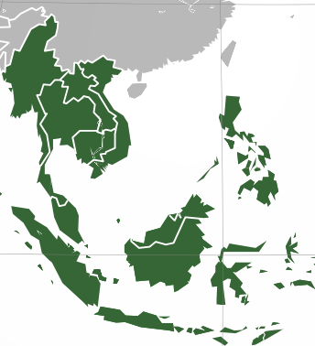
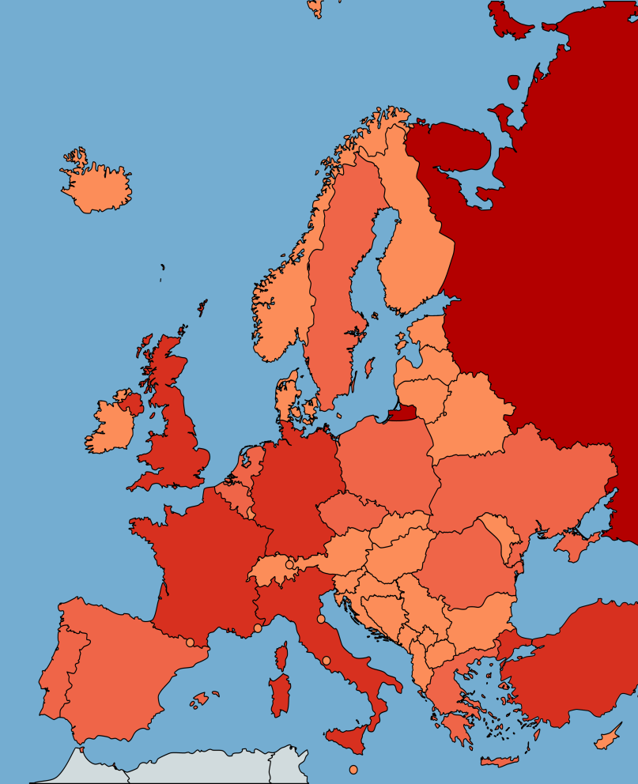
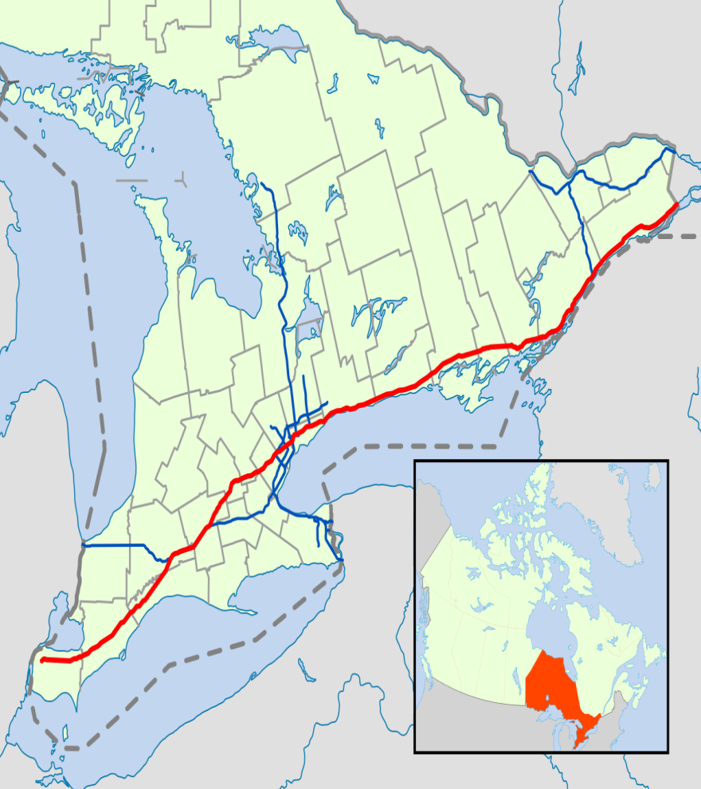
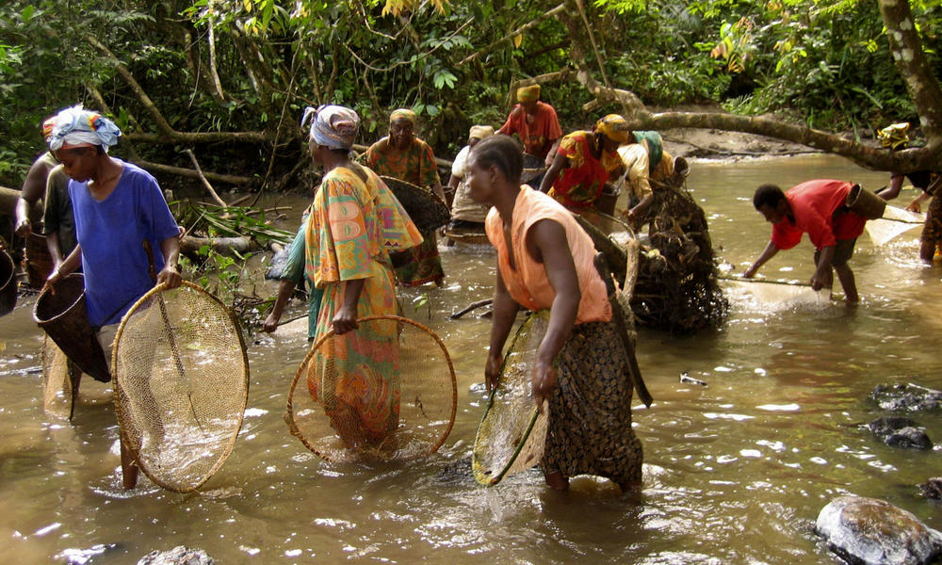
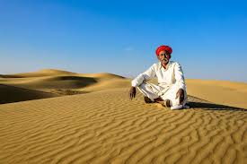
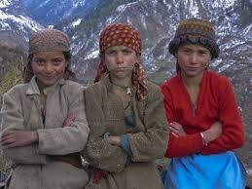
Some areas are very crowded and some are sparely populated.
The crowded areas are south and south east Asia, Europe and north eastern North America.
Very few people live in high latitude areas, tropical deserts, high mountains and areas of equatorial forests.
PEOPLE OF EQUATORIAL FOREST
PEOPLE OF DESERT REGION
PEOPLE OF MOUNTAINOUS REGION

Slide 6
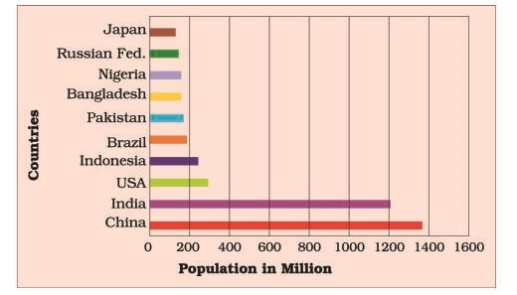
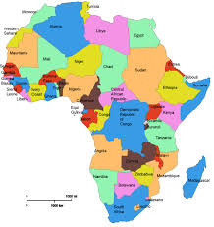
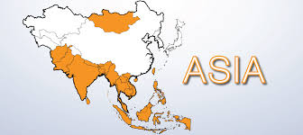
Almost three-quarters of the world’s people live in two continents Asia and Africa.
Many more people live north of the Equator than south of the Equator.

Slide 7
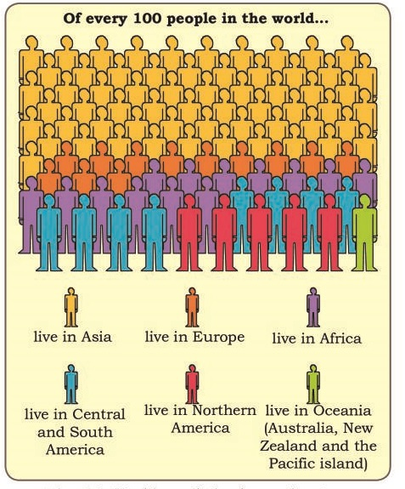
Sixty per cent of the world’s people stay in just 10 countries. All of them have more than a 100 million people.

Slide 8
DENSITY OF POPULATION
It is normally expressed as per square km.
Population density is the number of people living in a unit area of the earth’s surface.
The average density of population in the whole world is 45 persons per square km.
South Central Asia has the highest density of population followed by East and South East Asia
Average density of population in India is 324 persons per square km.

Slide 9
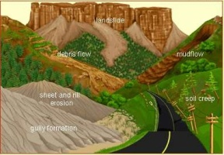
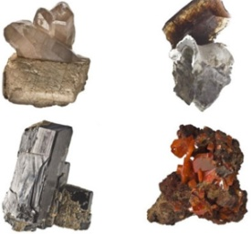
FACTORS AFFECTING DISTRIBUTION OF POPULATION
Geographical Factors
Social
Cultural
Economic
Topography
Climate
Soil
Water
Minerals

Slide 10
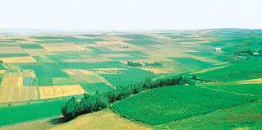
Geographical Factors
1. Topography:
People always prefer to live on plains rather than mountains and plateaus because these areas are suitable for farming, manufacturing and service activities.
The Ganga plains are the most densely populated areas of the world while mountains like Andes, Alps and Himalayas are sparsely populated.

Slide 11
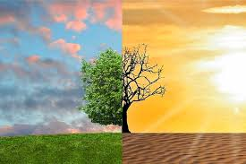
2. Climate:
3. Soil:
People usually avoid extreme climates that are very hot or very cold like Sahara desert, polar regions of Russia, Canada and Antarctica
Fertile soils provide suitable land for agriculture. Fertile plains such as Ganga and Brahmaputra in India, Hwang-He, Chang Jiang in China and the Nile in Egypt are densely populated.

Slide 12
4. Water:
5. Minerals:
People prefer to live in the areas where fresh water is easily available. The river valleys of the world are densely populated while deserts have spare population
Areas with mineral deposits are more populated. Diamond mines of South Africa and discovery of oil in the Middle east lead to settling of people in these areas

Slide 13
Social:
Areas of better housing, education and health facilities are more densely populated e.g., Pune.
Cultural:
Places with religion or cultural significance attract people. Varanasi, Jerusalem and Vatican city are some examples.
Economic:
Industrial areas provide employment opportunities. Large number of people are attracted to these areas. Osaka in Japan and Mumbai in India are two densely populated areas.

Slide 14
SHREEPARNA ACHARJEE
TGT
AECS-1
TARAPUR

