Slide 1
ATOMIC ENERGY CENTRAL SCHOOL
MODULE NO.- 2/3
CHAPTER -6
HUMAN RESOURCES
SOCIAL SCIENCE- GEOGRAPHY
SHREEPARNA ACHARJEE
TGT SOC.SCI
AECS-1 TARAPUR

Slide 2
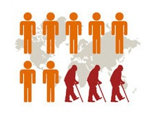
POPULATION CHANGE
The population change refers to change in the number of people during a specific time.
The world population has not been stable.
This is actually due to changes in the number of births and deaths.
For an extremely long period of human history, until the 1800s, the world’s
population grew steadily but slowly.
Large numbers of babies were born, but they died early too.
This was as there were no proper health facilities.
Sufficient food was not available for all the people.
Farmers were not able to produce enough to meet the food requirements of all
the people.
As a result the total increase in population was very low.

Slide 3
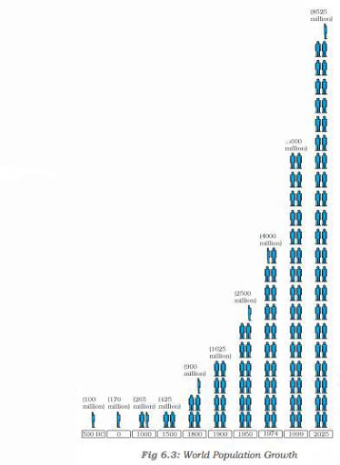
In 1820, the world’s population reached one billion.
A hundred and fifty years later, in the early 1970s, the world’s population reached 3 billion.
This is often called population explosion.
In 1999, less than 30 years later, the population doubled to 6 billion.
The main reason for this growth was that with better food supplies and medicine, deaths were reducing, while the number of births still remained fairly high.

Slide 4
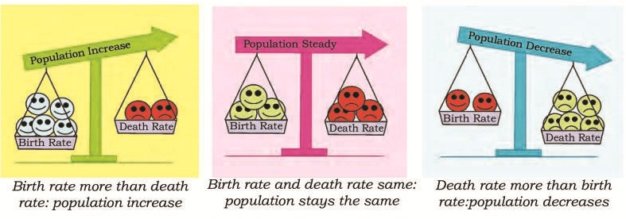
BIRTH RATE
DEATH RATE
The number Of deaths per 1,000 people.
MIGRATION
Migrations is the movement of people in and out of an area.
The number of live births per 1,000 people
The difference between the birth rate and the death rate of a country is called the natural growth rate.
The population increase in the world is mainly due to rapid increase in natural growth rate.

Slide 5
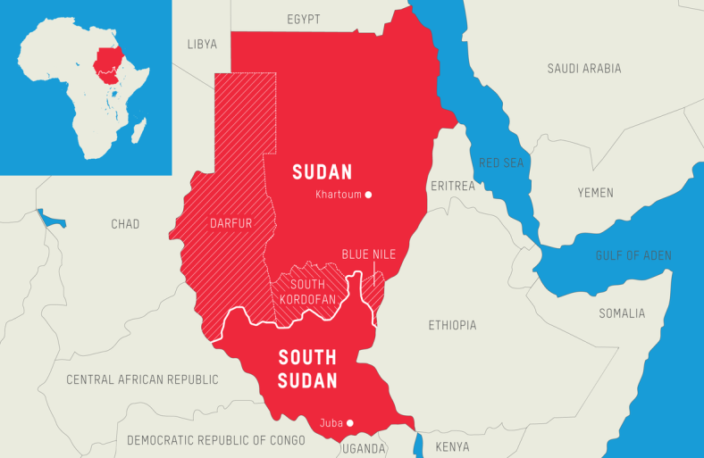
Migration is another way by which population size changes. People may move within a country or between countries. Emigrants are people who leave a country; Immigrants are those who arrive in a country.
Countries like the United States of America and Australia have gained in-numbers by in-migration or immigration. The general trend of international migrations is from the less developed nations to the more developed nations in search of better employment opportunities. Within countries large number of people may move from the rural to urban areas in search of employment, education and health facilities.
Sudan is an example of a country that has experienced a loss in population numbers due to out-migration or emigration.

Slide 6
Immigration
When a person enters a new country.
Emigration
When a person leaves a country.

Slide 7
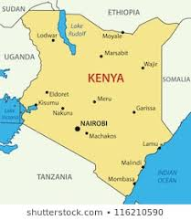
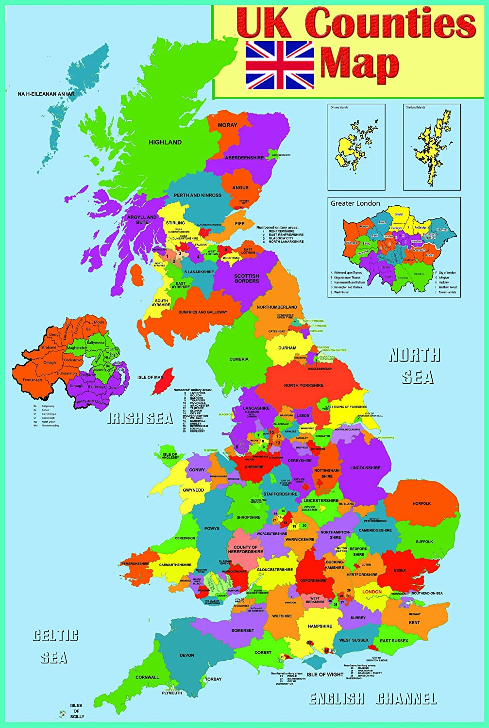
PATTERNS OF POPULATION CHANGE
The world’s total population is rising rapidly, not all countries are experiencing this growth.
Kenya have high population growth rates. They had both high birth rates and death rates.
United Kingdom, population
growth is slowing because of both low death and low birth rates.

Slide 8
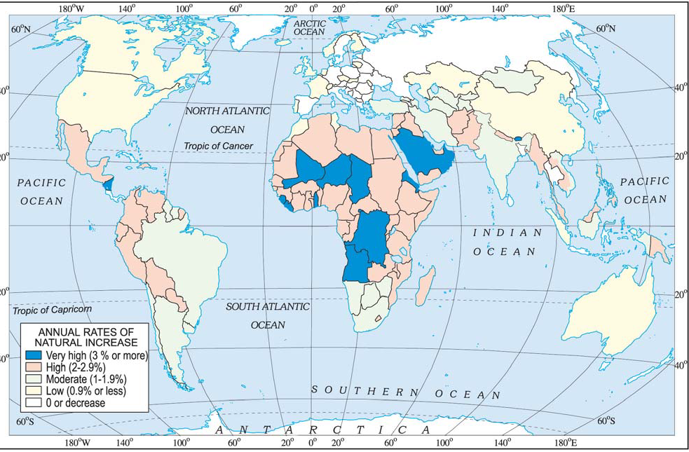
World: Differing rates of population growth

Slide 9
SHREEPARNA ACHARJEE
TGT
AECS-1
TARAPUR

