Slide 1


ATOMIC ENERGY CENTRAL SCHOOL
MODULE NO.- 3/3
CHAPTER -6
HUMAN RESOURCES
SOCIAL SCIENCE- GEOGRAPHY
SHREEPARNA ACHARJEE
TGT SOC.SCI
AECS-1 TARAPUR

Slide 2

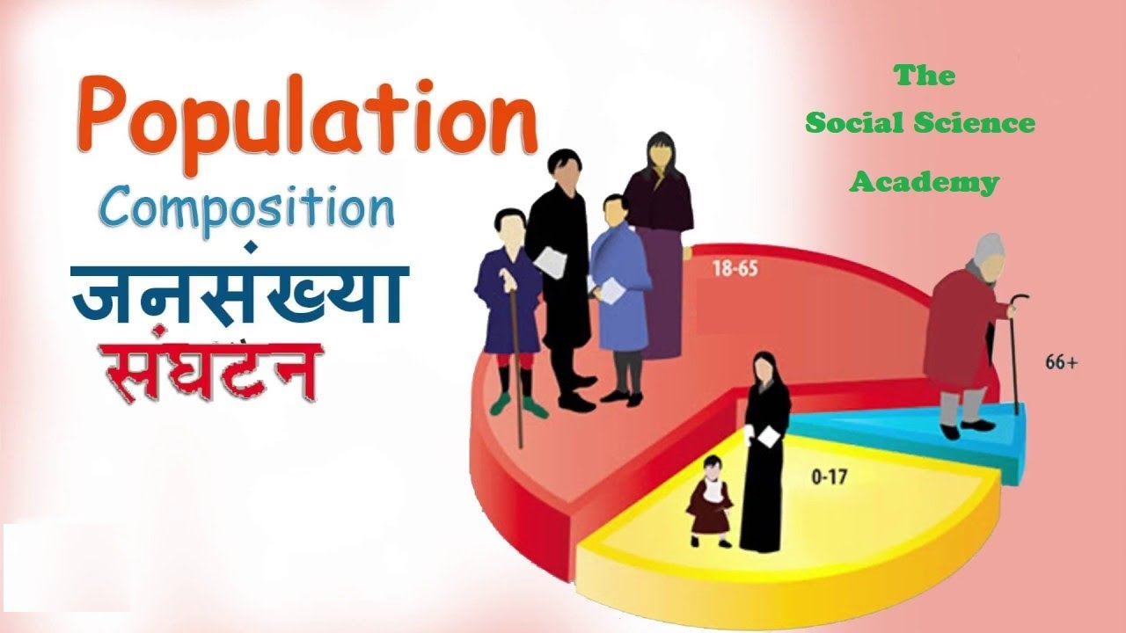
POPULATION COMPOSITION
People vary greatly in their age, sex, literacy level, health condition, occupation and income level.
It is essential to understand these characteristics of the people.
Population composition refers to the structure of the population.

Slide 3






The composition of population helps us to know how many are:
MALE OR FEMALE
AGE GROUP
LITERACY RATE AND LEVEL
OCCUPATION
INCOME LEVEL
HEALTH CONDITION

Slide 4
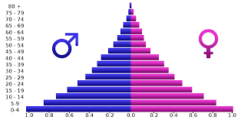
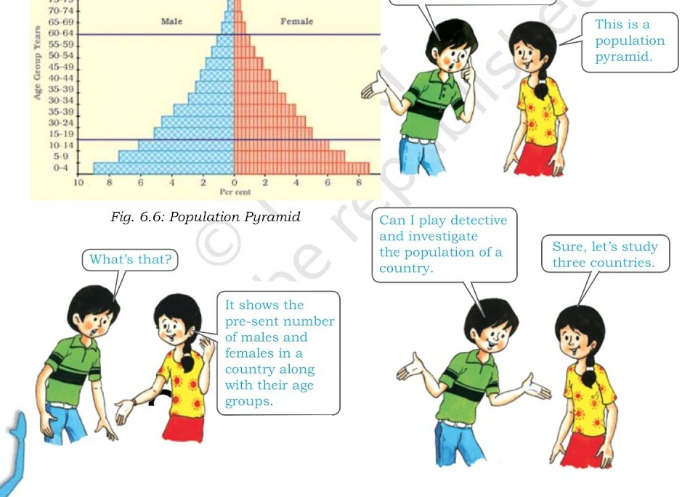
An interesting way of studying the population composition of a country is by looking at the population pyramid, also called an age-sex pyramid.
A population pyramid shows
• The total population divided into various age
groups, e.g., 5 to 9 years, 10 to 14 years.
• The percentage of the total population, subdivided
into males and females, in each of those groups.

Slide 5
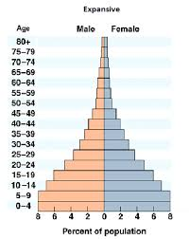
The shape of the population pyramid tells the story of the people living in that particular country. The numbers of children (below 15 years) are shown at the bottom and reflect the level of births. The size of the top shows the numbers of aged people (above 65 years) and reflects the number of deaths.
above 65 years (DEPENDENTS)
WORKING GROUP
below 15 years(DEPENDENTS)

Slide 6
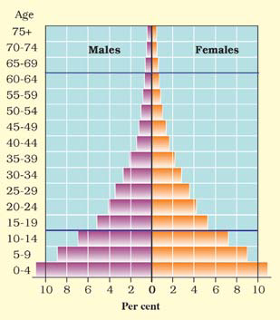

The population pyramid of a country in which birth and death rates both are high is broad at the base and rapidly narrows towards the top. This is because although, many children are born, a large percentage of them die in their infancy, relatively few become adults and there are very few old people. This situation is typified by the pyramid shown for Kenya
POPULATION PYRAMID OF KENYA

Slide 7
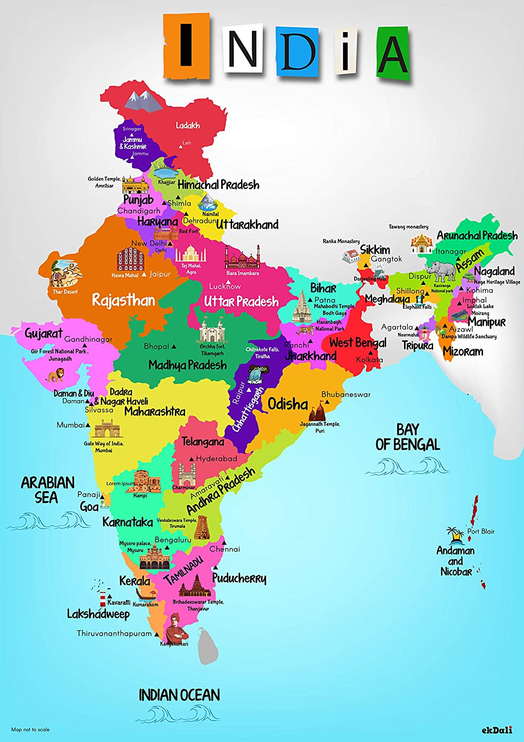
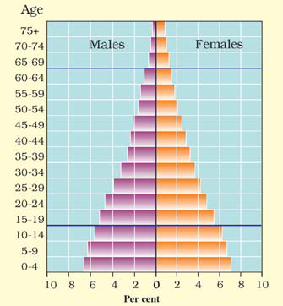
In countries where death rates (especially amongst the very young) are decreasing, the pyramid is broad in the younger age groups, because more infants survive to adulthood. This can be seen in the pyramid for India. Such populations contain a relatively large number of young people and which means a strong and expanding labour force.
POPULATION PYRAMID OF INDIA

Slide 8

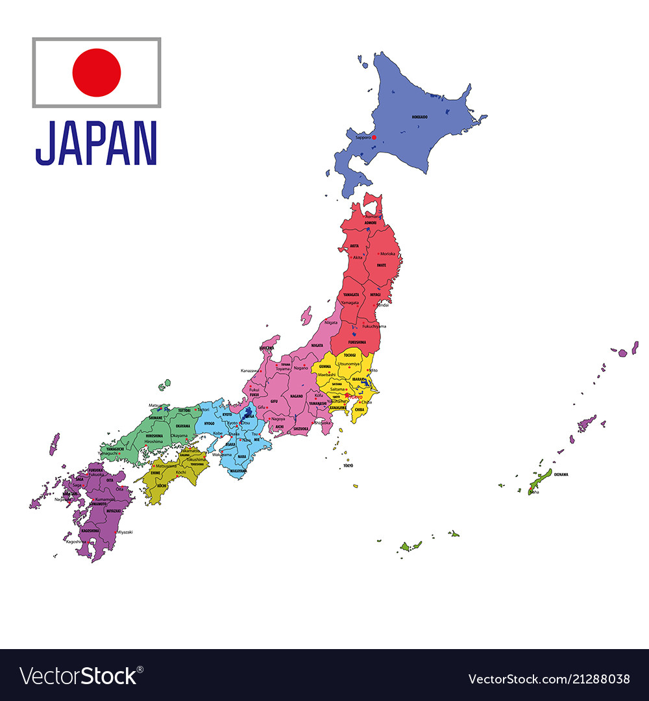
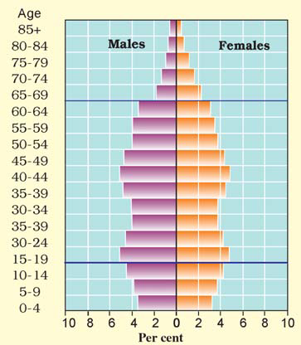
In countries like Japan, low birth rates make the pyramid narrow at the base. Decreased death rates allow numbers of people to reach old age.
POPULATION PYRAMID OF JAPAN

Slide 9



Skilled, spirited and hopeful young people endowed with a positive outlook are the future of any nation. We in India are fortunate to have such a resource. They must be educated and provided skills and opportunities to become able and productive.

Slide 10

SHREEPARNA ACHARJEE
TGT
AECS-1
TARAPUR

