Slide 1
ATOMIC ENERGY EDUCATION SOCIETY
CLASS:VIII
MATHEMATICS
11.Mensuration(Module 1/3)
-Chitrank Jwala
AECS 4 RBT

Slide 2
Introduction
We have learnt that for a closed plane figure, the perimeter is the distance around its boundary and its area is the region covered by it. We found the area and perimeter of various plane figures such as triangles, rectangles, circles etc. We have also learnt to find the area of pathways or borders in rectangular shapes.
In this chapter, we will try to solve problems related to perimeter and area of other plane closed figures like quadrilaterals.
We will also learn about surface area and volume of solids such as cube, cuboid and cylinder.

Slide 3
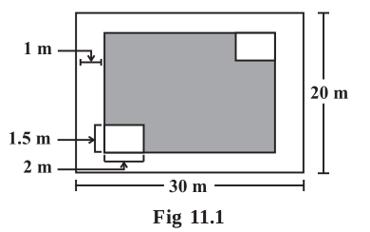
Let us Recall
Let us take an example to review our previous knowledge.This is a figure of a rectangular park (Fig 11.1) whose length is 30 m and width is 20 m.
(i) What is the total length of the fence surrounding it?
To find the length of the fence we need to find the
perimeter of this park, which is 100 m.
(ii) How much land is occupied by the park?
To find the land occupied by this park we need
to find the area of this park which is 600 square
meters (m²).
(iii) There is a path of one metre width running inside
along the perimeter of the park that has to be cemented.
If 1 bag of cement is required to cement 4 m² area, how many bags of cement would be required to construct the cemented path?

Slide 4
Area of cemented path = Area of park – Area of park not cemented.
Path is 1 m wide, so the rectangular area not cemented is (30 – 2) × (20 – 2) m² .
That is 28 × 18 m² .Hence number of cement bags used = ------------------
(iv) There are two rectangular flower beds of size 1.5 m × 2 m each in the park as
shown in the diagram (Fig 11.1) and the rest has grass on it. Find the area covered
by grass.
Area of rectangular beds = ------------------
Area of park left after cementing the path = ------------------
Area covered by the grass = ------------------
We can find areas of geometrical shapes other than rectangles also if certain
measurements are given to us . Try to recall and match the following:

Slide 5
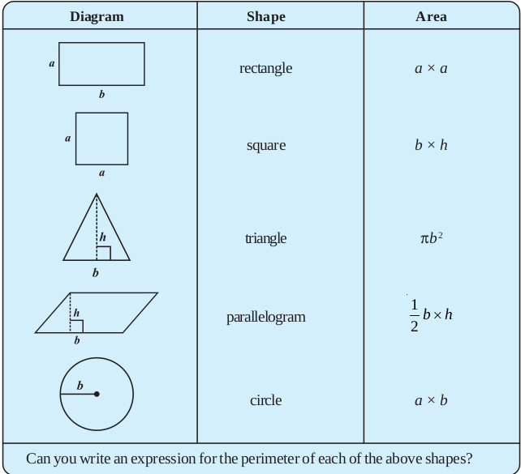

Slide 6
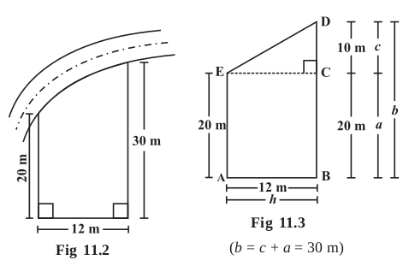
Area of Trapezium
Nazma owns a plot near a main road
(Fig 11.2). Unlike some other rectangular
plots in her neighbourhood, the plot has
only one pair of parallel opposite sides.
So, it is nearly a trapezium in shape. Can
you find out its area?
Let us name the vertices of this plot as
shown in Fig 11.3.
By drawing EC || AB, we can divide it
into two parts, one of rectangular shape
and the other of triangular shape, (which
is right angled at C), as shown in Fig 11.3.

Slide 7
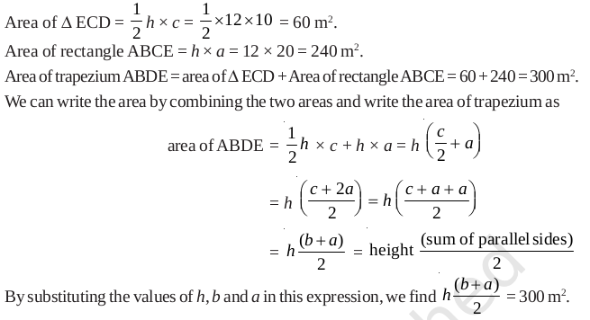
So to find the area of a trapezium we need to know the length of the parallel sides and the
perpendicular distance between these two parallel sides. Half the product of the sum of
the lengths of parallel sides and the perpendicular distance between them gives the area of
trapezium.

Slide 8
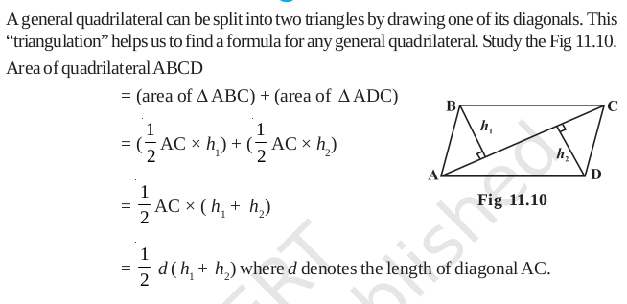
Area of General Quadrilateral

Slide 9
Area of special quadrilaterals

Slide 10
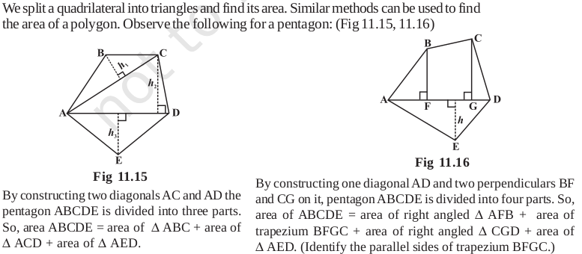
Area of a Polygon

Slide 11
Thank You

