Slide 1
ATOMIC ENERGY EDUCATION SOCIETY
CLASS:VIII
MATHEMATICS
11.Mensuration(Module 2/3)
-Chitrank Jwala
AECS 4 RBT

Slide 2
Solid Shapes
In your earlier classes you have studied that two dimensional figures can be identified as the faces of three dimensional shapes. Observe the solids which we have discussed so far (Fig11.24).

Slide 3
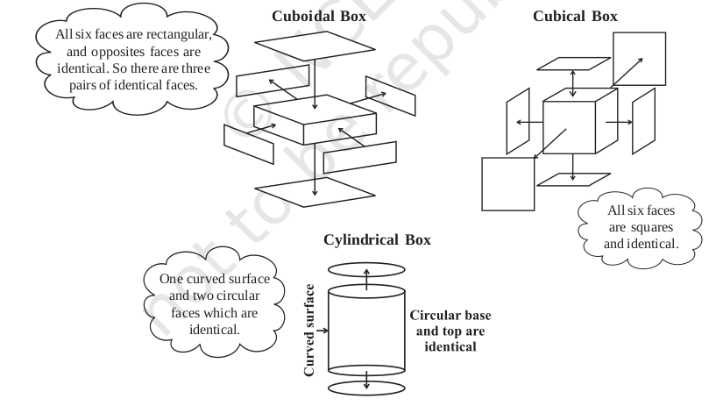

Slide 5
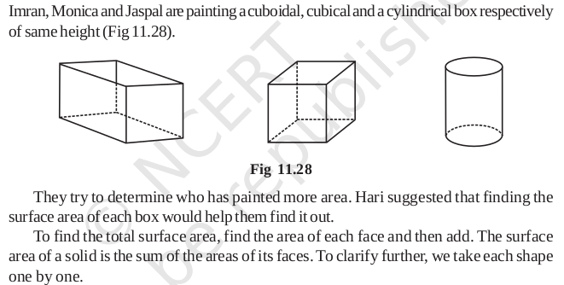
Surface Area of Cube, Cuboid and Cylinder

Slide 6
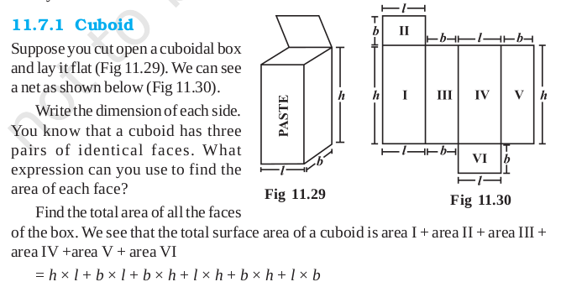

Slide 8
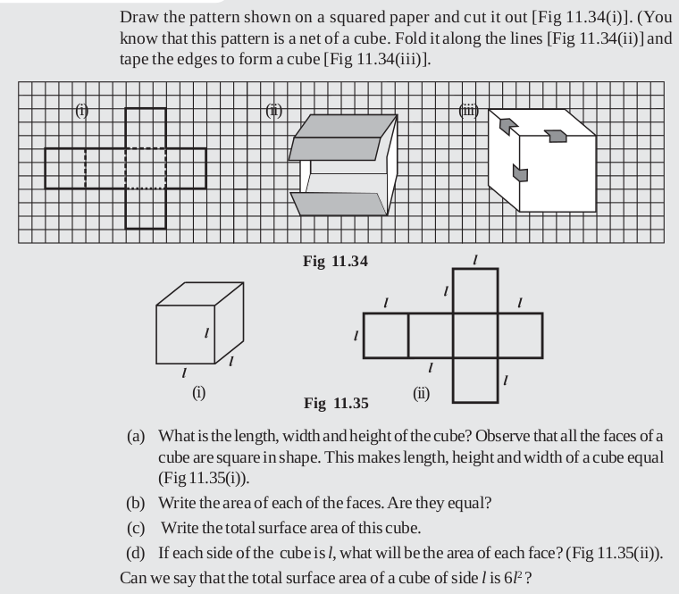
11.7.2 Cube

Slide 9
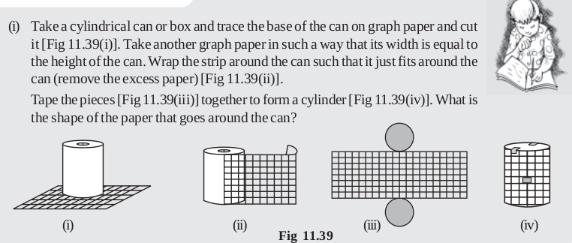
11.7.3 Cylinders
Most of the cylinders we observe are right circular cylinders. For example, a tin, round pillars, tube lights, water pipes etc.

Slide 10
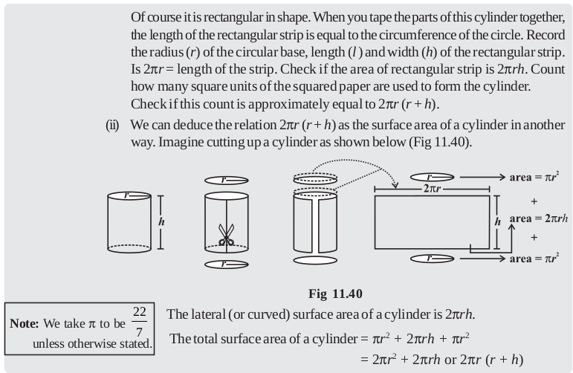

Slide 11
Thank You

