Slide 1
ATOMIC ENERGY EDUCATION SOCIETY
CLASS:VIII
MATHEMATICS
11.Mensuration(Module 3/3)
-Chitrank Jwala
AECS 4 RBT

Slide 2
Volume of Cube, Cuboid and Cylinder
Amount of space occupied by a three dimensional object is called its volume.
Remember, we use square units to find the area of a region. Here we will use cubic units to find the volume of a solid, as cube is the most convenient solid shape (just as square is the most convenient shape to measure area of a region).
For finding the area we divide the region into square units, similarly, to find the volume of a solid we need to divide it into cubical units.

Slide 3
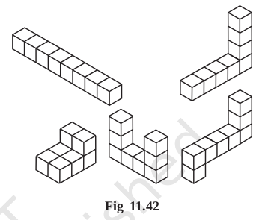
Observe that the volume of each of the adjoining solids is 8 cubic units (Fig 11.42 ).

Slide 4
Cuboid
Take 36 cubes of equal size (i.e., length of each cube is same). Arrange them to form a cuboid.You can arrange them in many ways.
Since we have used 36 cubes to form these cuboids, volume of each cuboid is 36 cubic units. Also volume of each cuboid is equal to the product of length,breadth and height of the cuboid.
we can say volume of cuboid = l × b × h. Since l × b is the area of its base we can also say that,
Volume of cuboid = area of the base × height

Slide 5
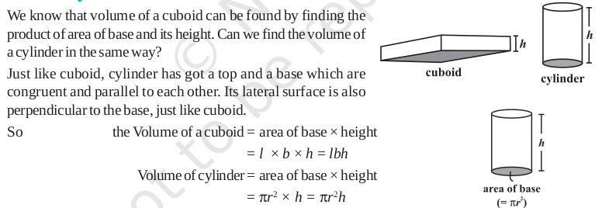
Cube
The cube is a special case of a cuboid, where l = b = h. Hence, volume of cube = l × l × l = l³
Cylinder

Slide 8
Thank You

