Slide 1
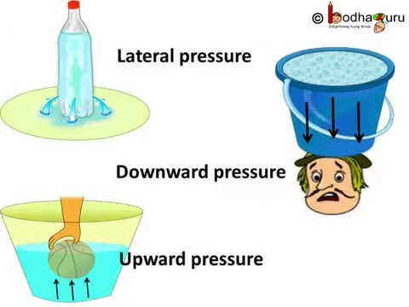


CLASS 8 SCIENCE
FORCE AND PRESSURE –MODULE 4 ON LIQUID PRESSURE
Mrs.Geeta Gupta
A.E.C.S.-1,Mumbai

Slide 2
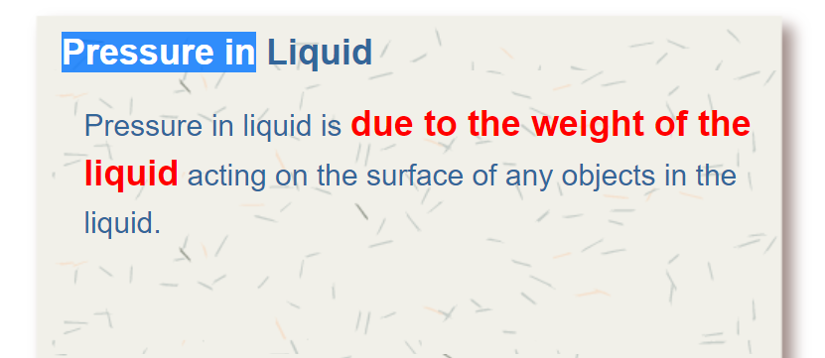
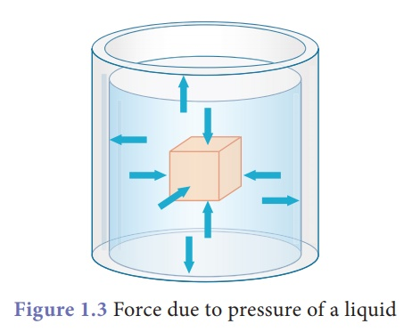

Slide 3
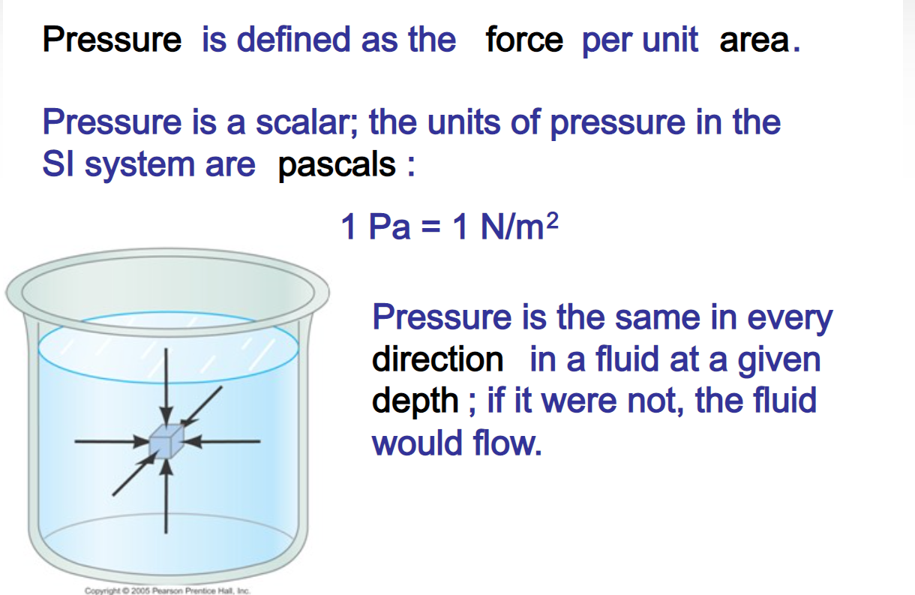

Slide 4
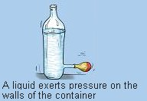

Slide 5
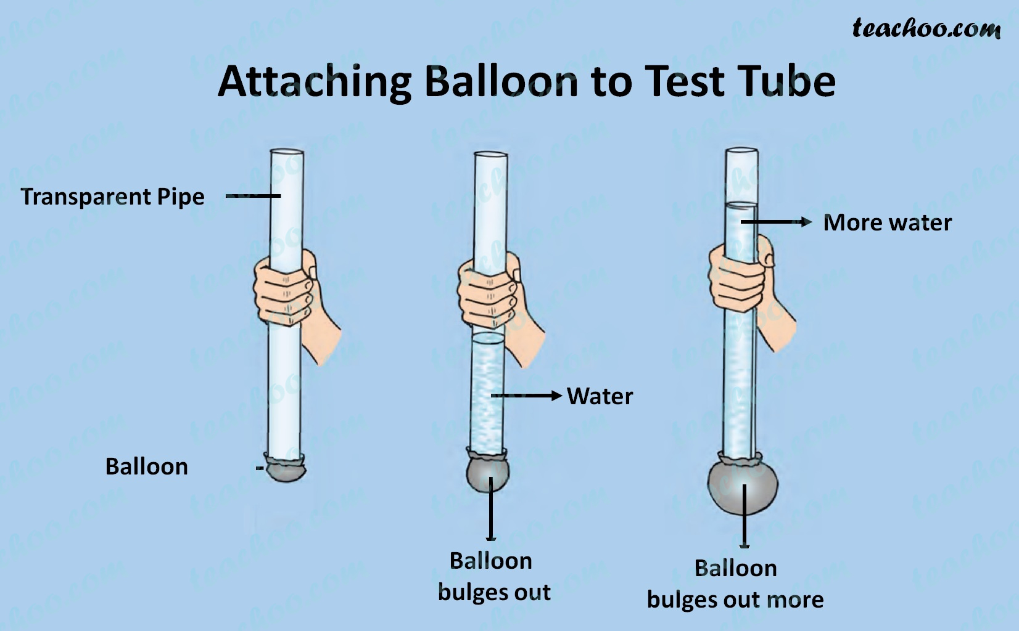

Slide 6
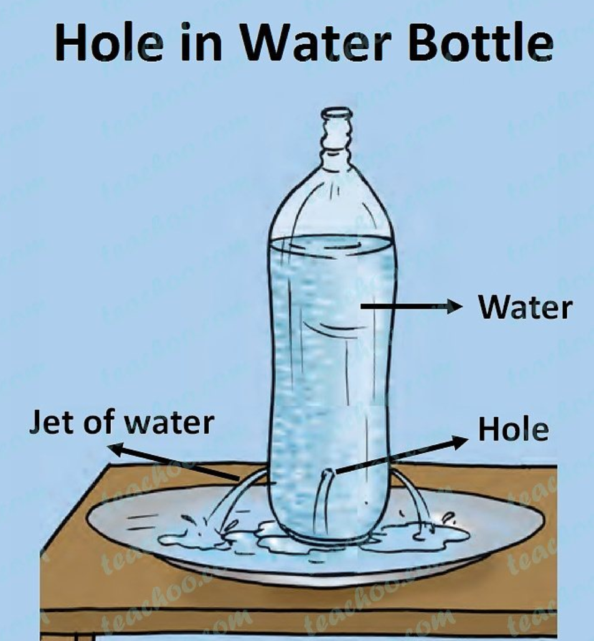


Slide 7
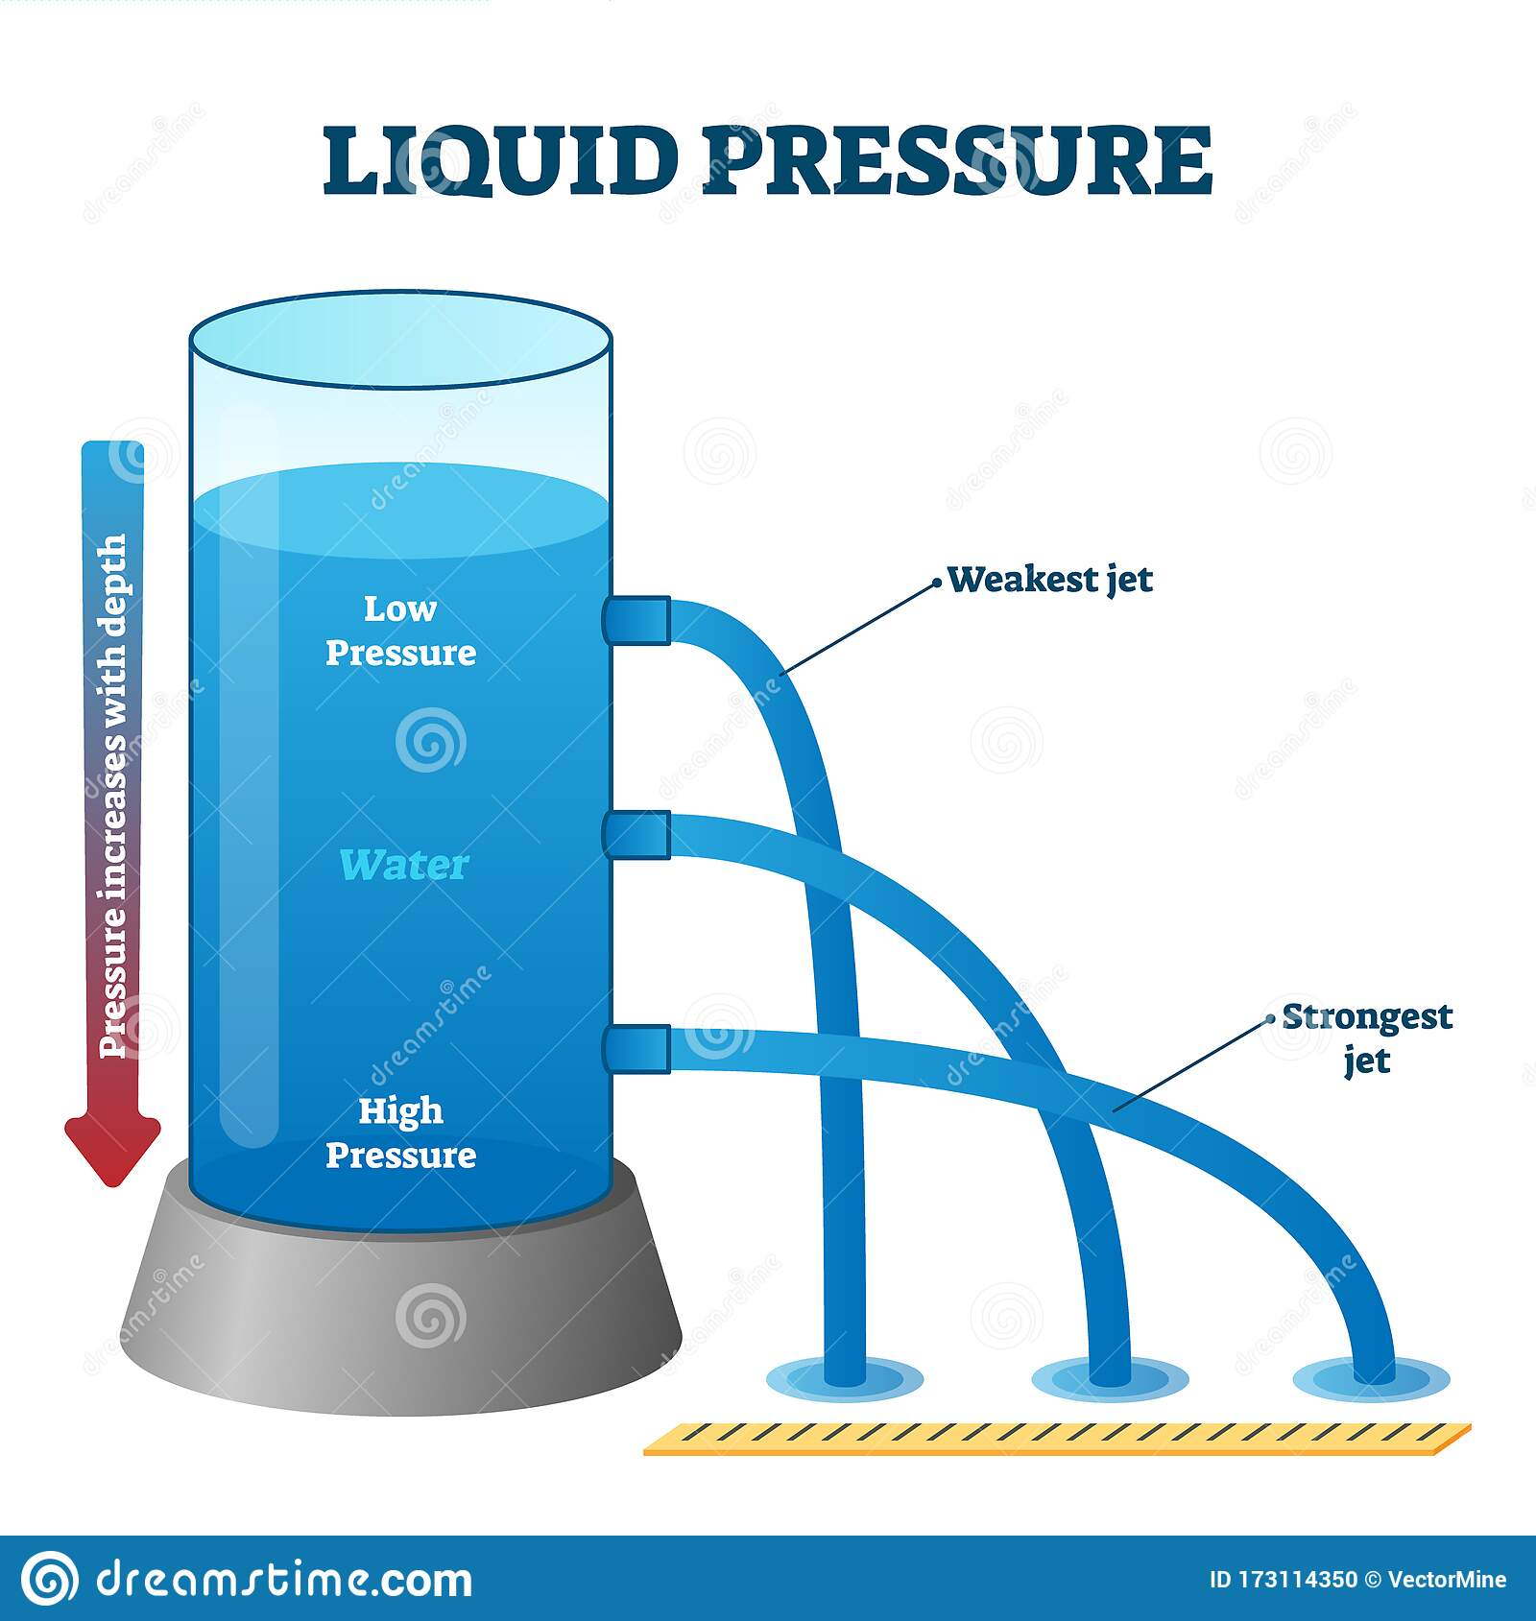

Slide 8
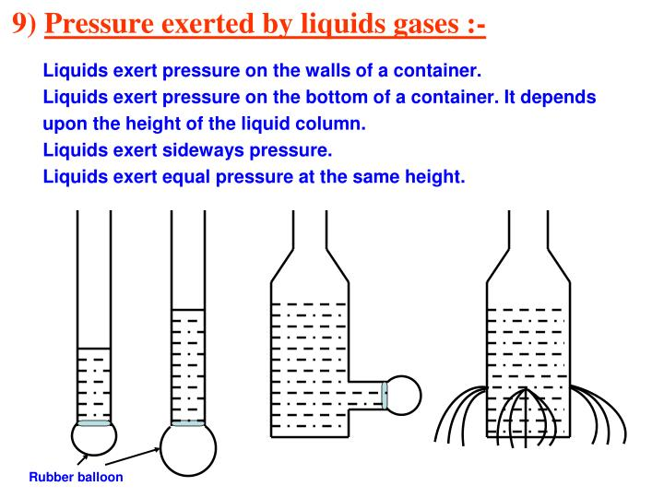
CHARACTERISTICS OF LIQUID PRESSURE

Slide 9
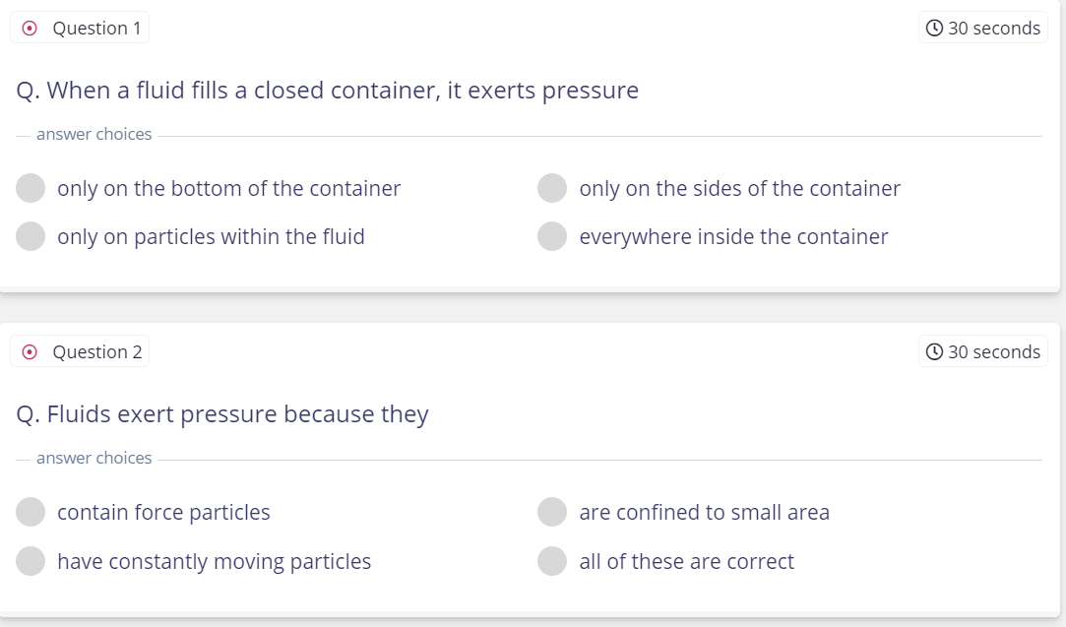

Slide 10


