Slide 1
REPRODUCTION IN ANIMALS
PREPARED BY
A K MISHRA, TGT/SS, AECS-3,MUMBAI
CLASS VIII MODULE 3

Slide 2
VIVIPAROUS AND OVIPAROUS ANIMALS
VIVIPAROUS
The animals which give birth to young ones are called viviparous animals.
Example- Mammals like cow,dog,cat etc
OVIPAROUS
Those animals which lay eggs are called oviparous.
Example- Hen,Duck,Birds etc.

Slide 3
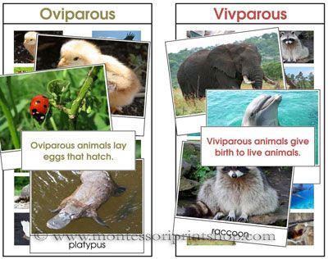
EXAMPLES

Slide 4
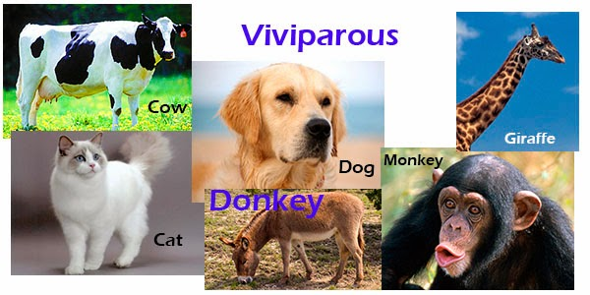
VIVIPAROUS

Slide 5
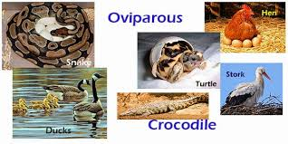
OVIPAROUS

Slide 6
YOUNG ONES TO ADULTS
The new individuals which are born or hatched from the eggs continue to grow till they become adult.
In some animals ,the young ones may look different from the adults.
Egg→ larva or caterpillar→pupa→adult

Slide 7
METAMORPHOSIS
The transformation of the larva into an adult through drastic changes is called metamorphosis.
Egg→ tadpole (larva)→ adult

Slide 8
*Similarly , the caterpillar or the pupa
of silkworm looks very different from the adult moth.
* The features that are present in the adult are not found in these young ones.

Slide 9
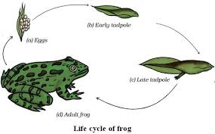
LIFE CYCLE OF FROG

Slide 10
What about the changes, that we
observe in our human body as we grow?
* In human beings ,body parts similar to those present in the adults are present in from the time of birth.

Slide 11
THANK YOU

