Slide 1
CHAPTER 10 REACHING THE AGE OF ADOLESCENCE
CLASS- VIII SCIENCE
MODULE 1
PREPARED BY
A K MISHRA
TGT/SS
A.E.C.S-3, MUMBAI

Slide 2
INTRODUCTION
Adolescence the word derived from Latin adolescere, meaning “to grow up” is a transitional stage of Physical and Psychological development that generally occurs during the period from Puberty to Legal adulthood.

Slide 3
*Growth begins from the day one is
born.
But upon crossing the age of 10 or 11,there is a sudden spurt in growth
which becomes noticeable.
* The changes taking place in the body
are part of growing up.
* They indicate that you are no longer
a child but are on the way to becoming
adult.

Slide 4
ADOLESCENCE AND PUBERTY
Growing up is a natural process .The period of life ,when the body undergoes changes, leading to reproductive maturity, is called adolescence.
Adolescence begins around the age of 11 and lasts upto 18 or 19 years of age.
Since this period covers the ‘ teen’ (13 to18 or 19years of age),adolescents are also called ‘teenagers’.
In girls ,adolescence may begin a year or two earlier than in boys.

Slide 5
PUBERTY
The human body undergoes several changes during adolescence. These changes mark the onset of puberty.
The most important change which marks puberty is that boys and girls become capable of reproduction.
Puberty ends when an adolescent reaches reproductive maturity.

Slide 6
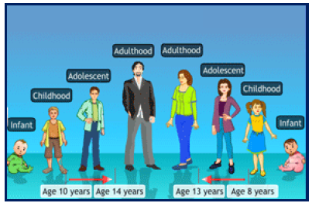
STAGES OF DEVELOPMENT

Slide 7
CHANGES AT PUBERTY
INCREASE IN HEIGHT- The most conspicuous change during puberty is the sudden increase in height. At this time the long bones, that is, the bones of the arms and the legs elongate and make a person tall.
Initially , girls grow faster than boys but by about 18 years of age, both reach their maximum height.

Slide 8
* The rate of growth in height varies
in different individuals.
* Some may grow suddenly at puberty and then slow down, while others may grow gradually.
* All parts of the body do not grow at the same rate.
* Sometimes the arms and legs or hands and feet of adolescents look oversized and
out of proportion with the body.

Slide 9
* But soon the other parts catch up and
result in a proportionate body.
* This is because height depends on the genes inherited from parents.
* It is ,however, very important to eat the right kind of food during these growing years. This helps the bones , muscles and other parts of the body get adequate nourishment for growth.

Slide 10
CALCULATION FOR FULL HEIGHT(cm)
Present height (cm)
------------------------------------ X 100
% of full height at this age

Slide 11
* CHANGE IN BODY SHAPE
In boys ,at the age of puberty, shoulders generally broaden as a result of growth.
In boys, the muscles of the body grow prominently than in the girls.
In girls, the region below the waist becomes wider.
Thus ,changes occurring in adolescent boys and girls are different.

Slide 12
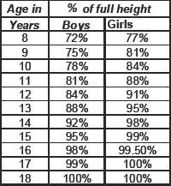
RATE OF GROWTH IN HEIGHT

Slide 13
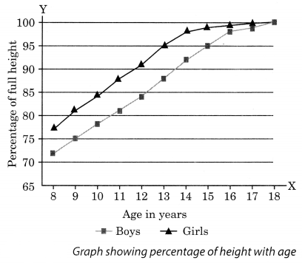
GRAPH

Slide 14
END OF MODULE 1
THANK YOU

