Slide 1
CHAPTER 10 REACHING THE AGE OF ADOLESCENCE
CLASS VIII MODULE 4
PREPARED BY
A K MISHRA
TGT/SS
AECS-3,MUMBAI

Slide 2
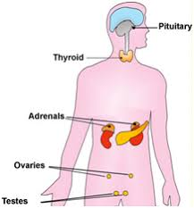
HORMONES OTHER THAN SEX HORMONES

Slide 3
* Apart from the Pituitary, the testes and
the ovaries , there are other endocrine glands
in the body such as thyroid, pancreas and
adrenals.
Thyroid gland produces thyroxine which
prevents ‘goitre.
* Endocrine part of Pancreas secretes insulin.

Slide 4
* A person was suffering from ‘ diabetes’
because pancreas was not producing
the hormone insulin in sufficient
quantities.
* Adrenal glands secrete hormones
which maintain the correct salt
balance in the blood.

Slide 5
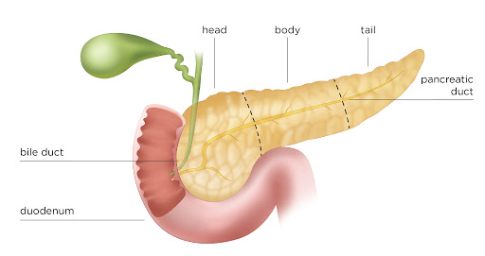
PANCREAS

Slide 6
* Adrenals also produce the hormone
adrenalin.
* It helps the body to adjust to stress when one is very angry, embarrassed or
worried.

Slide 7
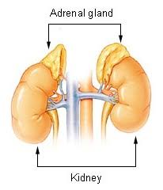
ADRENAL GLANDS

Slide 8
*Thyroid and adrenals secrete their
hormones when they receive orders
from the pituitary through its hormones.
* Pituitary also secretes growth
hormone which is necessary for the
normal growth of a person.

Slide 9
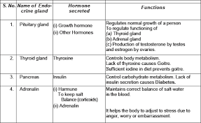
HORMONES AND THEIR FUNCTIONS

Slide 10
ROLE OF HORMONES IN COMPLETING THE LIFE HISTORY OF INSECTS AND FROGS
METAMORPHOSIS-
The change from larva to adult is called metamorphosis.
In insects, metamorphosis is controlled by insect hormones.
In a frog, it is controlled by thyroxin, the hormone produced by thyroid.
Thyroxine production requires the presence of iodine in water.

Slide 11
* If the water in which tadpoles are
growing does not contain sufficient iodine, the tadpoles cannot become
adult.

Slide 12
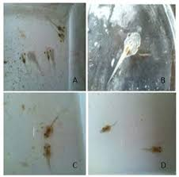
PRESENCE OF IODINE IN WATER

Slide 13
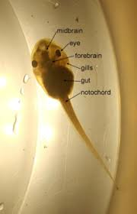
A TADPOLE LARVA

Slide 14
END OF
MODULE 4

