Slide 1
CHAPTER 10 REACHING THE AGE OF ADOLESCENCE
CLASS VIII MODULE 5
PREPARED BY
A K MISHRA
TGT/SS
AECS-3,MUMBAI

Slide 2
REPRODUCTIVE HEALTH
*The Physical and mental well being of an individual is regarded as an individual’s health.
* To keep the body healthy, every human being , at any age, needs to have a balance diet.

Slide 3
*The person must also observe
personal hygiene and undertake
adequate physical exercise.
* During adolescence, however, these become even more essential as the body is growing.

Slide 4
*NUTRITIONAL NEEDS OF THE ADOLESCENTS
Adolescence is a stage of rapid growth and development.
* Hence the diet for an adolescent has to be carefully planned.

Slide 5
BALANCED DIET
A diet which contains all the necessary nutrients such as proteins, carbohydrates, fats and vitamins in proper proportions is called a balanced diet.

Slide 6
* Our Indian meal of roti /rice , dal(pulses)
and vegetables is a balanced meal.
Milk is a balanced food in itself.
Fruits also provide nourishment .
Iron builds blood and iron-rich food
such as leafy vegetables, jaggery, meat,
citrus , Indian gooseberry (amla) good
for adolescents.

Slide 7
*Chips and packed or tinned snacks, though very
tasty should never replace regular meals as they do not have adequate
nutritional value.

Slide 8
* PERSONAL HYGIENE
Everyone should have a bath at least once everyday.
* It is more necessary for teenagers
because the increased activity of
sweat glands.

Slide 9
* All parts of the body should be washed
and cleaned everyday.
* If cleanliness is not maintained there
are chances of catching bacterial
infection.
* Girls should take special care of
cleanliness during the time of
menstrual flow.

Slide 10
* PHYSICAL EXERCISE
Walking and playing in fresh air keeps the body fit and healthy.
All young boys and girls should take walks, exercise and play outdoor games.

Slide 11
* SAY “ NO” TO DRUGS
Adolescence is a period of much activity in the body and mind which is a normal part of growing up.
Some people take advantage of this
and lead adolescents to bad habits.
* If anybody suggests that you will get
relief if you take some drugs,

Slide 12
Just say ‘ NO’ unless prescribed by the
the doctor.
* Drugs are addictive.
* They harm the body in the long run.
* They ruin health and happiness.
* AIDS , which is caused by a dangerous
virus HIV.

Slide 13
* This virus can pass on to a normal person
from an infected person by sharing
the syringes used for injecting drugs.
* It can also be transmitted to an infant
from the infected mother through
her milk.
* The virus can also be transmitted

Slide 14
through sexual contact with a person
infected with HIV.
MYTHS, TABOOS, Do’s and Don’ts
There are many wrong notions which you should now be able to discard as informed adolescents.
There are myths and taboos regarding bodily changes that adolescents experience.

Slide 15
* ADOLESCENT PREGNANCY
In our country, the legal age for marriage is 18 years for girls and 21 years for boys.
This is because teenage mothers are not prepared mentally or physically for motherhood.
Early marriage and motherhood cause

Slide 16
health problems in the mother and the
the child.
* It also curtails employment opportunities for the young woman and may cause mental agony as she is not ready for responsibilities of motherhood.

Slide 17
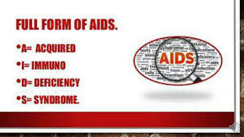
AIDS

Slide 18
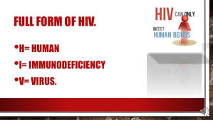
HIV

Slide 19
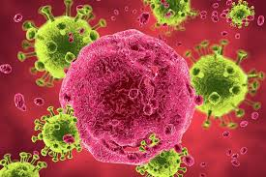
HIV VIRUS

Slide 20
END OF MODULE
5
THANK YOU

