Slide 1
Name : V.Amulya,TGT Month : November,2020 Class : VII Subject : English Modules : 2 Module : 1/2 Topic : Suppl. Reader L:7,Chandni

Slide 2
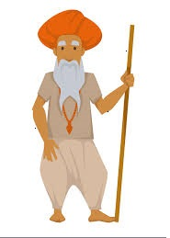
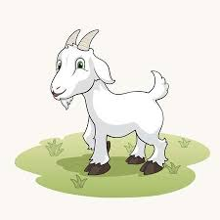
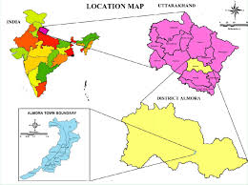
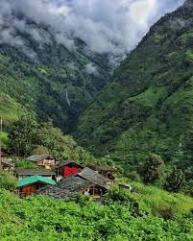
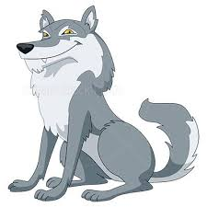
Chandni
Uttarakhand
Abbu Khan
Chandni
the hills of Almora
Almora
a wolf

Slide 3
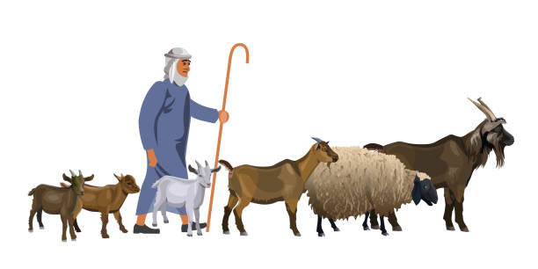
Except for a few goats he kept , he lived all by himself.
(2)
Once upon a time in Almora lived an old man called Abbu Khan (1)
So he spent all his time with his goats, taking them out for grazing in the day talking to them as he would to his pets.
(3)
He even gave his pet goats human names.
(4)

Slide 4
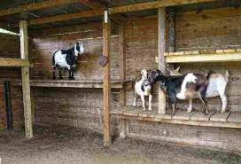
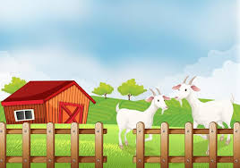
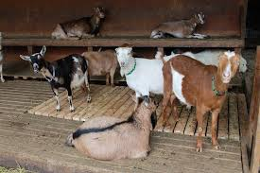
At night he would tie them because he was afraid they would escape and he would be left all alone.
The goats Abbu Khan had were all of the best hill breed and loved their freedom.
They loved to graze free on the meadows of the sloping hills, even though Abbu gave them the juiciest grass.
Many goats had escaped and died at the hands of a pack of wolves that lived in the hills.

Slide 5
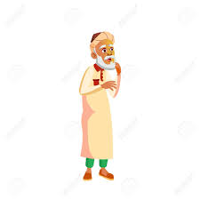
No more goats in my house ever again. I may yet live for a few more years but I will live without goats for sure.
However the poor old man was terribly lonely and he simply couldn’t live without his pets

Slide 6
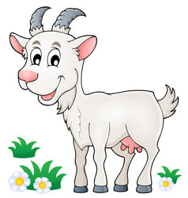
Very soon he bought a young goat pretty, white as snow with gleaming horns and bight eyes.
She was friendly and listened to Abbu Khan with deep interest and affection.
Abbu Khan called her Chandni , meaning ‘moonlight’. He would narrate to her stories of his friends who were dead and gone.

Slide 7
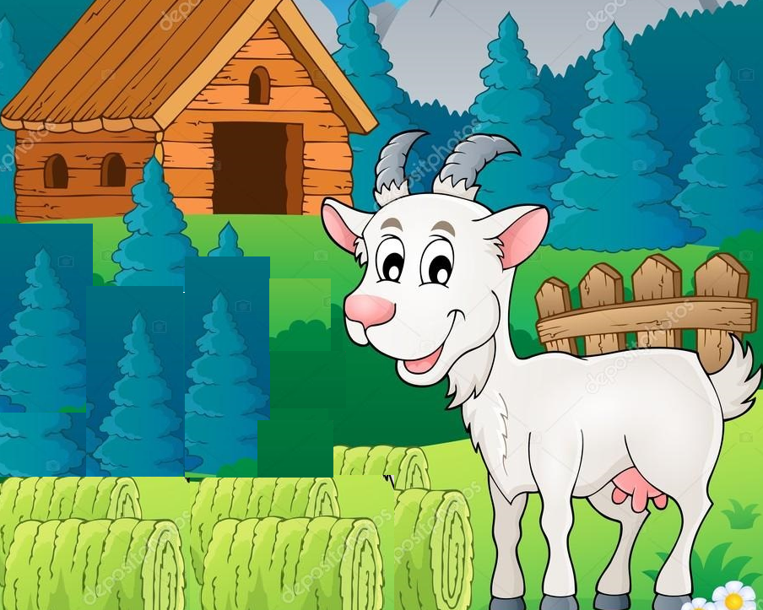
How beautiful those hills are. How refreshing the breeze that blows through them. How lovely to run across those green fields.
Several years passed, Chandni was still there.
Every morning she watched the hilltop bathed in sunlight.
She tried running to the hills ,but had to stop with a jerk. The rope around neck wouldn’t let her go any further. How she hated the rope.

Slide 8
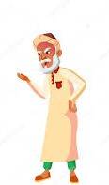
I believe that you’ll never leave this safe compound and go to the hills beyond.

Slide 9
She stopped listening to his stories, she lost her appetite and stared daily at the hills .Abbu Khan didn’t understand Chandni’s anguish. So, she decided to speak to him frankly.
Do you know the danger you’ll be in , the risk you are running? The wolf will finish you. Don’t be obstinate .
Why do you want to leave me Chandni? I’ll give you the tastiest food and a longer rope.
Abbu Khan , let me free! I want to run in the hills. If I stay in your compound I’ll die.
God has given me a pair od horns , I’ll fight the wolf if I have to.

Slide 10
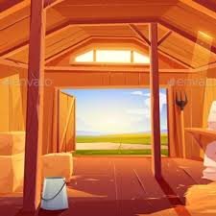
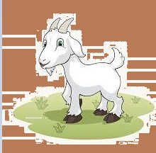
You are an ungrateful creature, stay here . You are going nowhere.
He shut the door but forgot to shut a window.

Slide 11
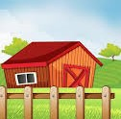
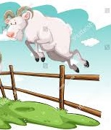
That same evening Chandni , made that little window her passage to freedom.

Slide 12
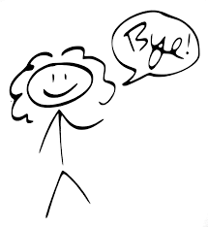
END OF MODULE-1
What will happen to Chandni?
Will she meet her fate li all other goats or will her happiness last for ever?
We will find the answer to this in the next module.
Bye....!

