Slide 1
Name : V.Amulya,TGT Month : November,2020 Class : VII Subject : English Modules : 2 Module : 2/2 Topic : Suppl. Reader L:7, Chandni

Slide 2
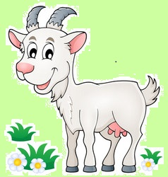
Once she was out of the village it seemed to Chandni that the old hills were welcoming her. She felt like a child meeting her parents after many long years of separation.
How different it is from the prison –house compound. It's the happiest day of my live.

Slide 3
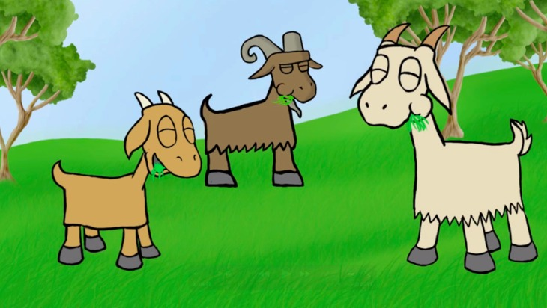
Chandni met a herd of goats ,she refused to join them as she wanted to enjoy her new freedom all by herself.
Come join us , we shall show you the best spot on the hills to graze the juiciest of grass.
No, thank you folks! I’m great on my own.

Slide 4
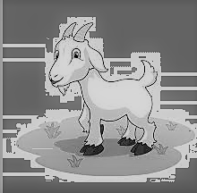
When darkness began to fall and the moon began to rise darkness enveloped the grass ,the flowers and the trees. The wind stopped blowing and there was stillness all around except for a strange sound which was coming from the bushes.
What’s that grunt like sound? It isn’t Abbu Khan’s voice calling me back to the compound, nor the voice of another goat.
Is it the dangerous wolf?
I’m scared!But should I go back to the safety of Abbu Khan’s hut?
grrr…..
No! death in an open field is better than life in a small hut.

Slide 5
The wolf leapt out of the bushes staring greedily at Chandni. His eyes shining greedily like burning coals. He knew the goat was his and seemed in no hurry. The wolf and the goat sized up each other. The wolf was big and ferocious whereas the goat although healthy ,was small. But, small is not weak. Chandni stood firm on her legs. Head slightly bent , horns jutting out .She was a picture of courage. She looked like a brave soldier ready to fight a treacherous enemy.
I must put up a good fight, and success or failure is a matter of luck or chance.
grrrrrr……….

Slide 6
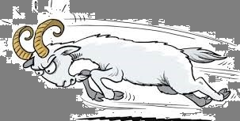
Two Content Layout with Table
The fight began and it went on through the night. The moon which had been watching the fight began to grow pale and suddenly hid behind the clouds.
The stars also began to disappear.
First bullet point here
Second bullet point here
Third bullet point here
Class | Group 1 | Group 2
Class 1 | 82 | 95
Class 2 | 76 | 88
Class 3 | 84 | 90

Slide 7
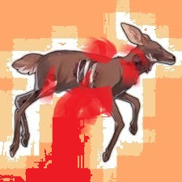
I declare that the goat is the winner. He got his food.She got her freedom.
A faint light appeared in the east, and the morning call of prayer came from a distant mosque.
The first rays of the sun saw Chandni lying on the ground completely drenched in blood. The wolf tired and sleepy was ready to devour Chandni.An assembly of birds nearby were debating the result of the fight.
Who’s the winner?
The wolf of course!

Slide 8
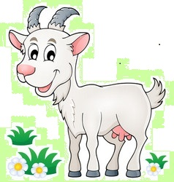
Chandni , indeed emerged the winner.
She had decided that it was better to die for freedom than be alive in a hut.

Slide 9
So, children we just went through the story.
Pick up your text book and read the story , once silently and once loudly. If you come across any difficult words try to puzzle out the meanings of these words based on their context .
Chandni is a beautiful story dealing with the theme love of freedom.
Hope, you enjoyed the story and learnt
Something.
Bye.... See you again!

