Slide 1
MODULE-1/1
CHAPTER – 7 INVENTION OF VITA –WONK
CLASS- VII
SUBJECT-ENGLISH(Honeycomb Textbook)
NAME OF THE TEACHER- EVA GURIA(ENG./SO.SC)
NAME OF THE SCHOOL- A.E.C.S.NARWAPAHAR

Slide 2
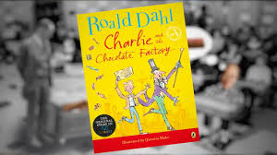


Slide 3
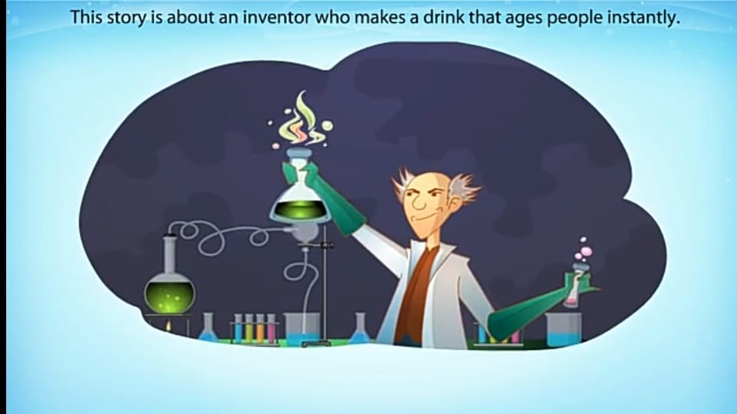

Slide 4
Chapter 7 the invention of vita wonk
Mr Willy Wonka begins by inventing Wonka Vite, which makes people younger. But Wonka Vite drug is too strong. So some people disappear, because their age becomes Minus! One person actually becomes minus eighty-seven, which means he’s got to wait eighty-seven years before he can come back. Mr Willy Wonka must invent a new thing...

Slide 5
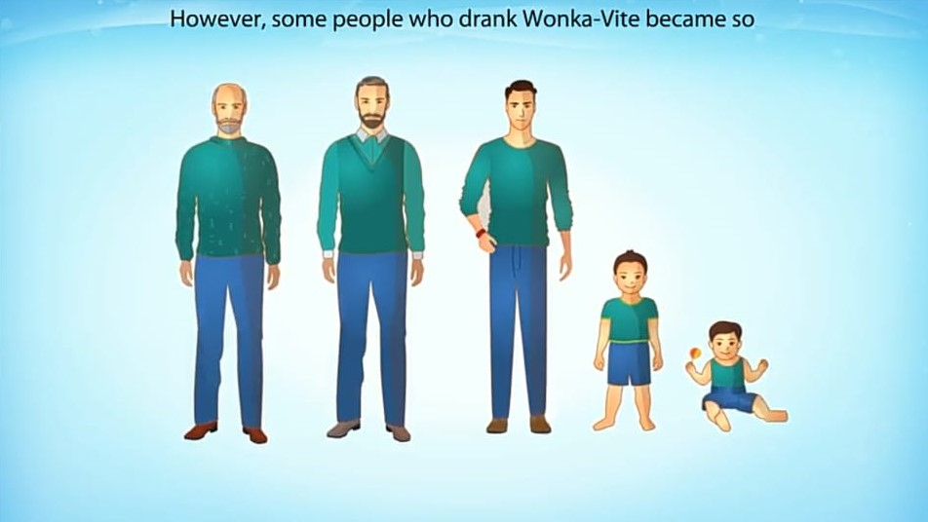

Slide 6
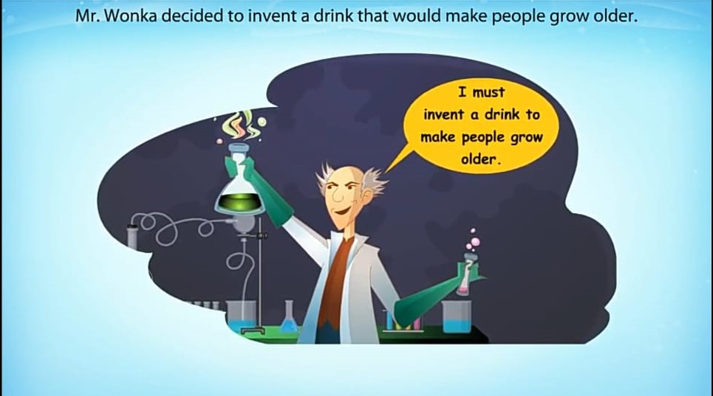

Slide 7
GEARING UP FOR THE NEW INVENTION
Mr. Wonka said, “So once again I rolled up my sleeves and set to work. Once again I squeezed my brain, searching for the new recipe... I had to create age... to make people old... old, older, oldest... ‘Ha-ha!’ I cried, for now the ideas were beginning to come. ‘What is the oldest living thing in the world? What lives longer than anything else?’
“A tree,” Charlie said. “Right you are, Charlie! But what kind of a tree? Not the Douglas fir. Not the oak. Not the cedar. No, no, my boy. It is a tree called the Bristlecone pine that grows upon the slopes of Wheeler Peak in Nevada, U.S.A. You can find Bristlecone Pines on Wheeler Peak today that are over 4000 years old! This is fact, Charlie. Ask any dendrochronologist you like (and look that word up in the dictionary when you get home, will you please?). So that started me off. I jumped into the Great Glass Elevator and rushed all over the world collecting special items from the oldest living things... l

Slide 8
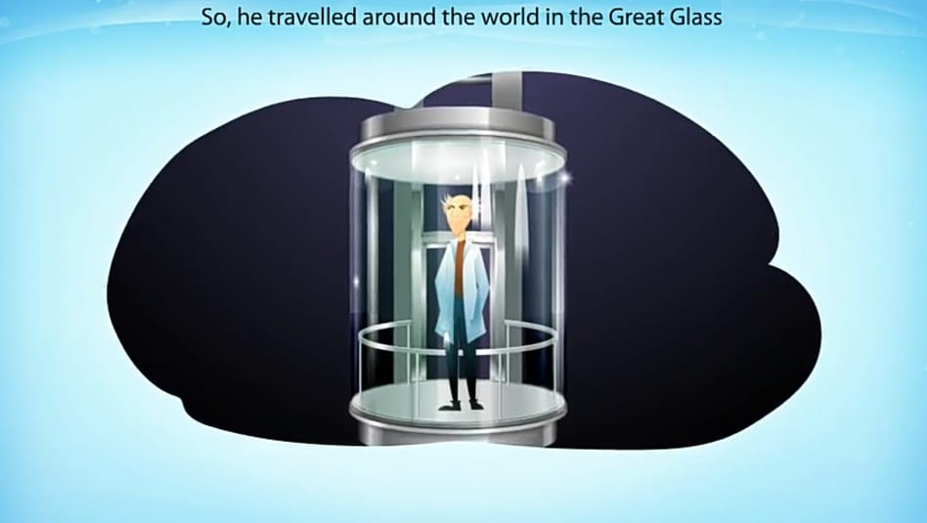

Slide 9
List of oldest living things
A PINT OF SAP FROM A 4000-YEAR-OLD BRISTLECONE PINE
THE TOE-NAIL CLIPPINGS FROM A 168-YEAR-OLD RUSSIAN FARMER CALLED PETROVITCH GREGOROVITCH
AN EGG LAID BY A 200-YEAR-OLD TORTOISE BELONGING TO THE KING OF TONGA
THE TAIL OF A 51-YEAR-OLD HORSE IN ARABIA
THE WHISKERS OF A 36-YEAR-OLD CAT CALLED CRUMPETS
AN OLD FLEA WHICH HAD LIVED ON CRUMPETS FOR 36 YEARS
THE TAIL OF A 207-YEAR-OLD GIANT RAT FROM TIBET
THE BLACK TEETH OF A 97-YEAR-OLD GRIMALKIN LIVING IN A CAVE ON MOUNT POPOCATEPETL
THE KNUCKLEBONES OF A 700-YEAR-OLD CATTALOO FROM PERU...”

Slide 10
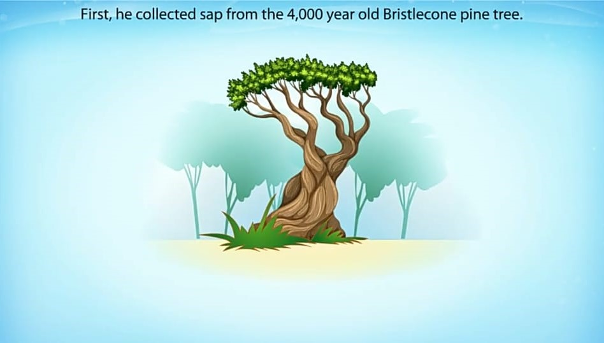
A PINT OF SAP FROM A 4000-YEAR-OLD BRISTLECONE PINE

Slide 11
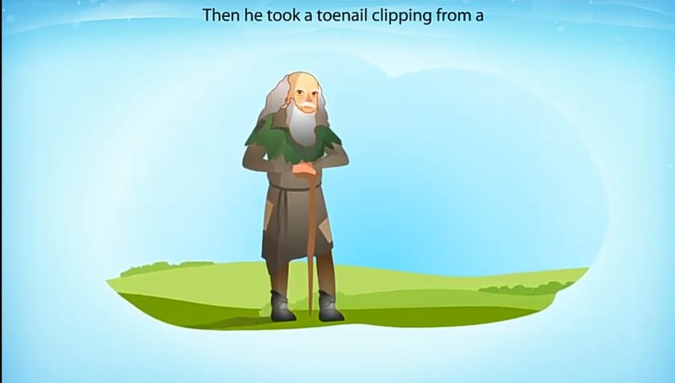
THE TOE-NAIL CLIPPINGS FROM A 168-YEAR-OLD RUSSIAN FARMER CALLED PETROVITCH GREGOROVITCH

Slide 12
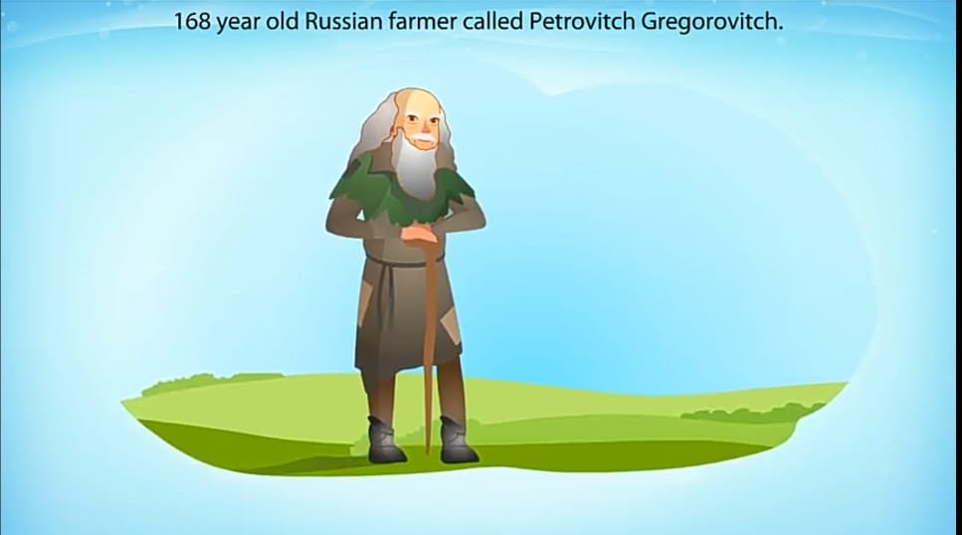

Slide 13
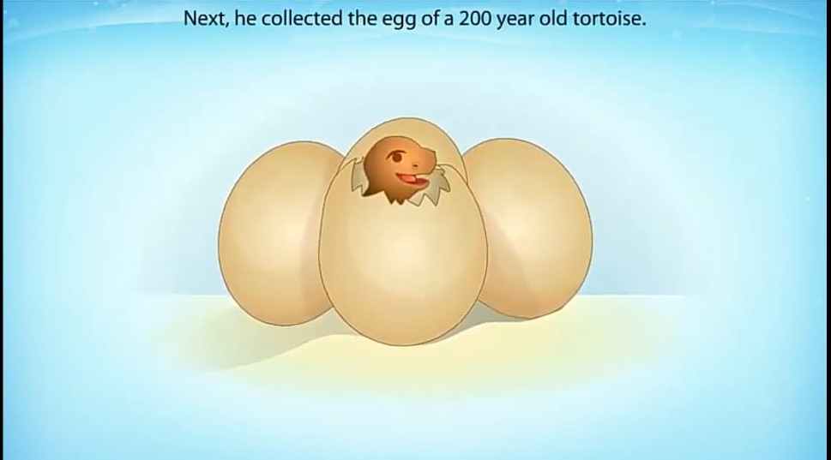
AN EGG LAID BY A 200-YEAR-OLD TORTOISE BELONGING TO THE KING OF TONGA

Slide 14
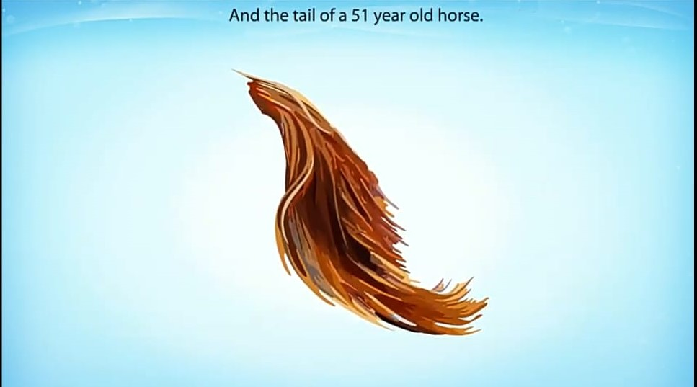
THE TAIL OF A 51-YEAR-OLD HORSE IN ARABIA

Slide 15
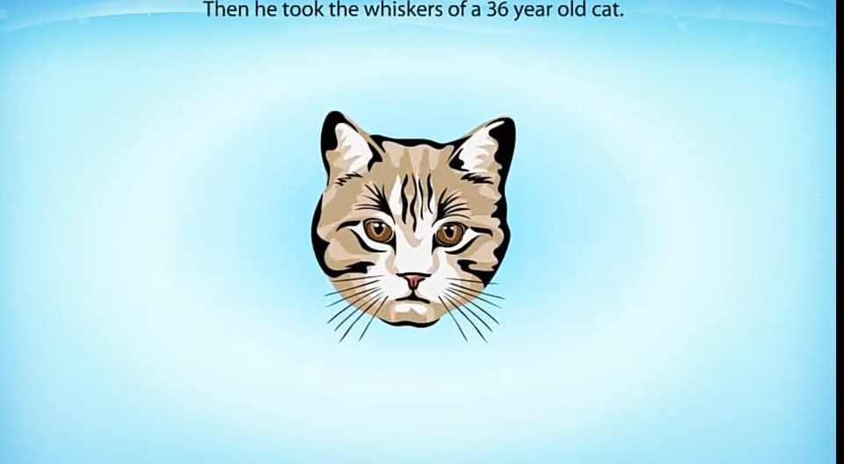
THE WHISKERS OF A 36-YEAR-OLD CAT CALLED CRUMPETS

Slide 16
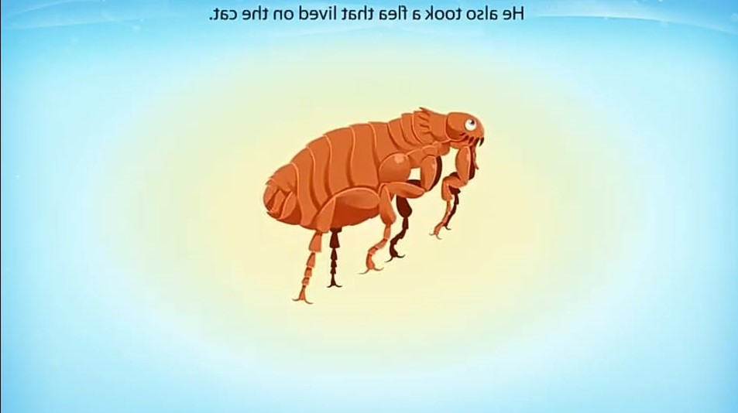
AN OLD FLEA WHICH HAD LIVED ON CRUMPETS FOR 36 YEARS

Slide 17
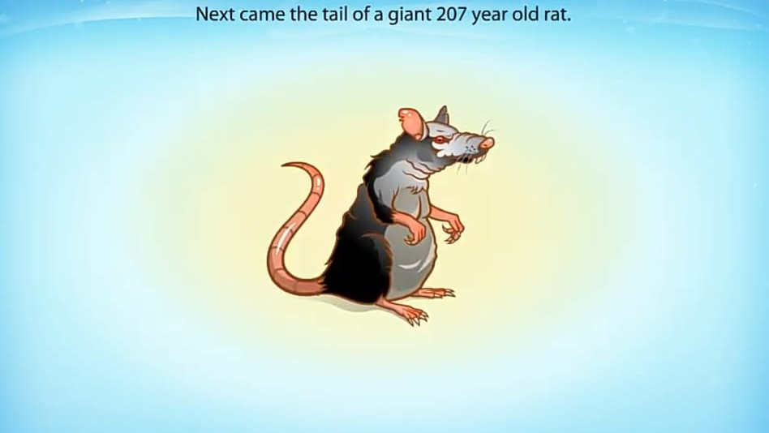
THE TAIL OF A 207-YEAR-OLD GIANT RAT FROM TIBET

Slide 18
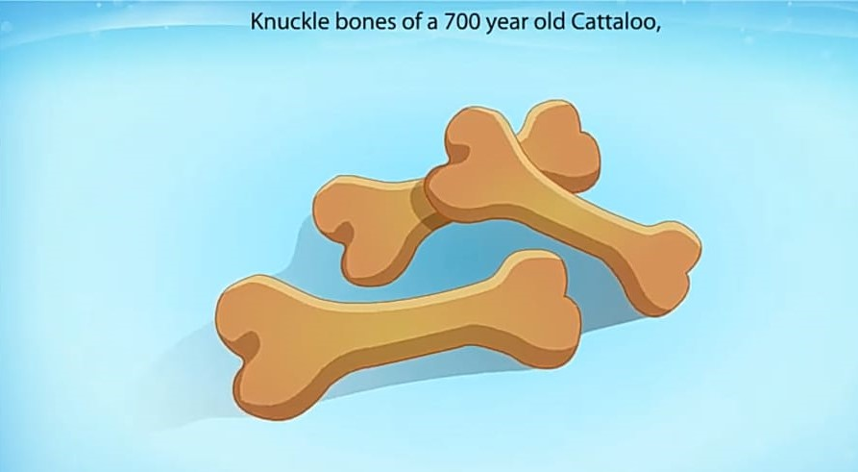
THE KNUCKLEBONES OF A 700-YEAR-OLD CATTALOO FROM PERU..

Slide 19
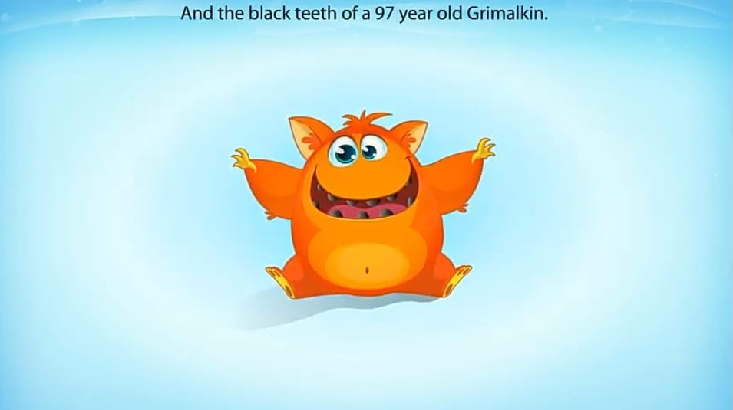
THE BLACK TEETH OF A 97-YEAR-OLD GRIMALKIN LIVING IN A CAVE ON MOUNT POPOCATEPETL

Slide 20
SAMPLES COLLECTION FROM ALL OVER THE WORLD
“All over the world, Charlie,” Mr Wonka went on “I tracked down very old and ancient animals and took an important little bit of something from each one of them — a hair or an eyebrow or sometimes it was no more than an ounce or two of the jam scraped from between its toes while it was sleeping. I tracked down THE WHISTLE-PIG, THE BOBOLINK, THE SKROCK, THE POLLYFROG, THE GIANT CURLICUE, THE STINGING SLUG AND THE VENOMOUS SQUERKLE who can spit poison right into your eye from fifty yards away. But there’s no time to tell you about them all now, Charlie.

Slide 21
INVENTION OF VITA -WONK
Let me just say quickly that in the end, after lots of boiling and bubbling and mixing and testing in my Inventing Room, I produced one tiny cupful of oily black liquid and gave four drops of it to a brave twenty-year-old Oompa-Loompa volunteer to see what happened.” “What did happen?” Charlie asked. “It was fantastic!” cried Mr Wonka. “The moment he swallowed it, he began wrinkling and shrivelling up all over and his hair started dropping off and his teeth started falling out and, before I knew it, he had suddenly become an old fellow of seventy-five! And thus, my dear Charlie, was Vita-Wonk invented!” ROALD DAHL [from Charlie and the Great Glass Elevator]

Slide 22
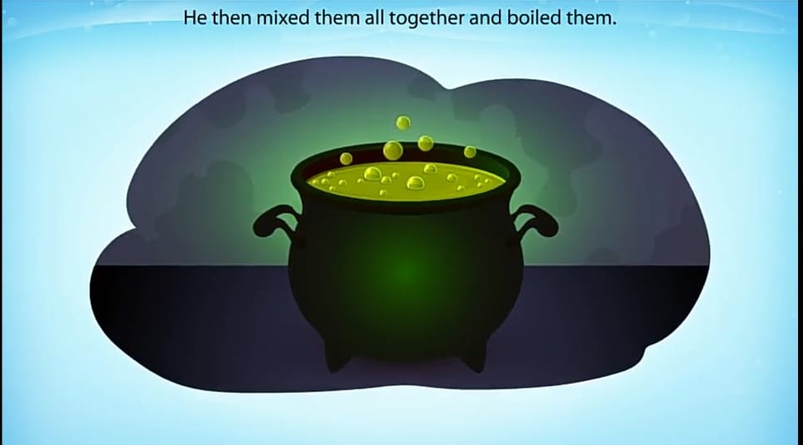
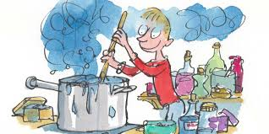
All the samples put together

Slide 23
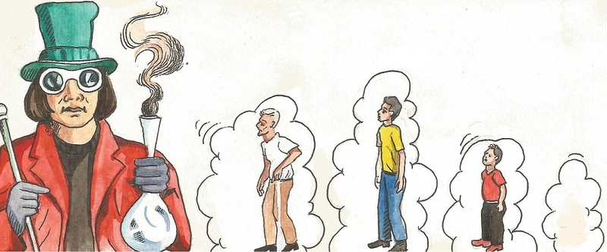
MR. WONKA TESTED HIS DRUG IN A YOUNG MAN WHO BECAME AN OLD MAN OF SEVENTY FIVE AFTER SWALLOWING FEW DROPS

Slide 24
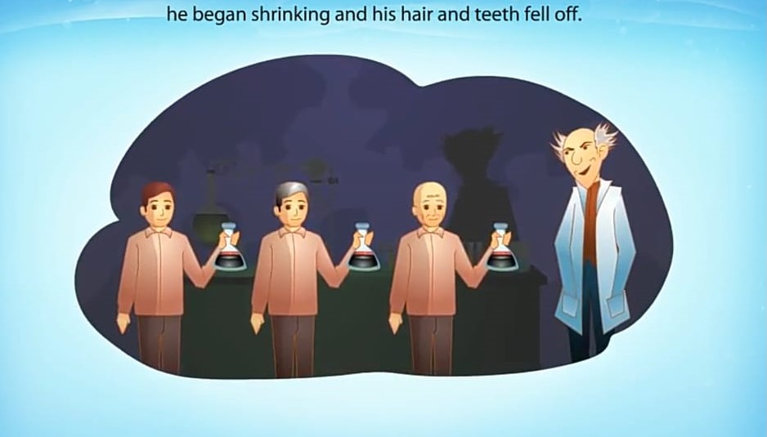
twenty-year-old Oompa-Loompa volunteer turns to a man of seventy- five

Slide 25
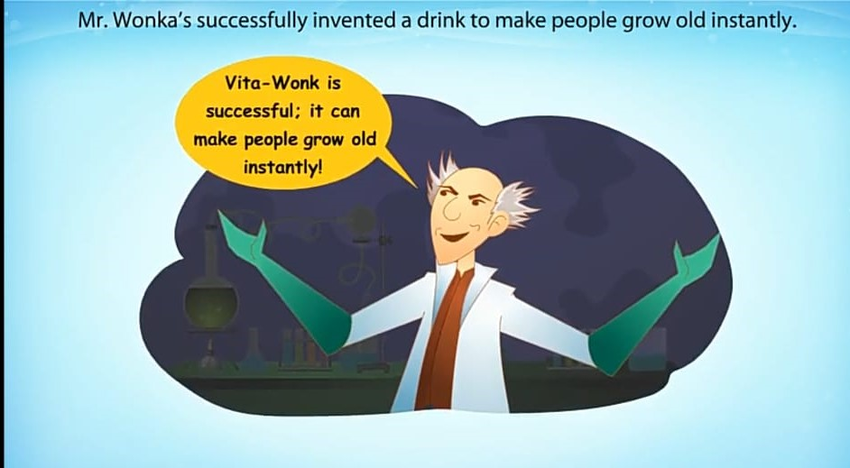
Vita-Wonk invented

Slide 26
New Words:
Old = advanced in age
He is too old to run.
Disappear = vanish, invisible
The boy disappeared in a moment from the street.
Giant = man of great size
The selfish giant knocked down the wall.
Knuckle = bone at the finger joint
The boy has broken his knuckle bone.
Elevator = a kind of lift
Recently a new elevator has been arranged for VIP at Agra cant railway station.
Swallow = drink
Swallow the tablets whole with a drink of water.
Squeeze = press hard
Mohan squeezed the egg with his hand.
Grimalkin =a cat, particularly an old female cat

Slide 27


