Slide 1
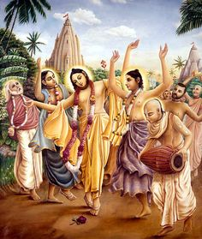
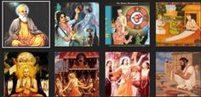
DEVOTIONAL PATH TO THE DIVINE

Slide 2
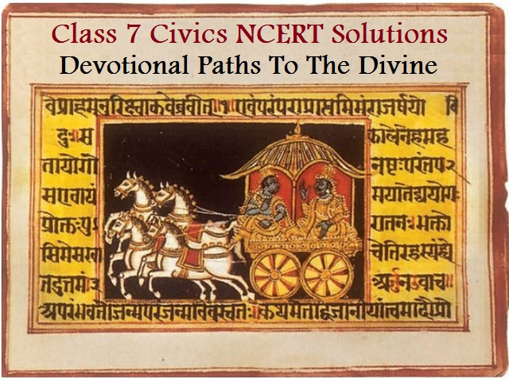
DEVOTIONAL PATHS TO THE DIVINE
People perform rituals of worship, or singing bhajans, kirtans or qawwalis, or even repeating the name of God in silence.
Intense devotion or love of God is the legacy of various kinds of bhakti and Sufi movements that have evolved since the eighth century.

Slide 3
The Idea of a Supreme God
Before large kingdoms emerged, different groups of people worshipped their own Gods and Goddesses. As people were brought together through the growth of towns, trade and empires, new ideas began to develop.
The idea that all human beings are not equal at birth gained ground during this period.
The idea of a Supreme God who could deliver humans from bondage through devotion or bhakti emerged.
Gods and goddesses worshipped in different areas came to be identified with Shiva, Vishnu or Durga.

Slide 4
A New Kind of Bhakti in South India – Nayanars and Alvars
The seventh to ninth centuries saw the emergence of a new religious movement, led by Nayanars (saints devoted to Shiva) and Alvars (saints devoted to Vishnu).
They were sharply critical of the Buddhists and Jainas and preached ardent love of Shiva or Vishnu as the path to salvation.
The Nayanars and Alvars went from place to place composing exquisite poems of praise of the deities enshrined in the village they visited and set them to music.
The Chola and Pandya kings built elaborate temples around many of the shrines.

Slide 5
Nayanars
Nayanars
There were 63 Nayanars, who belonged to different caste backgrounds such as potters, “untouchable” workers, peasants, hunters, soldiers, Brahmanas and chiefs.
The best known among them were Appar, Sambandar, Sundarar and Manikkavasagar.
There are two sets of compilations of their songs – Tevaram and Tiruvacakam

Slide 6
A
Alvars
There were 12 Alvars, who came from equally divergent backgrounds, the best known being Periyalvar, his daughter Andal, Tondaradippodi Alvar and Nammalvar.
Their songs were compiled in the Divya Prabandham

Slide 7
HAGIOGRAPHY –
        Writing Of Saints
SHANKARA
Advaita
RAMANUJA
Vishishtadvaita
BASAVANNA
Virashaivism

Slide 8
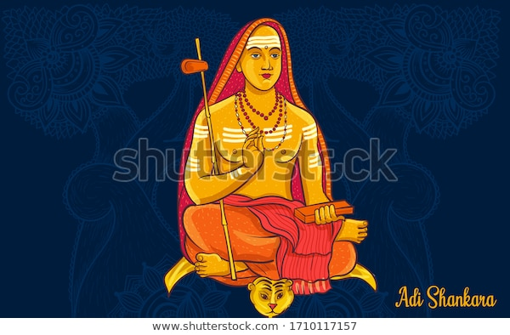
Philosophy and Bhakti
Shankara, the most influential philosophers of India, was born in Kerala in the 8th century.
He was an advocate of Advaita or the doctrine of the oneness of the individual soul and the Supreme God which is the Ultimate Reality.
He taught that Brahman, the only or Ultimate Reality, was formless and without any attributes.
He considered the world around us to be an illusion or Maya, and preached renunciation of the world.
He advocated adoption of the path of knowledge to understand the true nature of Brahman and attain salvation

Slide 9
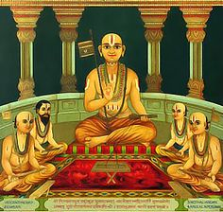
Ramanuja was born in Tamil Nadu in the 11th century.
He was deeply influenced by the Alvars.
According to him the best means of attaining salvation was through intense devotion to Vishnu.
Vishnu in His grace helps the devotee to attain the bliss of union with Him.
He propounded the doctrine of Vishishtadvaita or qualified oneness in that the soul, even when united with the Supreme God, remained distinct.
Ramanuja’s doctrine greatly inspired the new strand of bhakti which developed in north India subsequently.

Slide 10
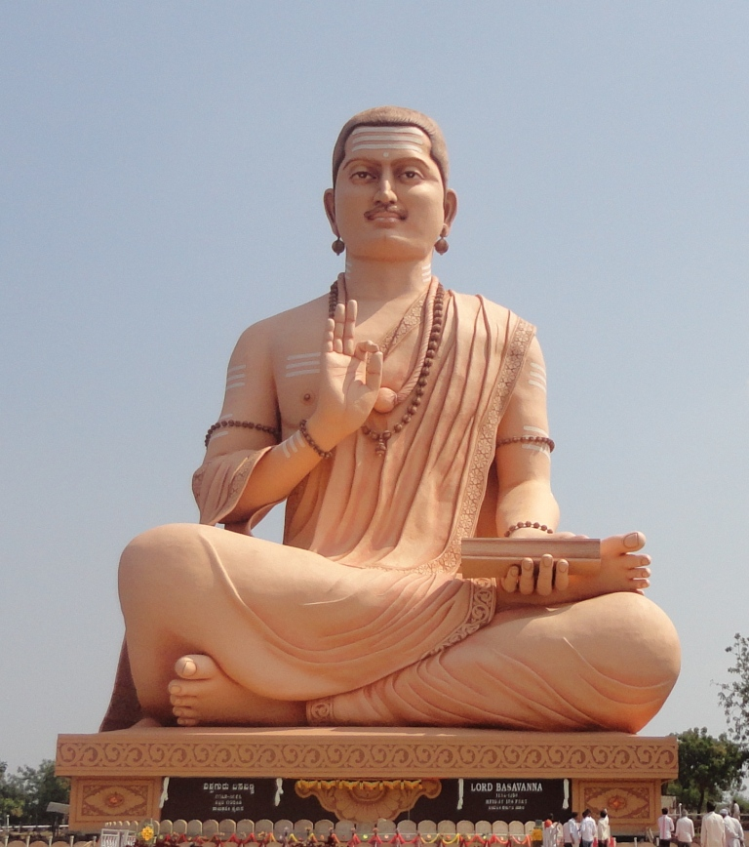
Basavanna
Virashaivism movement was initiated by Basavanna and his companions Allama Prabhu and Akkamahadevi in Karnataka in the mid-12th century.
They argued strongly for equality of all human beings, opposed Brahmanical ideas of caste and treatment of women.
They were against all forms of rituals and idol worship.

Slide 11

Nancy George
AECS, Mysore

