Slide 1

ATOMIC ENERGY EDUCATION SOCIETY , MUMBAI
DISTANCE LEARNING PROGRAMME 2020- 21
CLASS : 7
SUB : MATHEMATICS
TOPIC: RATIONAL NUMBERS

Slide 2

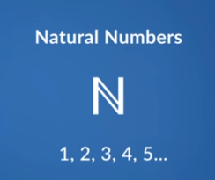
MODULE 1/3
INTRODUCTION :
We begin the study of numbers by counting the objects around us.
They are counting numbers and are called Natural Numbers
NATURAL NUMBERS : The numbers used for counting
are called Natural numbers
i.e the numbers 1,2 3, 4 . . . are Natural Numbers.
The Set of Natural numbers is denoted by N
N = {1, 2 , 3, 4, 5, 6 …}

Slide 3
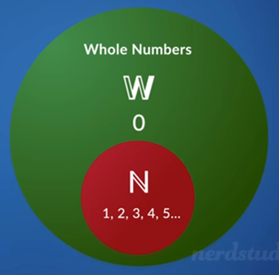
Whole numbers: 0 and all-Natural Numbers are called Whole Numbers
i.e, 0,1.2.3 ,5. . . are whole numbers
The Set of Whole Numbers
is denoted by W.
W = {0,1, 2 , 3, 4, 5, 6 …}

Slide 4


Integers : A collection of negative numbers and
all whole numbers together are called Integers
Set of Integers is denoted by Z
Z = { . . . – 5, − 4, − 3, − 2, − 1, 0 , 1, 2, 3, 4, 5, …}

Slide 5
Rational Numbers:
To write 500m above sea level in km, we say 500/1000 km =1/2 km
But to represent 500 m below sea level in km in a number, we need to extend the number system by including such numbers. Those numbers are named as Rational Numbers.
A Rational number is defined as a number that can be expressed in the form of p/q , where p and q are integers and q ≠ o
Set of Rational Numbers is denoted by ‘ Q’

Slide 6
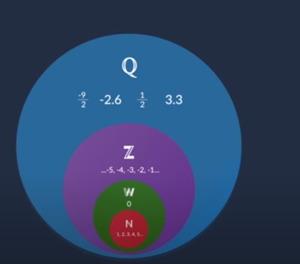

Slide 7

Which of the following are rational numbers.
(i) $\frac{0}{−5}$
ANS: Rational Number
$(ii)\frac{3}{0}$
ANS: Not a Rational Number (denominator zero is not defined)
(iii)$\frac{ −13}{23}$
ANS: Rational Number

Slide 8

Positive rational Numbers : If both the numerator and the denominator have the same sign, then the rational numbers are said to be positive rational numbers.
Ex: (- 8)/(- 17) , (- 13)/(- 11) , 9/5 … are positive rational numbers
Negative Rational Numbers : If the numerator and the denominator have the different signs, then the rational numbers are said to be negative rational numbers.
Ex:4/(- 5) , (-9)/10 , (-17)/3 . . . are negative rational numbers
Zero is neither positive nor negative rational number.
3 is a rational number , it can be written as 3/1

Slide 9


Separate positive rational numbers and negative rational numbers from the following :
Solution :
Positive rational numbers: $\frac{−3}{−5} ,\frac{3}{5},\frac{−13}{−3}$
Negative rational numbers are $\frac{− 3}{5}$, $\frac{3}{−5} ,\frac{−15}{8} and \frac{15}{−8}$
Zero is neither positive nor negative

Slide 10
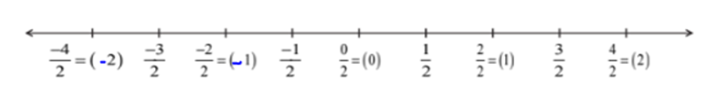
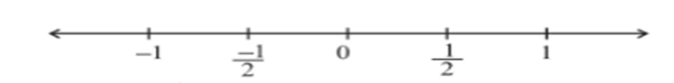
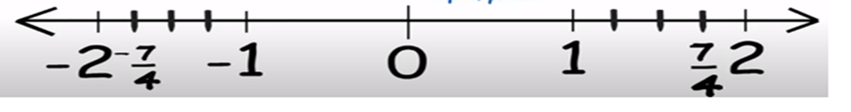
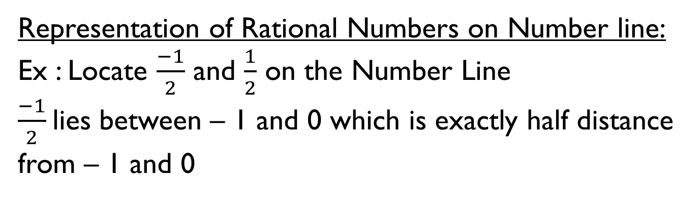
Representation of Rational Numbers on Number line:
Ex : Locate $\frac{−1}{2}$ and $\frac{1}{2}$ on the Number Line
$\frac{−1}{2}$lies between – 1 and 0 which is exactly half distance from – 1 and 0
Representation of (- 7)/(4 ) and 7/(4 ) on Number line

Slide 11
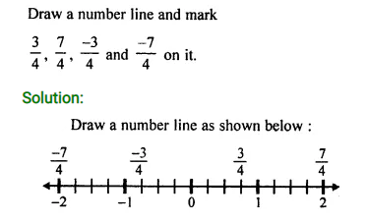

Slide 12
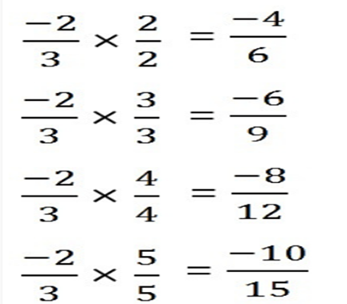
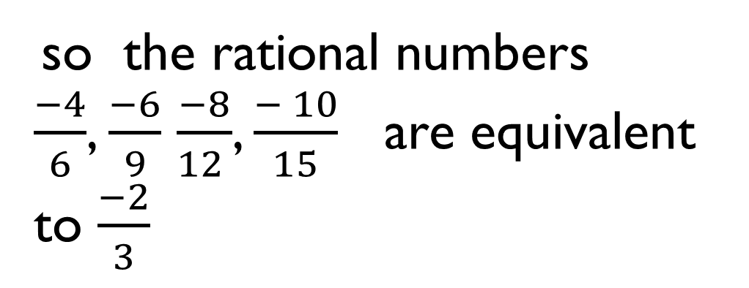
EQUIVALENT RATIONAL NUMBERS :
By multiplying or dividing the numerator and denominator of a rational number by a same non zero integer, we obtain another rational number equivalent to the given rational number. The rational numbers so obtained are equivalent to given rational number.
so the rational numbers
$\frac{−4}{6}$, $\frac{−6}{9}$ $\frac{−8}{12 }$, $\frac{− 10}{15}$ are equivalent to $\frac{−2}{3}$

Slide 13
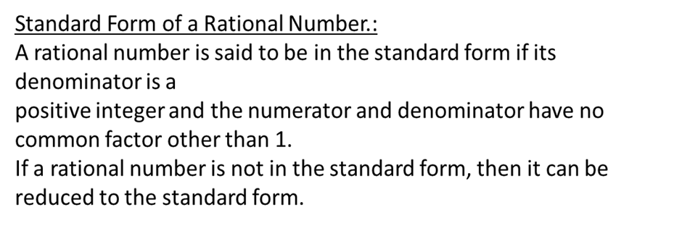
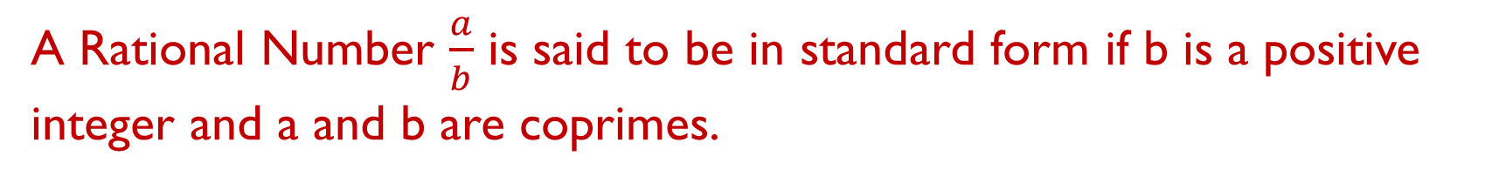
A Rational Number $\frac{a}{b}$ is said to be in standard form if b is a positive integer and a and b are coprimes.

Slide 14
WORKED OUT EXAMPLES:

Slide 15
𝓣𝓱𝓪𝓷𝓴 𝔂𝓸𝓾
𝓑. 𝓟𝓐𝓡𝓥𝓐𝓣𝓗𝓘 𝓓𝓔𝓥𝓘,
𝓐 𝓔 𝓒 𝓢 2
𝓗𝓨𝓓𝓔𝓡𝓐𝓑𝓐𝓓

