Slide 1
ATOMIC EBERGY EDUCATION SOCIETY , MUMBAI
DISTANCE LEARNING PROGRAMME 2020-21
class : 7
SUBJECT : MATHEMATICS
RATIONAL NUMBERS
MODULE - 2/3

Slide 2
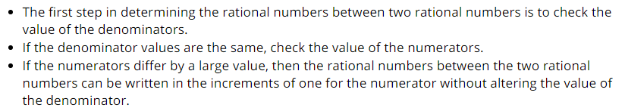
Rational numbers between two rational numbers:
Between two rational numbers there exists infinitely many rational numbers.
Rational numbers between two rational number with the same denominator

Slide 3
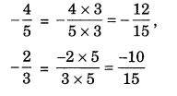
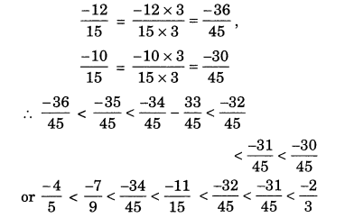
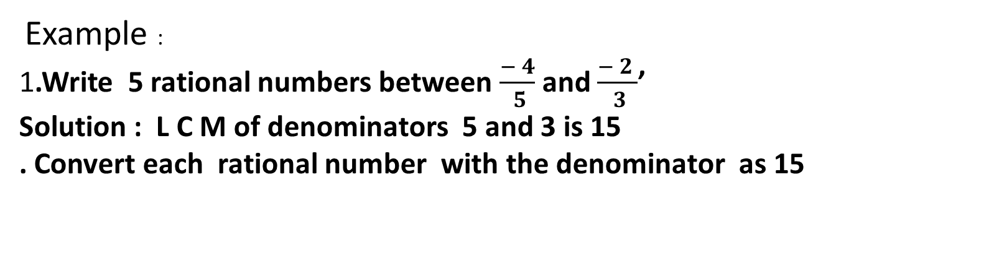
Example :
1.Write 5 rational numbers between $\frac{− 4}{ 5}$ and $\frac{− 2 }{ 3}$’
Solution : L C M of denominators 5 and 3 is 15
. Convert each rational number with the denominator as 15
Now between - 12 and – 10 there is only one integer – 11.
As we need 5 rational numbers , we have to find equivalent rational numbers with the denominator 45

Slide 4
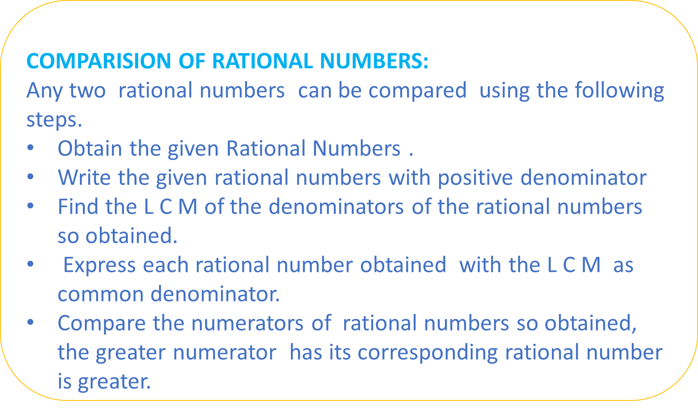
COMPARISION OF RATIONAL NUMBERS:
Any two rational numbers can be compared using the following steps.
Obtain the given Rational Numbers .
Write the given rational numbers with positive denominator
Find the L C M of the denominators of the rational numbers so obtained.
Express each rational number obtained with the L C M as common denominator.
Compare the numerators of rational numbers so obtained, the greater numerator has its corresponding rational number is greater.

Slide 5
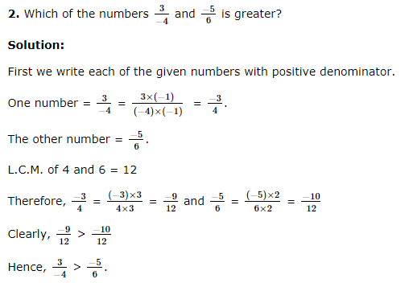

Slide 6


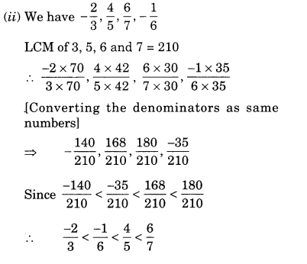
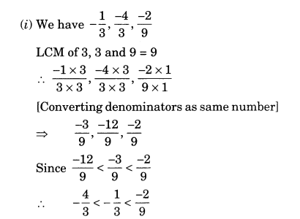
.
Write the following Rational numbers in ascending order

Slide 7

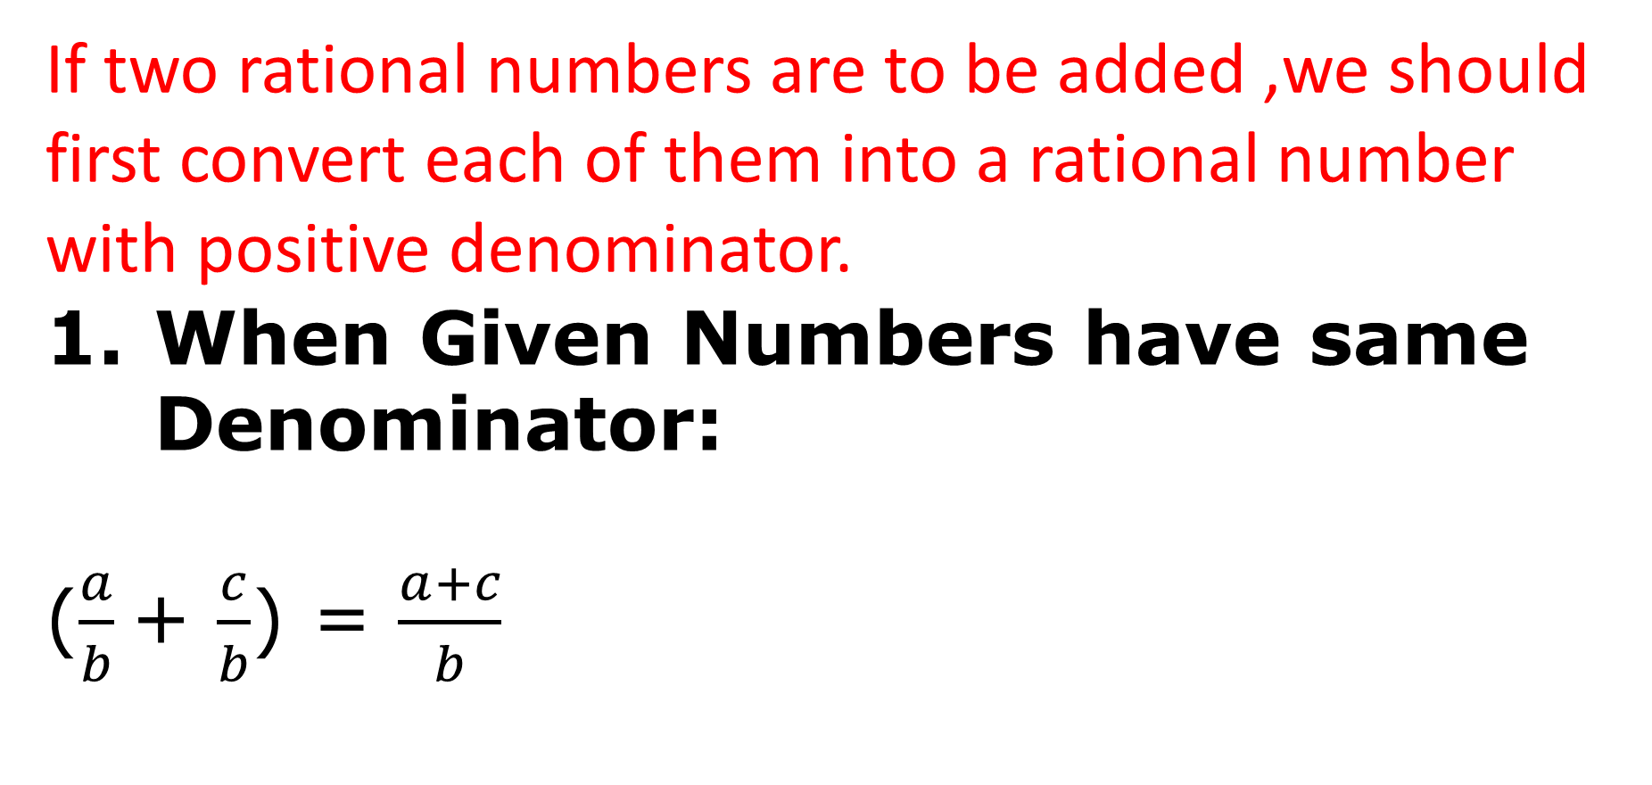
Addition of Rational Numbers:
If two rational numbers are to be added ,we should first convert each of them into a rational number with positive denominator.
When Given Numbers have same Denominator:
($\frac{a}{b}$+ $\frac{c}{b}$) = $\frac{a+c}{b}$

Slide 8
2. When Denominators of Given Numbers are Unequal:
Find LCM of their denominators and express each of the given numbers with that same LCM as the common denominator. Now, we add these numbers as shown above.

Slide 9

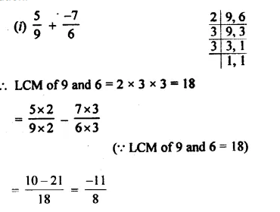
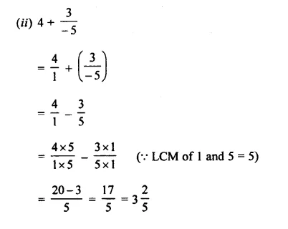

Slide 10
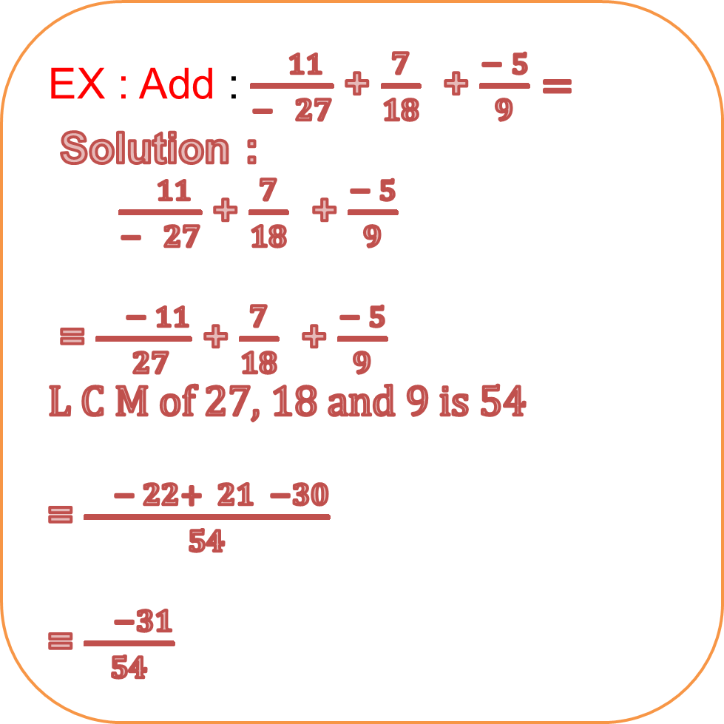
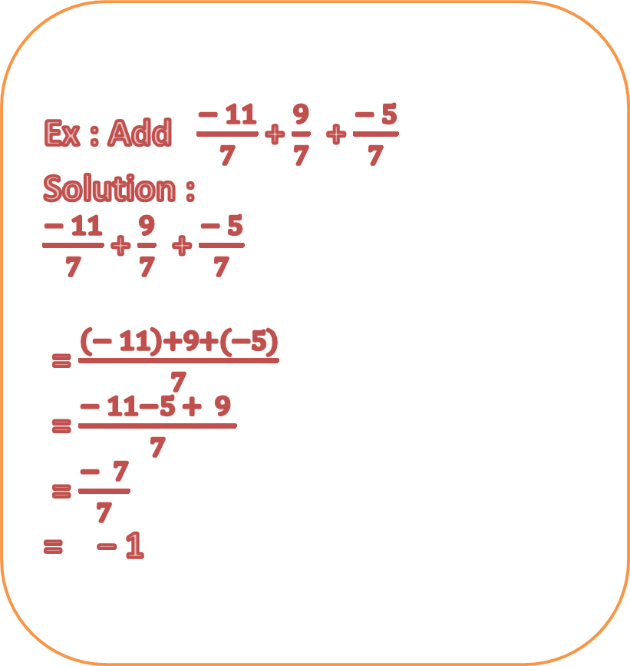
EX : Add : $\frac{ 11}{− 27}$ + $\frac{7}{18}$ + $\frac{− 5}{9}=$
Solution :
$\frac{ 11}{− 27}$ + $\frac{7}{18}$ + $\frac{− 5}{9}$
= $\frac{ − 11}{ 27}$ + $\frac{7}{18}$ + $\frac{− 5}{9}$
L C M of 27, 18 and 9 is 54
= $\frac{ − 22+ 21 −30}{54}$
= $\frac{ −31}{54}$
Ex : Add $\frac{− 11}{7}$ + $\frac{9}{7}$ + $\frac{− 5}{7}$
Solution :
$\frac{− 11}{7}$ + $\frac{9}{7}$ + $\frac{− 5}{7}$
= $\frac{\left(− 11\right)+9+(−5)}{7}$
= $\frac{− 11−5 + 9 }{7}$
= $\frac{− 7}{7}$
= − 1

Slide 11

The Additive inverse of a number is what you add to a number to create the sum of zero.
The Additive Inverse of a number is its mirror image on the Number Line
The additive inverse of −5 is +5, because −5 + 5 = 0
The additive inverse of +5 is −5, because +5 − 5 = 0
X + y =0
X = - y
OR
y = - x
Additive inverse of x = -x

Slide 12
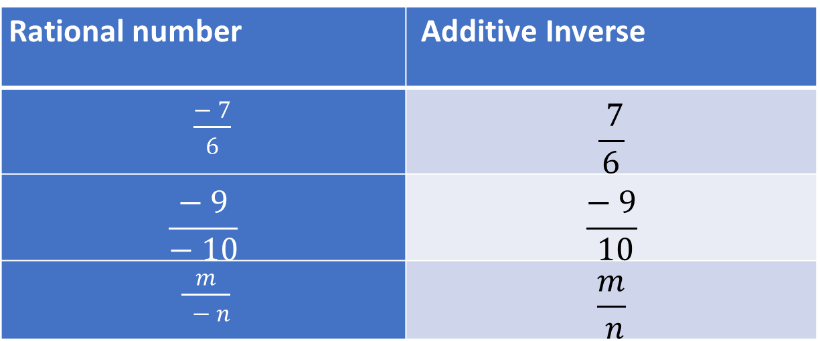
Additive Inverse of a positive rational number is negative. Additive Inverse of a negative rational number is positive.
Rational number | Additive Inverse
$\frac{− 7}{6}$ | $$\frac{ 7}{6}$$
$$\frac{− 9}{− 10}$$ | $$\frac{− 9}{ 10}$$
$\frac{m}{ − n}$ | $$\frac{m}{ n}$$

Slide 13
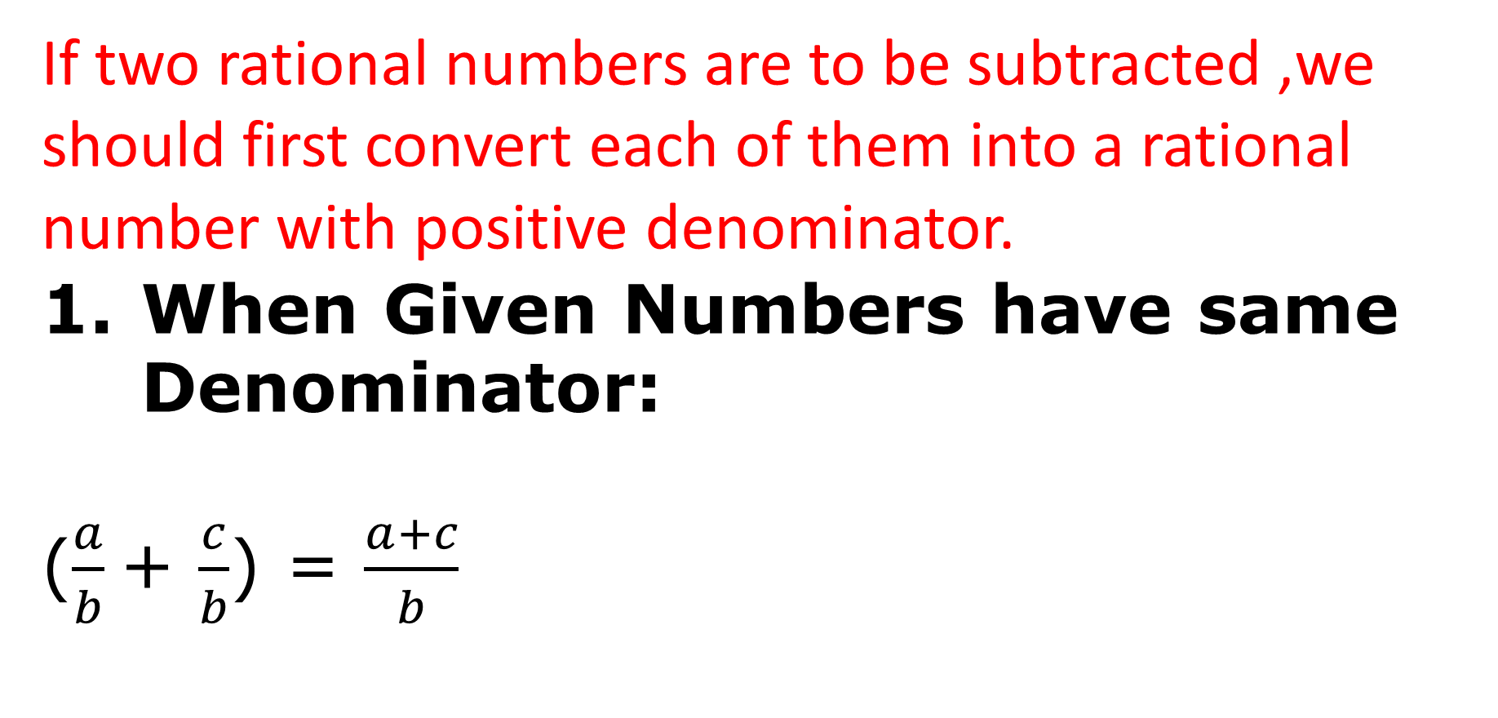
Subtraction of Rational Numbers:
If two rational numbers are to be subtracted ,we should first convert each of them into a rational number with positive denominator.
When Given Numbers have same Denominator:
($\frac{a}{b}$+ $\frac{c}{b}$) = $\frac{a+c}{b}$

Slide 14
Subtraction of Rational Number with Different Denominator:
Find the LCM of their denominators and express each of the given numbers with that same LCM as the common denominator.
while subtracting two rational numbers, we add the additive inverse of the rational number that is being subtracted, to the other rational number.

Slide 15

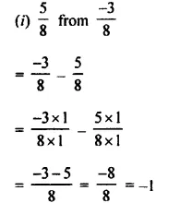
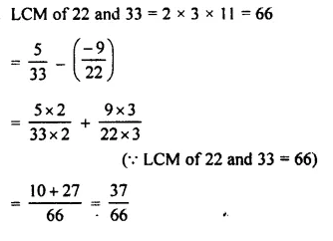

Worked out Examples :
Subtract $\frac{−4}{5}$from the sum of
$\frac{−3}{10}$and 1 .
Solution: ($\frac{−3}{10} +$ 1) − ($\frac{−4}{5} )$
= ($\frac{−3+10}{10}$) + $\frac{4}{5}$
= $\frac{7 }{10}$ + $\frac{4}{5}$= ($\frac{7+8}{10}$)
=$\frac{15}{10}$= $\frac{3}{2}$
2. Subtract :
(ii)

Slide 16



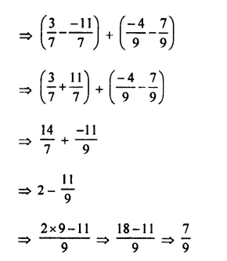
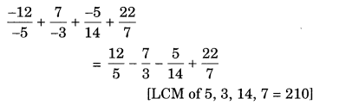
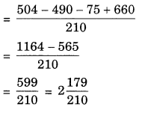
Evaluate :
Evaluate :
(ii)
Solution :
Solution :

Slide 17
𝓣𝓱𝓪𝓷𝓴 𝔂𝓸𝓾
𝓑. 𝓟𝓐𝓡𝓥𝓐𝓣𝓗𝓘 𝓓𝓔𝓥𝓘,
𝓐 𝓔 𝓒 𝓢 2
𝓗𝓨𝓓𝓔𝓡𝓐𝓑𝓐𝓓

