Slide 1
ATOMIC ENERGY EDUCATION SOCIETY
DISTANCE LEARNING PROGRAMME
CLASS :7
SUBJECT : MATHEMATICS
TOPIC : RATIONAL NUMBERS
MODULE : 3

Slide 2
LEARNING OBJECTIVES :
MULTIPLICATION OF A RATIONAL NUMBER BY A POSITIVE INTEGER
MULTIPLICATION OF INTEGERS ON NUMBER LINE
PRODUCT OF RATIONAL NUMBERS
RECIPROCAL OF A NON ZERO RATIONAL NUMBER.
DIVISION OF RATIONAL NUMBERS.
WORKED OUT EXAMPLES

Slide 3

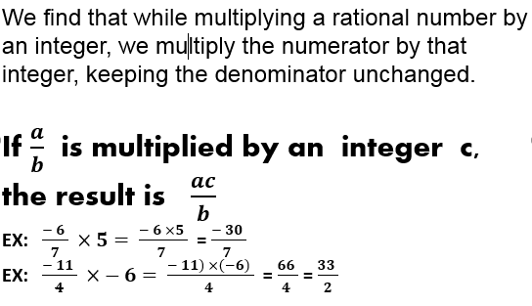

Slide 4
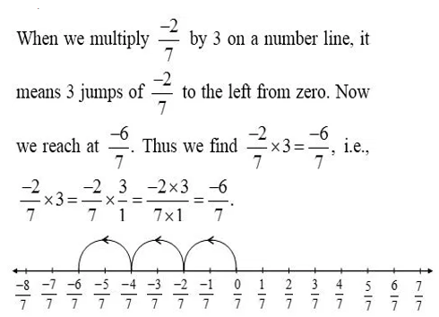

Multiplication of a rational number with a positive integer on number line.

Slide 5
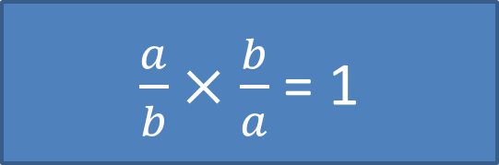

RECIPROCAL or MULTIPLICATIVE INVERSE
If $\frac{ a}{b } is a non zero rationa$l number , then $\frac{ b}{a }$ is said to be
the reciprocal of $\frac{ a}{b }$
$\frac{a}{b}×\frac{b}{a}$ = 1

Slide 6
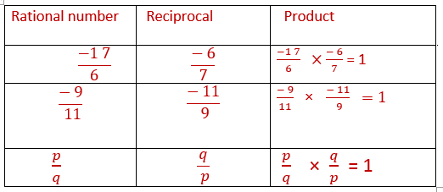
:Reciprocal of 1 is 1 and reciprocal of – 1 is -1
Reciprocal of positive Rational Number is Positive and Reciprocal of Negative Rational Number is Negative

Slide 7
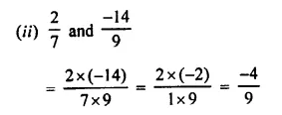
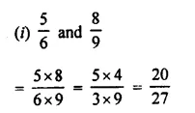
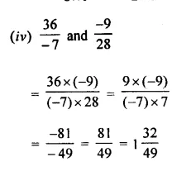
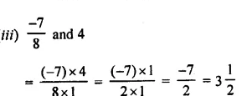
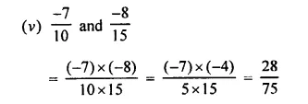
Find the product of the following rational numbers

Slide 8
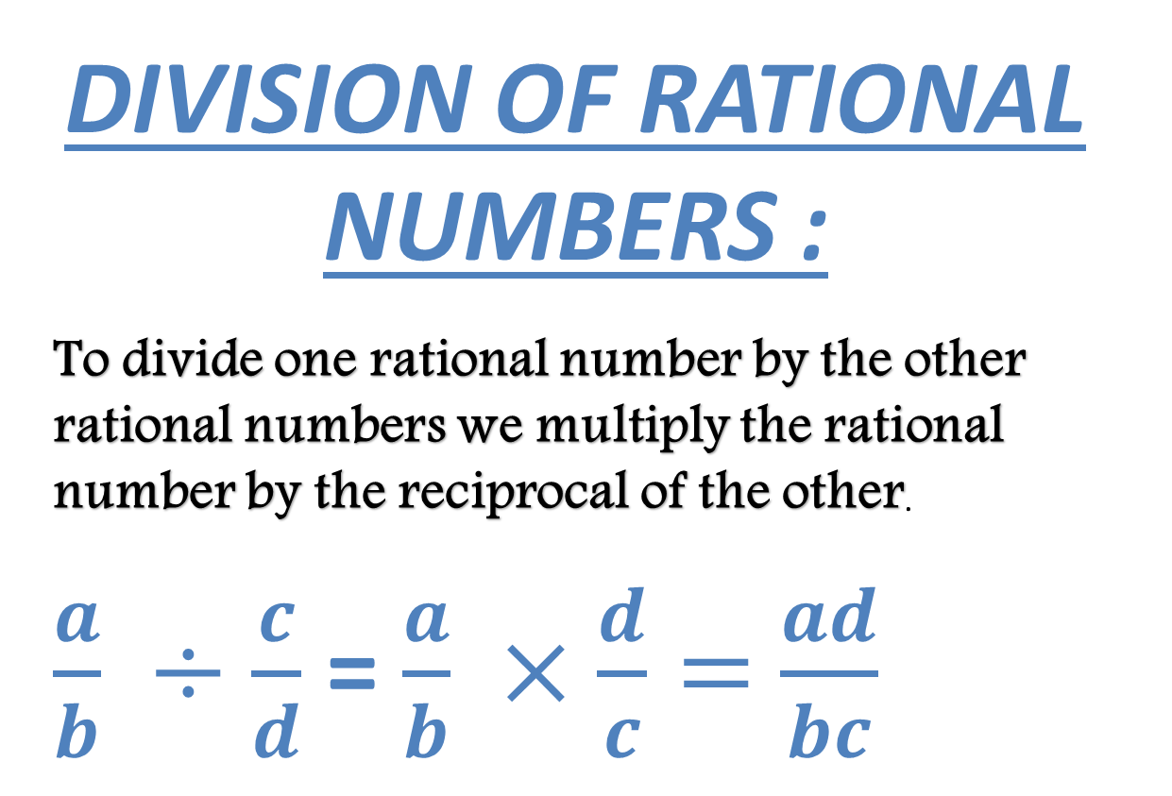
DIVISION OF RATIONAL NUMBERS :
To divide one rational number by the other rational numbers we multiply the rational number by the reciprocal of the other.
$\frac{a}{b} ÷\frac{c}{d}$ = $\frac{a}{b} ×\frac{d}{c}=$ $\frac{ad}{bc}$

Slide 9
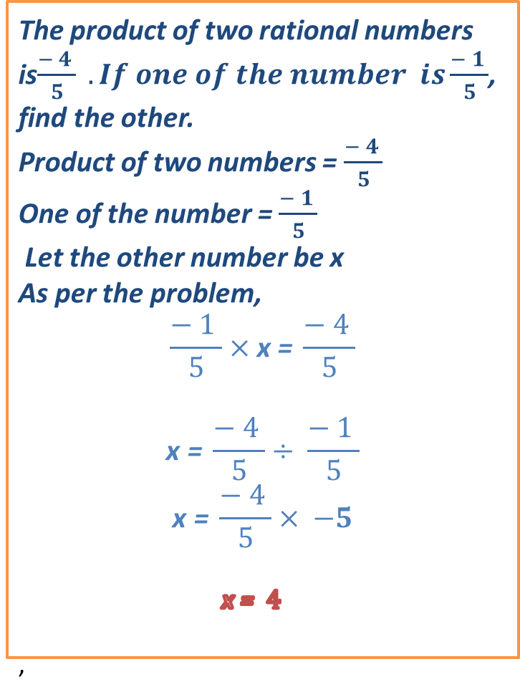
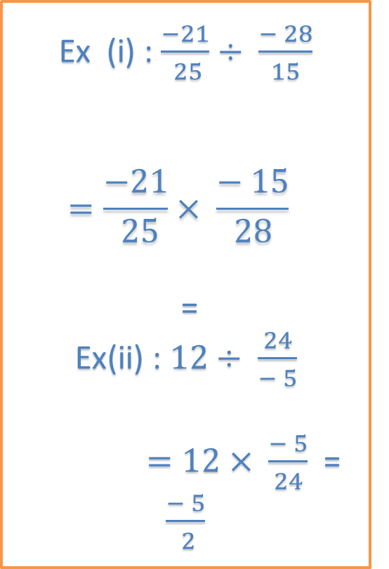
The product of two rational numbers is$\frac{− 4 }{5} . If one of the number is\frac{− 1 }{5}$,
find the other.
Product of two numbers = $\frac{− 4 }{5}$
One of the number = $\frac{− 1 }{5}$
Let the other number be x
As per the problem,
$$\frac{− 1 }{5}×\text{x}\text{ = }\frac{− 4 }{5}$$
$$\text{x}\text{ = }\frac{− 4 }{5}÷ \frac{− 1 }{5}$$
$$\text{x}\text{ = }\frac{− 4 }{5}× −5$$
$\text{x}\text{ = } 4$
,
Ex (i) : $\frac{−21}{ 25}÷ \frac{− 28}{15}$
$$=\frac{−21}{ 25}× \frac{− 15}{28}$$
=
Ex(ii) : $12÷ \frac{24}{− 5}$
$=12× \frac{− 5}{24}$ = $\frac{− 5}{ 2}$

Slide 10
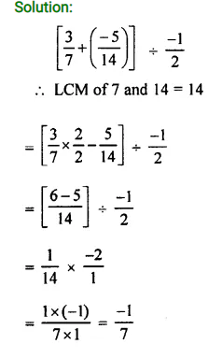

Divide the sum of $\frac{3}{7}$ and $\frac{− 5}{14}$ by $\frac{−1}{2}$

