Slide 1
TRANSPORTATION IN ANIMALS AND PLANTS
PREPARED BY : - MITA SAHA
TGT ( SS)
A.E.C.S. 1
JADUGUDA

Slide 2
TRANSPORTATION IN ANIMALS AND PLANTS
Transportation in animals and plants deals with the transport of food, water and gases to various parts of the body. Along with these , the transport of waste products towards kidney and intestine is introduced . This entire system of transportation is termed as a circulatory system.

Slide 3
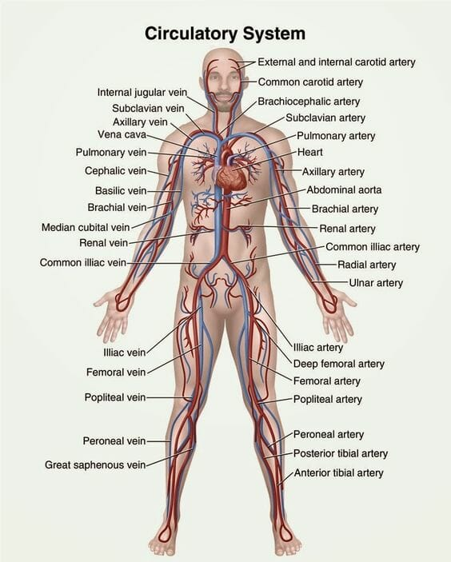
CIRCULATION IN HUMAN

Slide 4
BLOOD
Blood is a fluid connective tissue which flows in blood vessels
It has cells of various kinds called RBCs , WBCs and platelets.
The fluid part of the blood is called plasma .
RBC (Red blood cells)- contain a red pigment called haemoglobin
Heamoglobin bind with oxygen and transport it to all the parts of the body
The presence of heamoglobin makes blood appear red.
WBCs (White blood cells ) fight against germs that may enter our body.
Platelets helps in the clotting of blood.

Slide 5
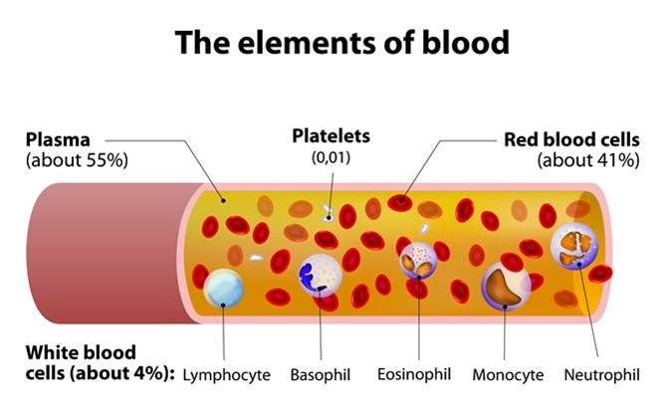

Slide 6
FUNCTION OF BLOOD
It transports substance like digested food from the small intestine to the other parts of the body
It carries oxygen from the lungs to the cells of the body
It also transports waste for removal from the body .

Slide 7
BLOOD CIRCULATORY SYSTEM
It comparises of heart and blood vessels ( arteries , veins and capillaries )
Arteries -It carries oxygen rich blood from the heart to all parts of the body
Veins - Veins are the vessels which carry carbon – di – oxide rich blood from all the parts of the body back to heart
Capillaries – Arteries divide into smaller vessels ,i.e arterioles . On reaching the tissues , they divide further into extremely thin tubes called capillaries .
The capillaries join up to form vennules and further joins to form veins which empty into the heart

Slide 8
PULSE
The throbbing sound due to the blood flowing in the arteries is called pulse
PULSE RATE
The number of beats per minute is called the pulse rate
A resting person , usually has a pulse rate between 72 and 80 beats per minute

Slide 9
HEART
The heart is a muscular organ which beats continuously to act as a pump for the transport of blood
The heart is located in the chest cavity with the lower tip slighty tilted towards the left
The heart has four chambers. The two upper chambers are called the atria (singular atrium ) and two lower chambers are called the ventricles. The partithion between the chambers helps to avoid mixing of blood rich in oxygen with the blood rich in carbon dioxide

Slide 10
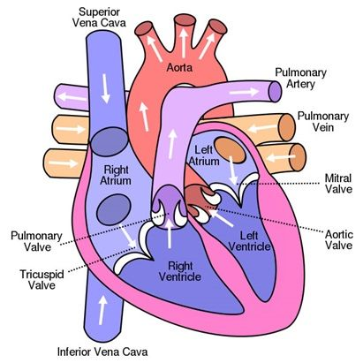
HUMAN HEART

Slide 11
The heart has four chambers. The two upper chambers are called the atria (singular atrium ) and two lower chambers are called the ventricles. The partithion between the chambers helps to avoid mixing of blood rich in oxygen with the blood rich in carbon dioxide

Slide 12
HEARTBEAT
The walls of the chambers of the heart are made up of muscles . These muscles contract and relax rhythmically. This rhythmic contraction followed by its relaxation constitute a heartbeat.

Slide 13
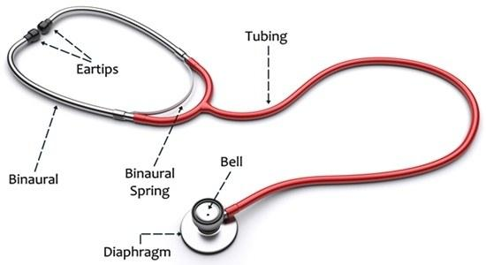
STETHOSCOPE

Slide 14
THANK YOU
HAVE A NICE DAY

