Slide 1
Class – VII
Subject - Science
Chapter -15 Light
Module-1/3
Prepared By Sh. Sunil Kumar Yadav T.G.T. (CHEM /BIO),
A.E.C.S. NO.2 , RAWATBHATA

Slide 2
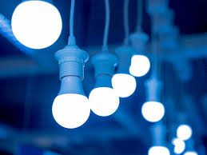
Light is something that makes all other things visible to us. We are able to see the things around us due to presence of light.

Slide 3

We experience that things which are clearly visible in daytime are not clearly during night because there is bright sunlight during daytime whereas light is dim in night.

Slide 4
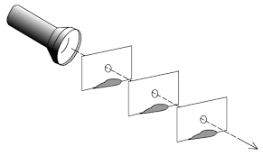
Light always travels along a straight path. Its path is never curved. Light does not bend.

Slide 5
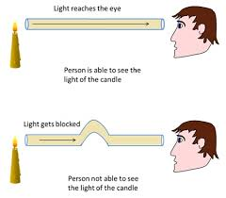

Slide 6
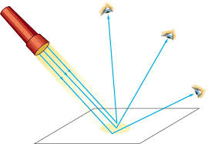
Reflection of Light :
When light falls on a mirror ,the direction of light changes . This change in the direction of light by a mirror is called reflection of light.

Slide 7
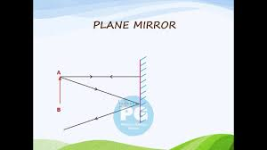
CHARACTERISTICS OF IMAGE FORMED BY A PLANE MIRROR
The image is formed behind the mirror.
The image is erect.
The image is of the same size as that of the object.
The image is virtual.
The image is at the same distance from the mirror as the object is in front of it.
The image is laterally inverted. i.e., right side of the object appears left in the image and vice-versa.

Slide 8
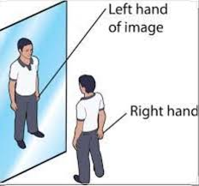
LATERAL INVERSION:
When we stand in front of a plane mirror and look at our image , our right hand appears left in the image whereas our left hand appears right in the image. The image is erect with respect to the object but sides are interchanged. This interchange of sides by a plane mirror is termed as LATERAL INVERSION.

Slide 9
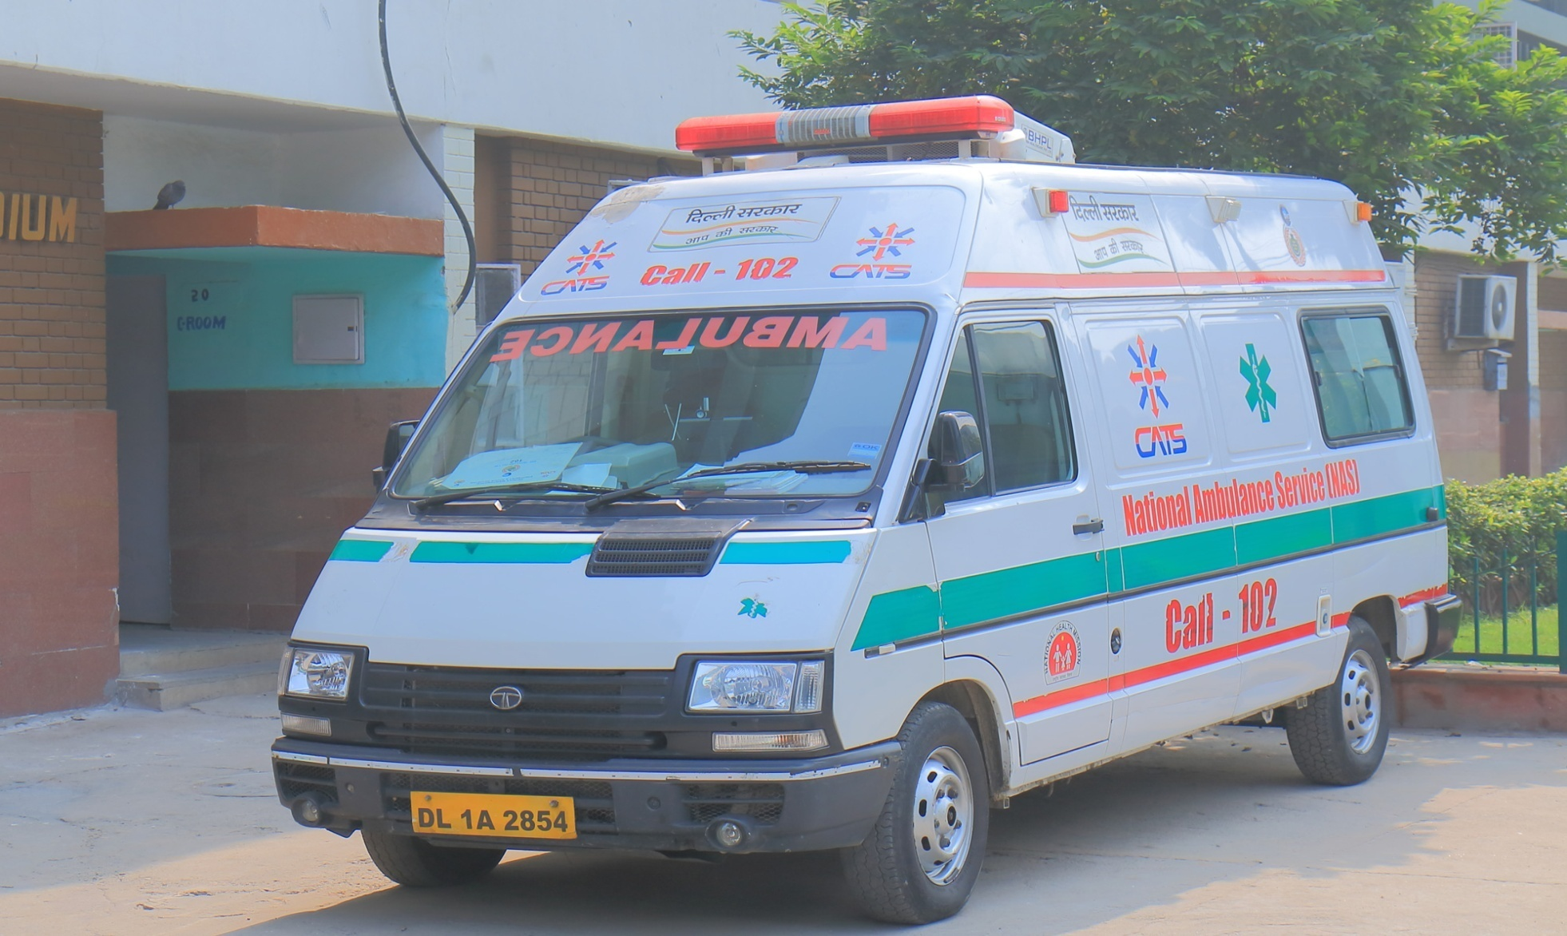
Now you recall how the word ‘AMBULANCE’is written on a vehicle that carries patients to hospital.This is written in such a manner that when the driver of a vehicle ahead of an ambulance looks in his rear view mirror, he can read ‘AMBULANCE’ written on it and give way to it.

Slide 10


