Slide 1
Class-VII
SUBJECT:SCIENCE
CHAPTER-15 LIGHT
MODULE-2/3
PREPARED BY:SUNIL KUMAR YADAV
T.G.T (CHEM/BIO)
A.E.C.S. NO.2 ,RAWATBHATA

Slide 2
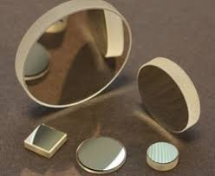
SPHERICAL MIRRORS
Spherical mirrors are curved mirrors.
Spherical mirrors are of two types depending upon the surface which acts as reflecting surface

Slide 3
Take a stainless steel spoon. Bring the outer side of the spoon near your face and look into it.
OBSERVATION: We see our image on the surface of spoon , but this image is different from that formed by a plane mirror. Similarly inner side of the spoon also acts as a mirror but the surfaces are curved .The outer and inner surface of the spoon act as two different types of mirrors.
Note: The inner surface of a spoon acts like a concave mirror , while its outer surface acts like a convex mirror.
ACTIVITY

Slide 4
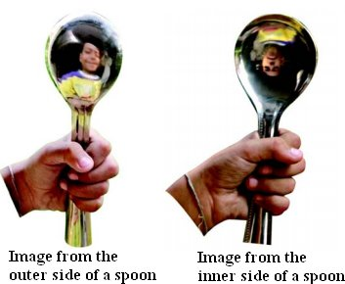
Concave mirror: If the reflecting surface of a spherical mirror is concave,it is called a concave mirror.For example the inner surface of a steel spoon acts like a concave mirror.
Convex mirror: If the reflecting surface of a spherical mirror is convex, then it is called a convex mirror. For example the outer surface of a steel spoon acts like a convex mirror.

Slide 5
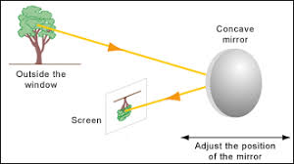
TYPE OF IMAGE FORMED BY CONCAVE MIRROR
The image formed by a concave mirror can be smaller , same size or larger than the object.
The image can be real or virtual .
The image can be erect or inverted

Slide 6
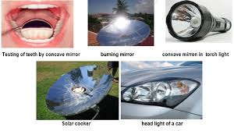
USES OF CONCAVE MIRROR
Doctors use concave mirrors for examining eyes , ears , nose and throat.
Dentists use concave mirrors to see enlarged image of teeth.
Concave mirrors are used as reflectors in torches , headlights of cars and scooters.

Slide 7
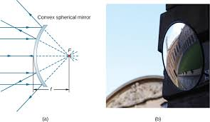
TYPE OF IMAGE FORMED BY CONVEX MIRROR
The image formed by a convex mirror is virtual.
The image is erect.
The convex mirror always forms image smaller than the object.

Slide 8
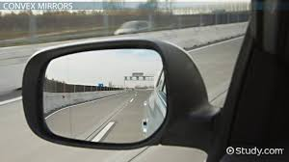
USES OF CONVEX MIRROR
Convex mirrors are used as side mirrors in cars and scooters.
Convex mirrors can form images of objects spread over a large area. So these mirrors help the drivers to see the traffic behind them

Slide 9


