Slide 1
Class-VII SUBJECT:SCIENCE CHAPTER-15 LIGHT MODULE-3/3
PREPARED BY:SUNIL KUMAR YADAV
T.G.T (CHEM/BIO)
A.E.C.S. NO.2 ,RAWATBHATA

Slide 2
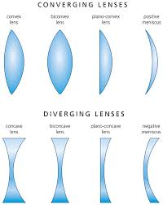
LENSES
Lenses are transparent and light can pass through them .
A magnifying glass which is used to read very small print or to observe the body parts of a cockroach or an earthworm. Magnifying lens is actually a type of lens.
Lenses are widely used in spectacles , telescopes and microscopes

Slide 3
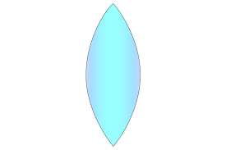
TYPES OF LENSES
CONVEX LENS : Those lenses which are thicker in the middle than at the edges are called convex lenses.
A convex lens converges (bends inward) the light that falls on it .Therefore it is called a converging lens.
A magnifying lens is a convex lens
CONCAVE LENS :Those lenses which are thinner at the middle than at the edges are called concave lenses.
A concave lens diverges (bends outwards) the light that falls on it. Therefore it is called diverging lens.

Slide 4
IMAGES FORMED BY LENSES
A convex lens forms an image that is :
The image formed by a convex lens may be smaller or larger than the object.
The image may be real (can be obtained on a screen) or virtual (cannot be obtained on a screen).
The image may be erect or inverted.
A concave lens forms an image that is :
Virtual (cannot be obtained on a screen ).
Erect
Small in size as compared to the size of object and appears far away from the lens.

Slide 5
USES OF LENSES
Convex lens is used as a magnifying lens to see tiny objects.
Lenses are used in spectacles .
Lenses are used in microscopes.

Slide 6
SUNLIGHT – WHITE OR COLOURED ?
ACTIVITY TO SHOW THAT SUNLIGHT CONSISTS OF SEVEN COLOURS
Take a glass prism . Allow a narrow beam of sunlight through a small hole in the window of a dark room to fall on one face of the prism. Let the light coming out of the other face of the prism fall on a white sheet of paper or on a white wall.
OBSERVATION : It is observed that light coming out of the other face of the prism consists of seven colours similar to those seen in a rainbow. This shows that the sunlight consists of seven colours. The sunlight is said to be white light. This means that the white light consists of seven colours.
DISPERSION OF LIGHT: The process of splitting white light into seven colours on passing through a prism is called dispersion of light and the pattern of seven distinct colours obtained on a screen is called spectrum.

Slide 7
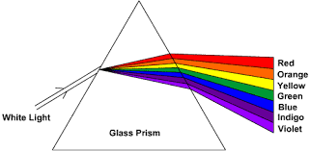
DISPERSION OF LIGHT THROUGH A PRISM

Slide 8
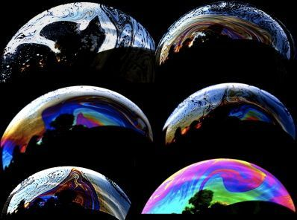
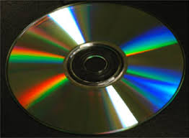
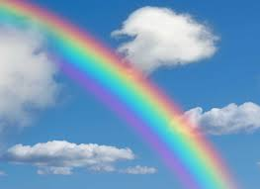
SOAP BUBBLES
COMPACT DISC
RAINBOW

Slide 9
NEWTON’S DISC
Take a circular cardboard disc and divide it into seven segments. Paint the seven colours as found in a rainbow. Make a small hole at the centre of the disc . Fix the disc loosely on the top of a refill of a ball pen . Now rotate the disc in the daylight. When the disc is rotated fast , the colours painted on the disc get mixed together and the disc appears to be whitish. Such a disc is popularly known as Newton’ s disc.

