Slide 1
ADVERBS
Adverbs are one of the four major word classes, along with nouns, verbs and adjectives. We use adverbs to add more information about a verb, an adjective, another adverb, a clause or a whole sentence and, less commonly, about a noun phrase.

Slide 2
adverbs
An adverb is a word/a set of words that modifies verbs, adjectives, and other adverbs.
It tells when, where, and how an action is performed or indicates the quality or degree of the action.
Many adverbs end in -ly but some words which end in -ly (such as friendly) are not adverbs.
Many words can be both adverbs and adjectives according to their activity in the sentence.

Slide 4
Use of adverbs
1. to modify verbs
The handball team played badly last Saturday.
2. to modify adjectives
It was an extremely bad match.
3. to modify adverbs
The handball team played extremely badly last Wednesday.
4. to modify quantities
There are quite a lot of people here.
5. to modify sentences
Unfortunately, the flight to Dallas had been cancelled.

Slide 5
Placement of Adverbs
Place adverbs as close as possible to the words they are supposed to modify. Putting the adverb in the wrong spot can produce an awkward sentence at best and completely change the meaning at worst. Be especially careful about the word only, which is one of the most often misplaced modifiers. Consider the difference between these two sentences:
Phillip only fed the cat.
Phillip fed only the cat.
The first sentence means that all Phillip did was feed the cat. He didn’t pet the cat or pick it up or anything else. The second sentence means that Phillip fed the cat, but he didn’t feed the dog, the bird, or anyone else who might have been around.

Slide 7
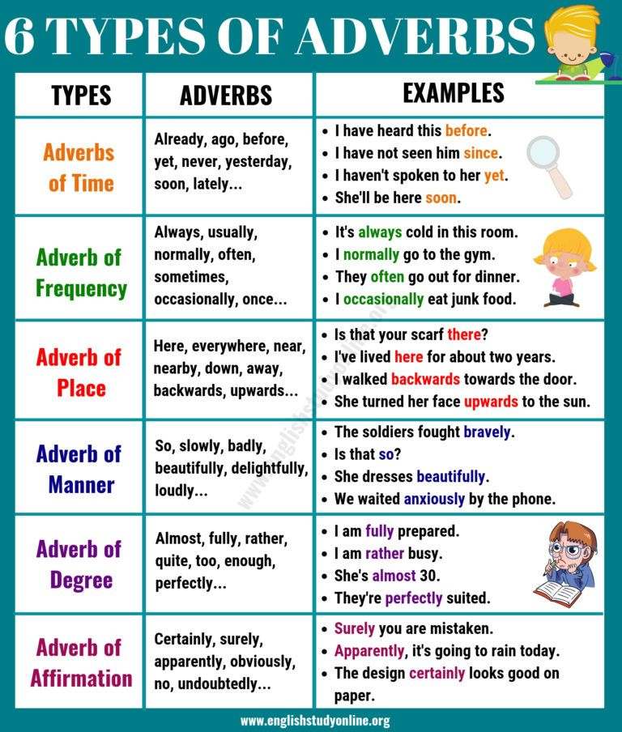

Slide 8
EXERCISE
Identify the adverb in each of the following sentences.
(i) They spoke loudly.
(ii) I am highly impressed with her presentation.
(iii) She looked quite nervous.
(iv) Radha works diligently in order to get promoted.
(v) Fox is often believed to be cunning animal.
(vi) Barking dogs seldom bite.
(vii) Earlier, they used to travel in their car.
(viii) The birds were chirping merrily.
(ix) I sometimes go for a walk in the park.
(x) He never came to my place to visit me.

Slide 9
Thank you
P CHRISTY NIRMALA
AECS 2, KALPAKKAM

