Slide 1
Atomic Energy Central School-2, Mumbai Subject- Hindi Topic- संसार पुस्तक है Lesson no: 12 Module- 1/1 Madhu Sharma TGT (SS) Author- Jawaharlal Nehru
PPT

Slide 2
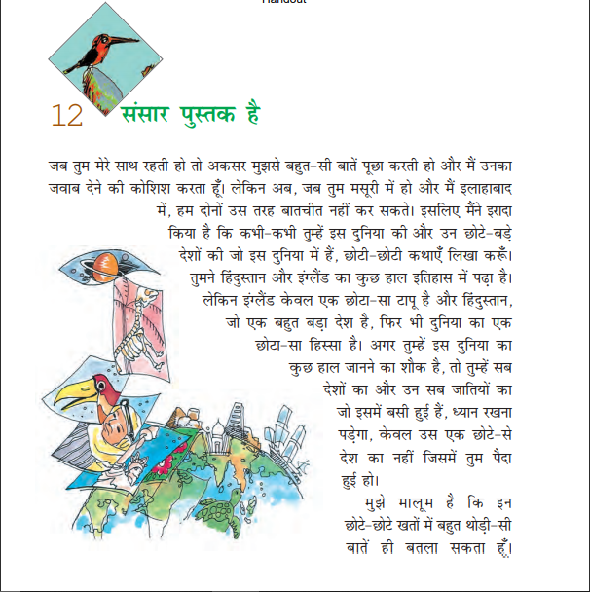

Slide 3
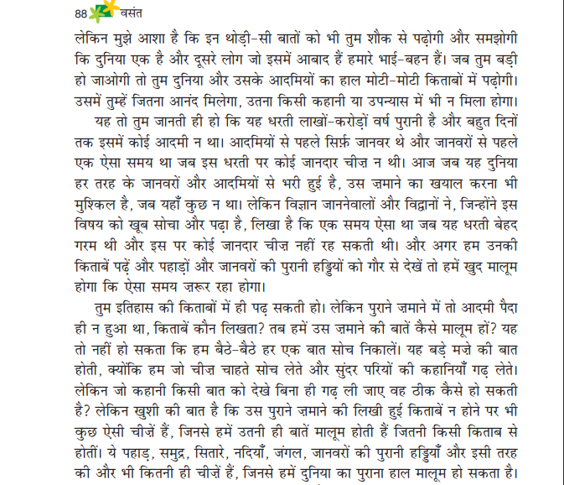

Slide 4
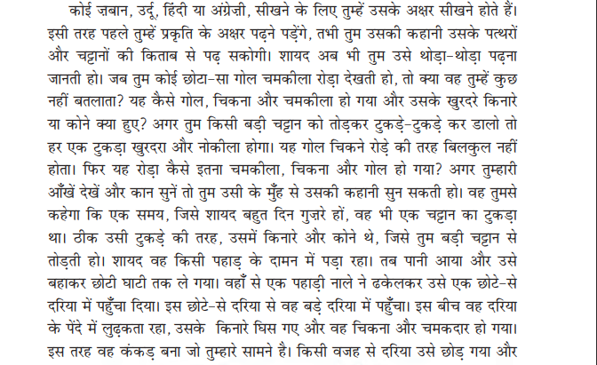

Slide 5
