Slide 1
Atomic Energy Central School-2, Mumbai Subject- Hindi Topic- मैं सबसे छोटी होऊँ Lesson no: 13 Module- 1/1 Madhu Sharma TGT (SS) Author- Sumitranandan Pant
PPT

Slide 2
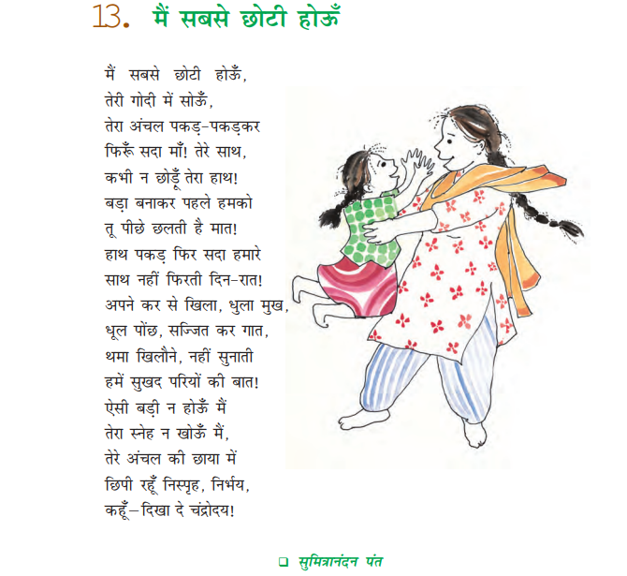

Slide 3
