Slide 1
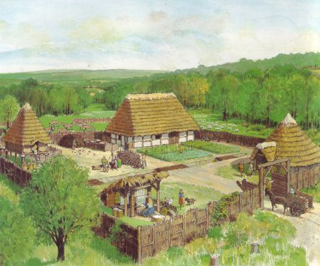
CLASS VI HISTORY
Name of the chapter
VITAL VILLAGES
THRIVING TOWNS
MODULE 1/2

Slide 2
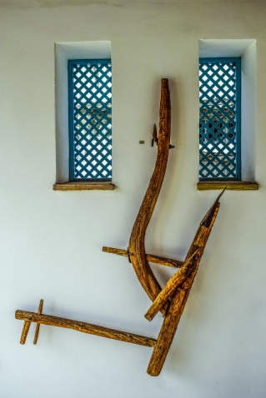
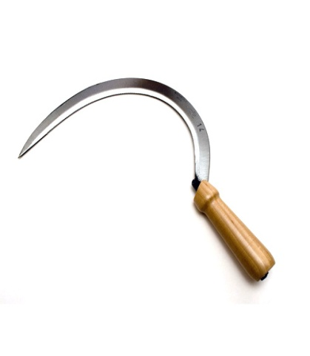
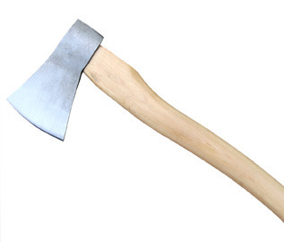
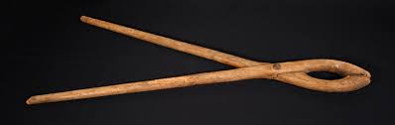
IRON TOOLS AND THEIR USES
PLOUGH SHARES: Used for ground breaking and digging deeper into the earth
SICKLE: Used for harvesting
TONGS: Used for holding
AXE: Used for cutting trees
PLOUGH SHARE
SICKLE
TONGS
AXE

Slide 3
KEY TERMS AND DEFINITIONS
VELLALARS: -> Large land owners
UZHAVAR : -> Ordinary people
JATAKA TALES : -> Narratives preserved by Buddhist monks
KADAISIYAR ADIMAI: -> Slaves and landless labourers
GRAMA BHOJAKS: -> Hereditary village headman- acted as judge/policeman
GRIHAPATI: -> Small land owners
SANGAM LITERATURE: -> Earliest works in Tamil

Slide 4
CLASS VI HISTORY
VITAL VILLAGES
THRIVING TOWNS
MODULE 1/2

Slide 5
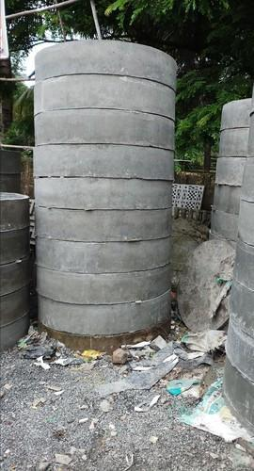
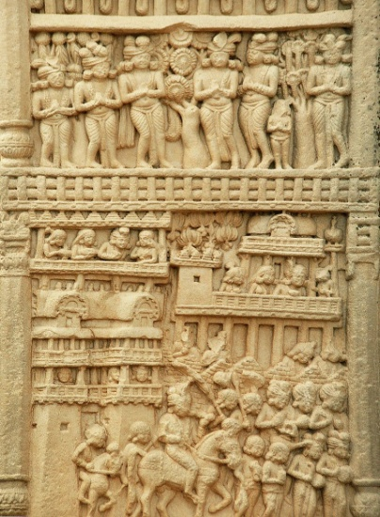
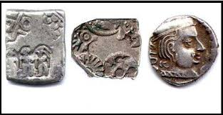
TERMS AND EXPLANATIONS
RINGWELLS: Rows of ceramic rings arranged one on top of the other
SCULPTURE: Carved scenes depicting towns, villages, pillars, gateways and buildings visited by people
PUNCH MARKED COINS: Designs punched on metals
PUNCH MARKED COINS
RINGWELLS
SCULPTURES IN SANCHI TEMPLE

