Slide 1
CLASS VI HISTORY Name of the chapter VITAL VILLAGES THRIVING TOWNS
MODULE 2/2

Slide 2
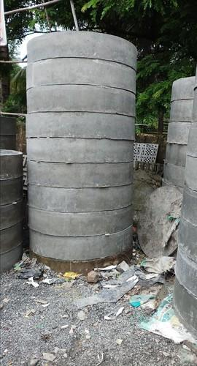
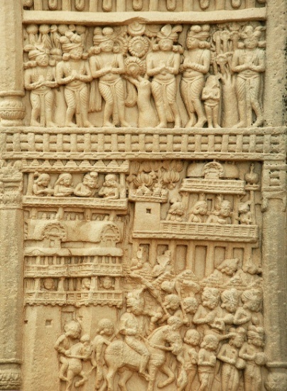
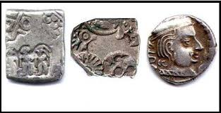
TERMS AND EXPLANATIONS
RINGWELLS: Rows of ceramic rings arranged one on top of the other
SCULPTURE: Carved scenes depicting towns, villages, pillars, gateways and buildings visited by people
PUNCH MARKED COINS: Designs punched on metals
PUNCH MARKED COINS
RINGWELLS
SCULPTURES IN SANCHI TEMPLE

Slide 3
IMPORTANT PLACES

Slide 4
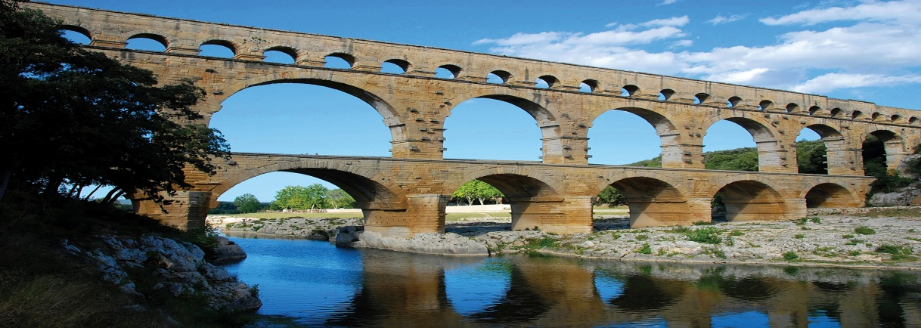
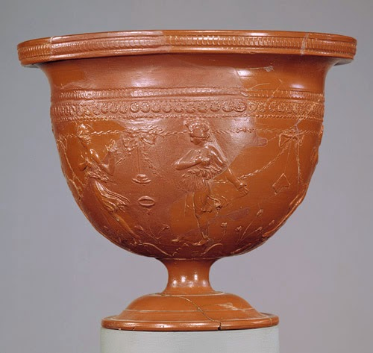
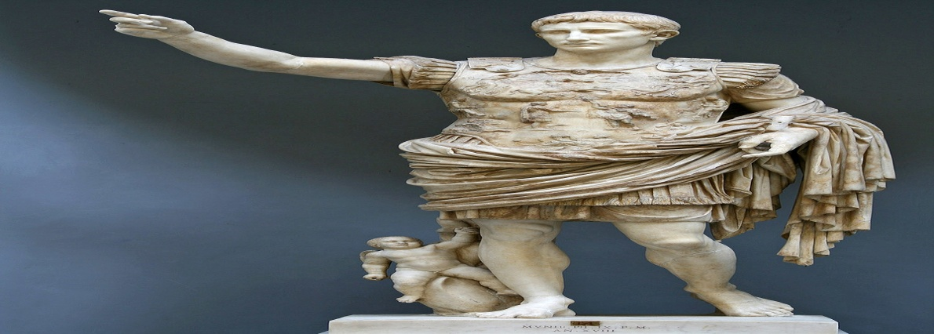
IMAGES
AMPHITHEATRE
AQUDUCT
ARRETINE WARE
AUGUSTUS CESAR

