Slide 1
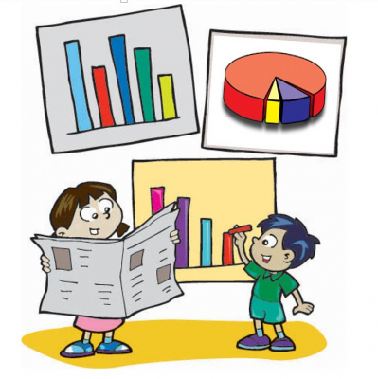
Class VI – Mathematics Chapter – 9 Data Handling
Module 1 of 3
Prepared by
Sumithra Madathil
TGT(Maths/Physics)
A E C S – 2 , Mumbai

Slide 2
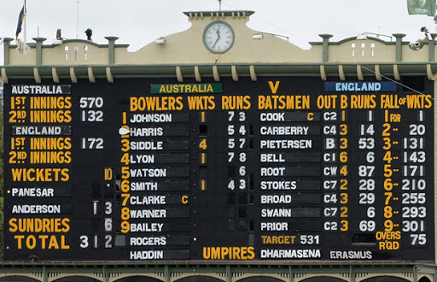
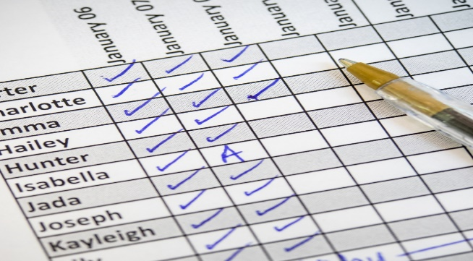
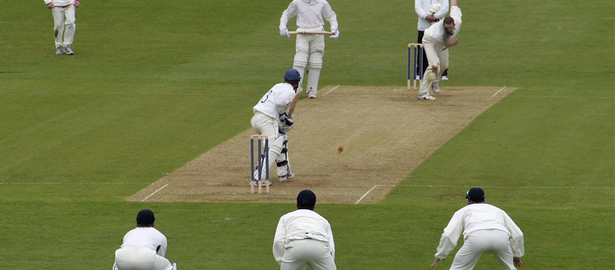
Teacher taking attendance
Score Board

Slide 3
.
In our day to day life, we have seen several kinds of tables consisting of numbers, figures, names etc. These tables provide “DATA”

Slide 4
DATA
A data is a collection of numbers gathered to give some information.
Examples-
Marks of students of a class
Heights of girls and boys in a class
Number of bicycles sold in different years by company
Number of students liking various games, food, books…….

Slide 5
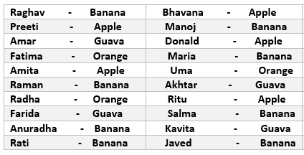
Recording Data
Example
A class is preparing to go for a picnic. Choice of fruits of 20 students of the class is noted for distribution during the picnic

Slide 6
.
To record the number of fruits required to be taken for the picnic the monitor of the class made four squares on the floor
Every square is kept for fruit of one kind only.
She asks the students to put one pebble in the square which matches their choices. i.e. a student opting for banana will put a pebble in the square marked for banana and so on
By counting the pebbles in each square, she can quickly tell the number of each kind of fruit required.
She can get the required information quickly by systematically placing the pebbles in different squares

Slide 7
.

Slide 8
.
This is one way of recording the data.
But if there are more number of students then the recording of data will become tedious.
So we need to organise the data systematically and efficiently .

Slide 9
Organisation Of Data
To get the same information of the fruits preferred by students going for picnic, let us prepare the following table
Banana | √ √ √ √ √ √ √ √ | 8
Orange | √ √ √ | 3
Apple | √ √ √ √ √ | 5
Guava | √ √ √ √ | 4

Slide 10
.
We get more information from this method of organizing the data like…..
What does one (√) indicate?
The number of students preferring each type of fruit.
How many students were there in the class?
Which fruit is the most preferred one? Or the least preferred?
……..

Slide 11
.
Instead of these (√) we can use tally marks
To get a particular information from the given data quickly, the data can be arranged in a tabular form using tally marks.

Slide 12
.
Let us learn how to use of tally marks.
When the observations are large, it may not be easy to find the numbers by simply counting, so we make the use of tally marks.
Tally marks are usually marked in bunches of five.
The first four tallies are marked vertically.
The fifth tally in a bunch is marked diagonally across the earlier 4 i.e.,

Slide 13
Tally marks

Slide 14
.
Ekta is asked to collect data for size of shoes of students in her Class VI. Her finding are recorded in the manner shown below
From the table how do we get the following information:
The size of shoes worn by the maximum number of students
The size of shoes worn by the maximum number of students
The total number of students in the class
How many students are there with shoe size 4? …………..

Slide 15
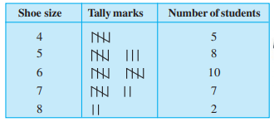
.
These information could be easily obtained by preparing a table using tally marks

Slide 16
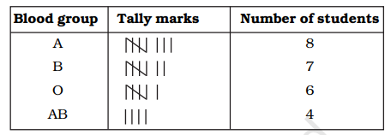
Practice Time ….
1. The blood groups of 25 students are recorded as under:
A, B, O, A, AB, O, A, O, B, A, O, B, A, AB, AB, A, A, B, B, O, B, AB, O, A, B.
Arrange the information in a table using tally marks

Slide 17
What have we discussed ?
Meaning of the word DATA.
The need for recording the data
How to organize data using tally marks..
^*^*^*^*^*^*

Slide 18
.
End of Module 1 of 3

