Slide 1
Class VI – Mathematics Chapter – 9 Data Handling
Module 2 of 3
Prepared by
Sumithra Madathil
TGT(Maths/Physics)
A E C S – 2 , Mumbai

Slide 2
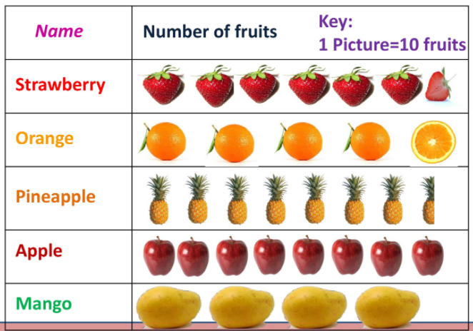
Let us observe and understand picture representation of data in order to answer the question on data at a glance

Slide 3
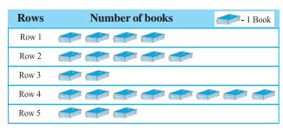
Let us consider an example: A cupboard has five compartments. In each compartment a row of books is arranged.
Which row has the greatest number of books? Which row has the least number of books? Is there any row which does not have any books?
How many books are there in the cupboard?
We can answer these questions by just studying the diagram.

Slide 4
The picture visually helps you to understand the data.
It is a pictograph.

Slide 5
.
PICTOGRAPH

Slide 6
.
A pictograph represents data through pictures of objects. It helps answer the questions on the data at a glance

Slide 7
.
Pictographs are often used by dailies and magazines to attract readers attention.
It requires some practice to understand the information given by a pictograph.

Slide 8
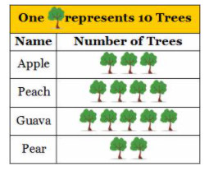
Interpretation of pictograph
The pictograph shows the number of different fruit trees in a farm.
How many guava trees are there in the farm?
Which fruit tree is least in number?
How many trees are there in all in the farm?
.

Slide 9
.
A pictograph represents data in the form of pictures, objects or parts of objects.
We can also interpret a pictograph and answer the related questions.
Different types of information can be obtained from a pictograph

Slide 10
.
Drawing a Pictograph.
Pictographs can be drawn using symbols to represent a certain number of items or things.
For example :
=500 cars
= 25 boys

Slide 11
.
Sometimes, a symbol may represent multiple units and may be difficult to draw.
Instead of it we can use simpler symbols.
If represents say 4 students, how will you represent, say, 3 or 2 students? We can solve such a situation by making an assumption that represents 3 students, represents 2 students, represents 1 student and then start the task of representation.

Slide 12
Let us draw a pictograph for the following data. Arun records the number of oranges his hotel purchases every week for four weeks. The data is as shown below
Solution:
Week | 1 | 2 | 3 | 4
No. of oranges | 150 | 175 | 200 | 225
Week | No. of Oranges = 50 oranges
1
2
3
4

Slide 13
Practice Time ….
1. The pictograph shows the number of bouquets sold by a flower shop in the past 4 days.
What is the difference between the greatest number of bouquets sold and the least number of bouquets sold?
Day | No. of bouquets = 3 bouquets
Monday
Tuesday
Wednesday
Thursday

Slide 14
What have we discussed ?
What is a Pictograph?
Interpretation of a pictograph.
Drawing a Pictograph.
^*^*^*^*^*^*

Slide 15
.
End of Module 2 of 3

