Slide 1
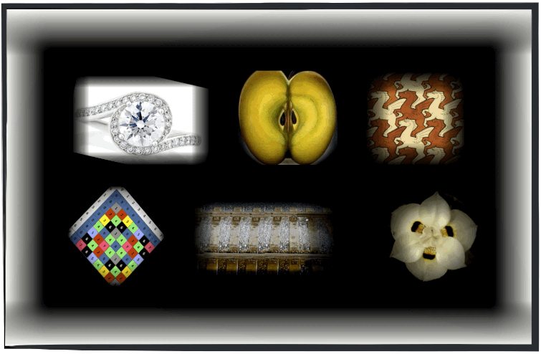
CLASS VI CHAPTER 13
SYMMETRY
MODULE 2
CLASS VI
CHAPTER 13
-
SYMMETRY
MODULE 2
PREPARED BY
Mrs. Saumia Nair
AECS-6,Mumbai
PREPARED BY
Mrs. Saumia Nair
AECS-6,Mumbai

Slide 2
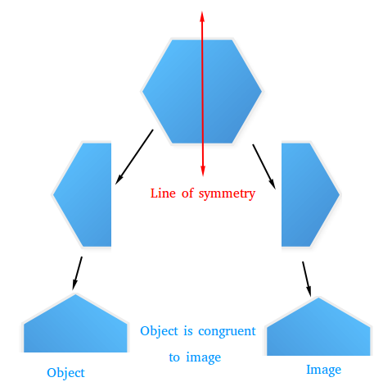
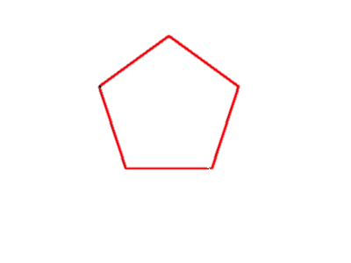
LINES OF SYMMETRY
LINES THAT DIVIDE A FIGURE INTO TWO IDENTICAL HALVES.
not a line of symmetry

Slide 3
LINES OF SYMMETRY CAN BE
HORIZONTAL
VERTICAL
DIAGONAL

Slide 4
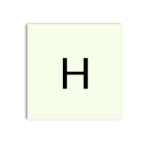
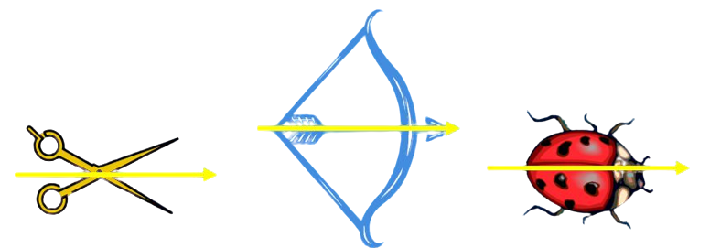
Horizontal line of symmetry
The following objects possess a horizontal line of symmetry.
Go Back

Slide 5
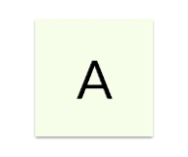
Vertical line of symmetry
The following objects possess a vertical line of symmetry
Go Back

Slide 6
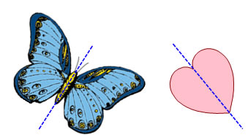
Diagonal line of symmetry
The following objects possess a diagonal line of symmetry.

Slide 7
A FIGURE MAY HAVE MORE THAN ONE LINES OF SYMMETRY.

Slide 9
Lines of symmetry in the alphabet!

Slide 10
Thank you!

