Slide 1
Class VI
CHAPTER 13
SYMMETRY MODULE 3
Prepared by
Mrs. Saumia Nair
AECS-6,Mumbai

Slide 2
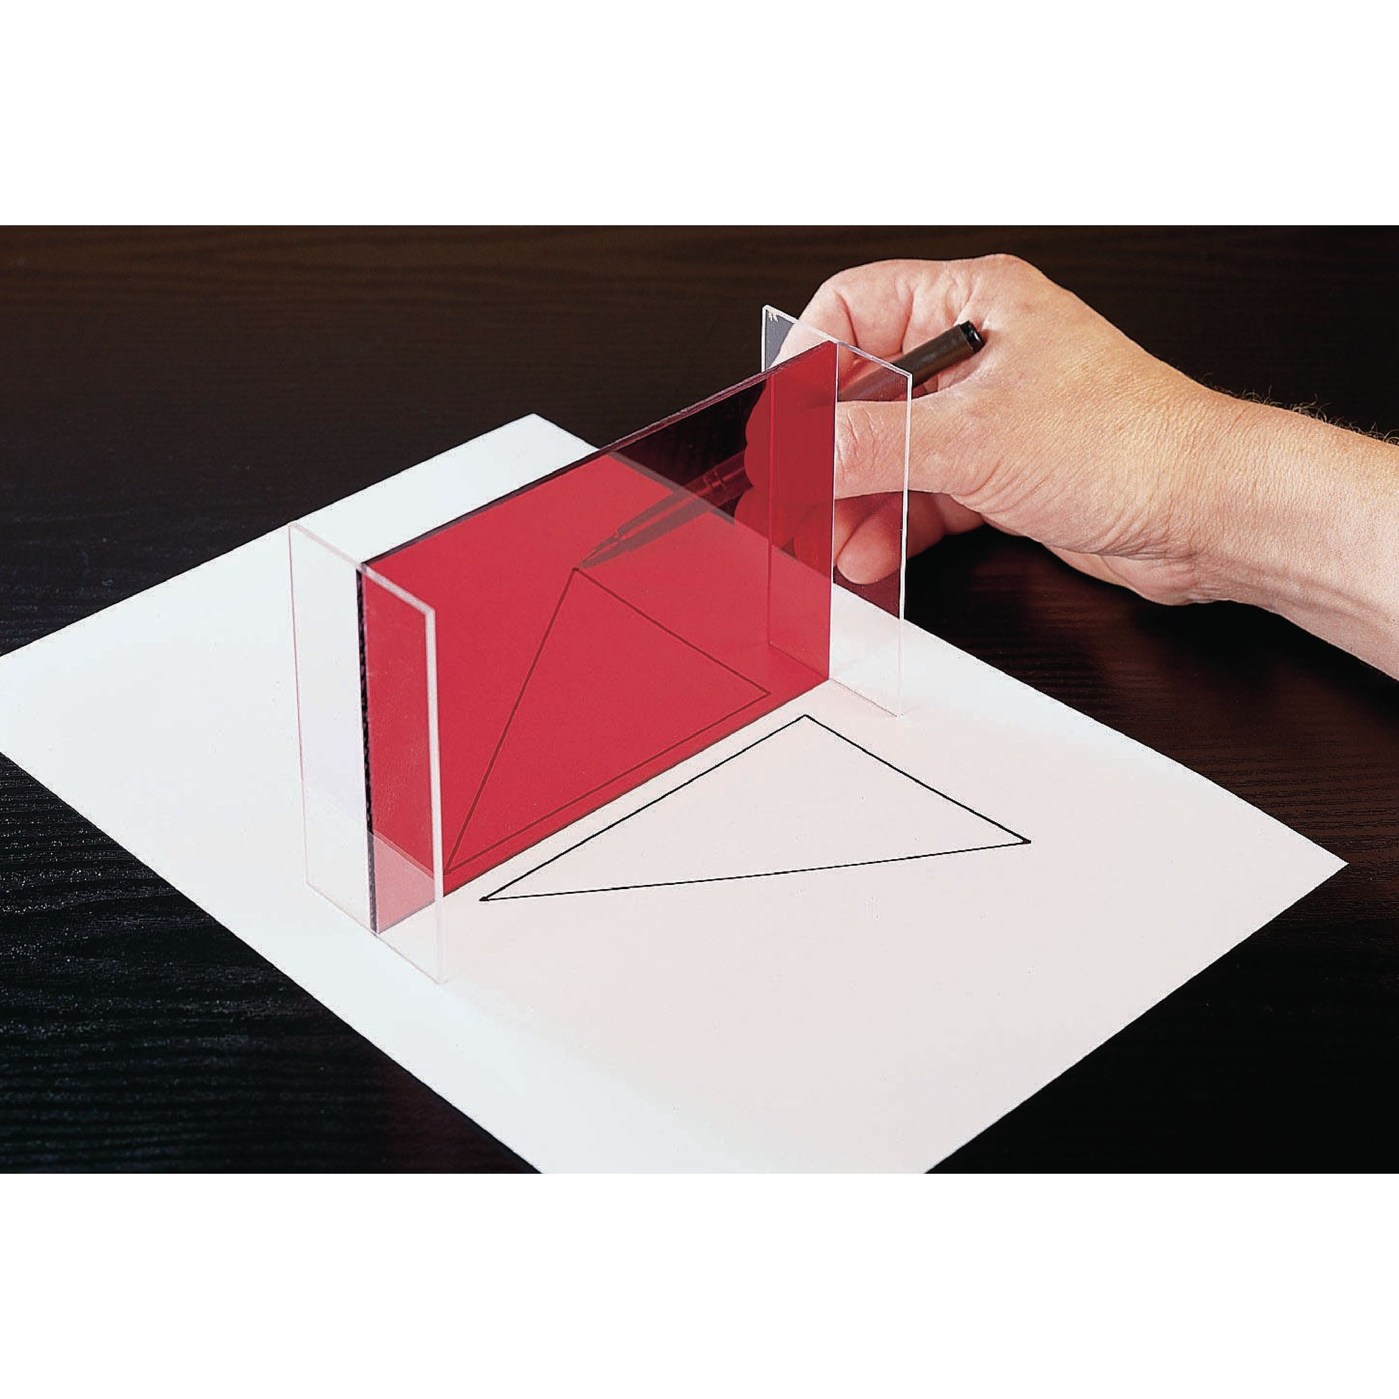
REFLECTION AND SYMMETRY
The reflection of an object is its image as seen in a mirror.
The reflection of an object is always symmetric to it.
The distance between the object from the mirror is equal to
the distance of its image from the mirror.
When an object is reflected, there is no change in the
lengths and angles.
However the left and right sides of the object appear
reversed in the image.
This type of symmetry is called reflectional symmetry.

Slide 3
Applications of reflectional symmetry
Paper decoration
Kaleidoscope
Rangoli

Slide 4
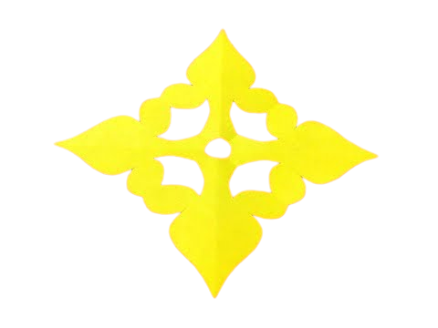
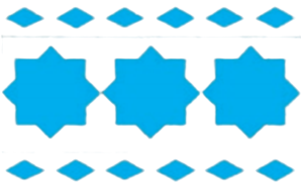
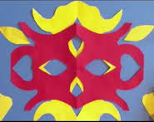
Paper decoration You could make several symmetrical designs out of paper and use them as decorative items. The idea is to fold a piece of paper into equal parts, cut out a design and open it up to get a symmetrical pattern.
Go back

Slide 5
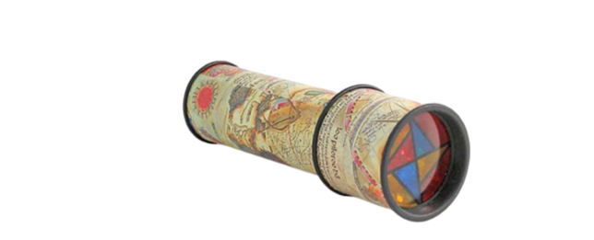
Kaleidoscope An instrument that uses mirrors to produce images that have several lines of symmetry. The angle between the mirrors determines the number of lines of symmetry.
Go forward

Slide 6
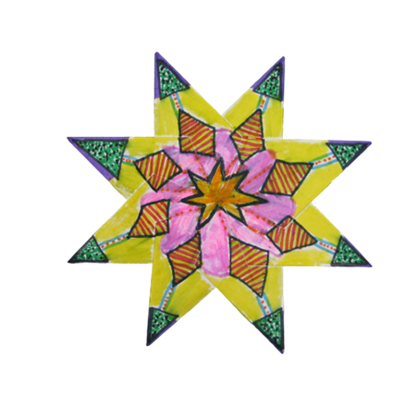
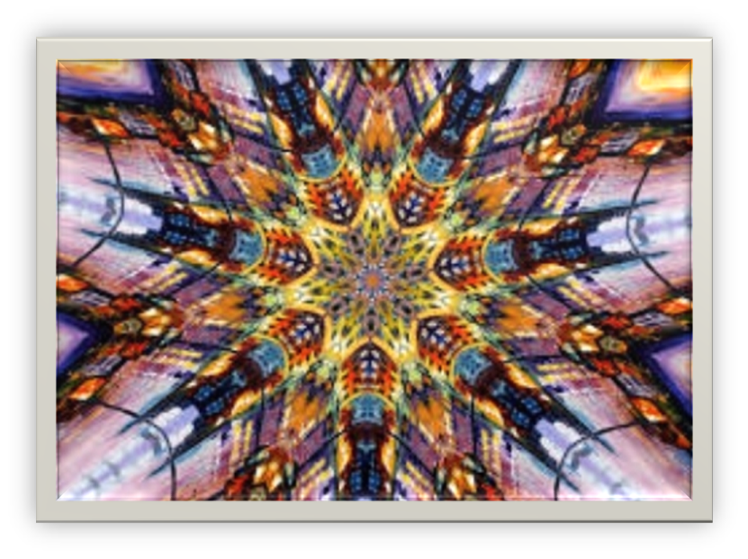
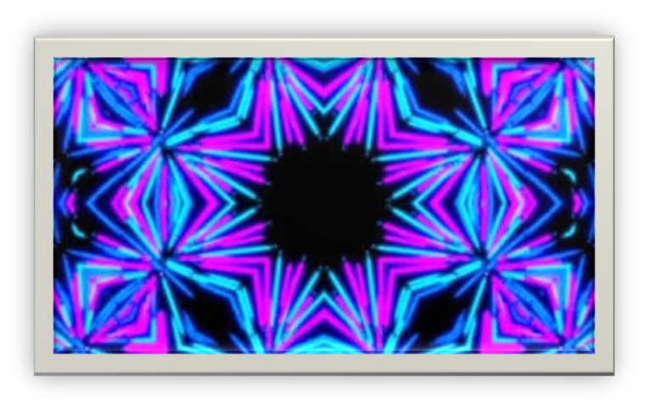
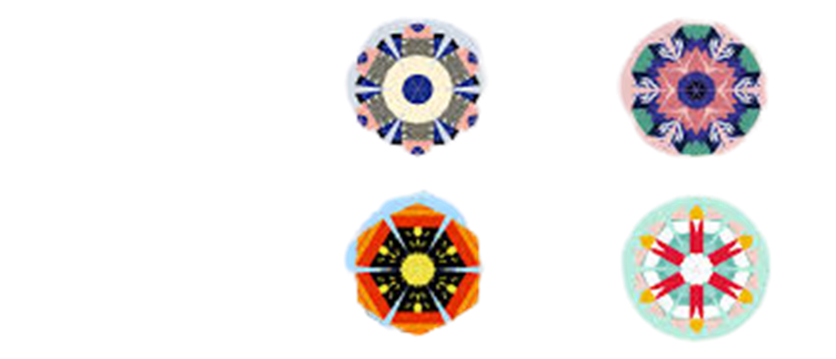
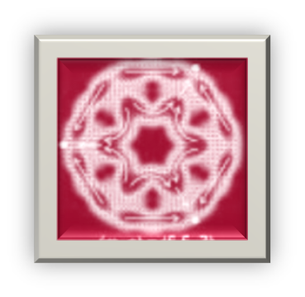
A SNEAK PEEK INTO A KALEIDOSCOPE
Go back

Slide 7
Rangoli PATTERNS Symmetrical designs form a part of several rangoli patterns too!!!

Slide 8
Thank you!

