Slide 1
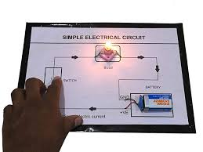
Chapter 12 ELECTRICITY AND CIRCUITS
MODULE 1of 2
BY
M.VARALAKSHMI
TGT
AECS , ANUPURAM

Slide 2
WHAT IS ELECTRICITY?
Advantages of Electricity:
Light in our houses, offices,
roads e t c even past sunset .
To operate pumps which in
turn have a lot of
applications.
Electrical appliances like
refrigerator, fans etc.
Building houses, installing
equipment etc.
A SOURCE OF ENERGY WITH
WHICH IT IS POSSIBLE TO
LIGHT OUR HOMES,
RUN FACTORIES,OFFICES
CONDUCT ONLINE
CLASSES etc.

Slide 3
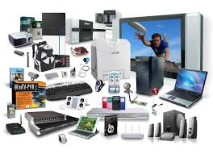
APPLIANCES USED IN DAILY LIFE

Slide 5
Electric Cell
Features of an Electric Cell:
It is a small cylindrical structure which helps
in operating the devices.
A small metal cap is placed on one side and a
metal disc is present on the other side.
All cells have two terminals:
Positive and Negative.

Slide 6
The metal cap and metal disc are
positive (+) and negative( - )terminals
of the electric cell respectively.
Chemical energy is converted into
electrical energy inside a cell.
. When the chemicals are exhausted,
the cell stops working.

Slide 7
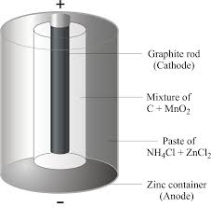
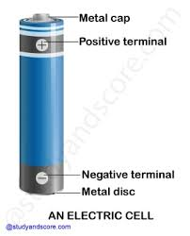
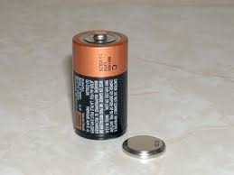
ELECTRIC CELL

Slide 8
Electric Bulb
Features of an Electric Bulb:
The outer covering is glass and the
base is metallic.
The part of the bulb which glows is
called Filament and is made
up of Tungsten.
The filament is attached to two wires.
One of the wires is connected to the
metal case at the base and the other
wires connected to the metal
wire at the centre of the base.
Base of the bulb and metal tip
are the terminals of the bulb and
they do not touch each other.

Slide 9
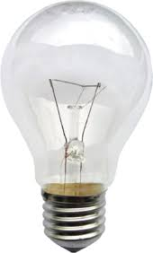
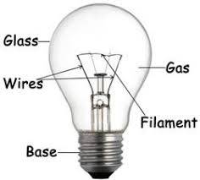
An electric bulb

Slide 10
A light bulb produces light from electricity.
In addition to lighting a dark space, they can be used to show
an electronic device is on, to direct traffic, for heat, and for
many other purposes. Early people used candles and oil lamps
for light.

Slide 11
A SIMPLE CIRCUIT
In a closed circuit ,the
electric current passes
from one terminal of
the electric cell to the
other terminal.
A bulb indicates the flow
of electric current.
The switch is used to control
the current flow.

Slide 12
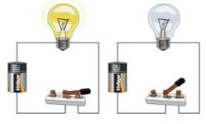
WHY IS THE BULB GLOWING IN THE FIRST PICTURE AND NOT IN THE SECOND?

Slide 13
ASSIGNMENT LIST SOME REASONS FOR A BULB NOT GLOWING IN A COMPLETED ELECTRIC CIRCUIT?

Slide 14
END OF MODULE ONE

