Slide 1
ATOMIC ENERGY EDUCATION SOCIETY
SUBJECT – GEOGRAPHY
STREAM – ARTS
CLASS -12
CHAPTER-02 THE WORLD POPULATION
MODULE-01/03
Prepared By: Mr S.SADHUKHAN (PGT-SS)
AECS-2, JADUGUDA

Slide 2
Distribution, Density and Growth
PATTERNS OF POPULATION DISTRIBUTION IN THE WORLD
The 10 most populous countries of the world contribute about 60% of the world’s population. Of these 10 countries, 6 are located in Asia.

Slide 3
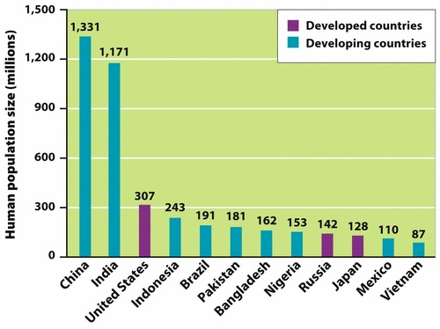
MOST POPULOUS COUNTRIES

Slide 4
DENSITY OF POPULATION
Density of Population = Population/Area
Densely Populated Regions -- more than 200 persons per sq.km
East Asia(China,Japan,South Korea and Taiwan)
South Asia(India,Pakistan,Bangladesh,Sri Lanka
and Nepal)
North-West Europe (U.K, France,Germany,Netherlands,
Belgium,Luxemberg,Ireland,Denmark,Spain and Italy)
Eastern North America (North-East United States and
South- East Canada)

Slide 5
Sparsely Populated Regions –
less than 01 person per sq.km
Deserts (hot and cold), arid and
semi-arid areas
The polar caps(Tundra and
Antarctica)
The lofty and rugged mountains
The Equatorial dense forests

Slide 6
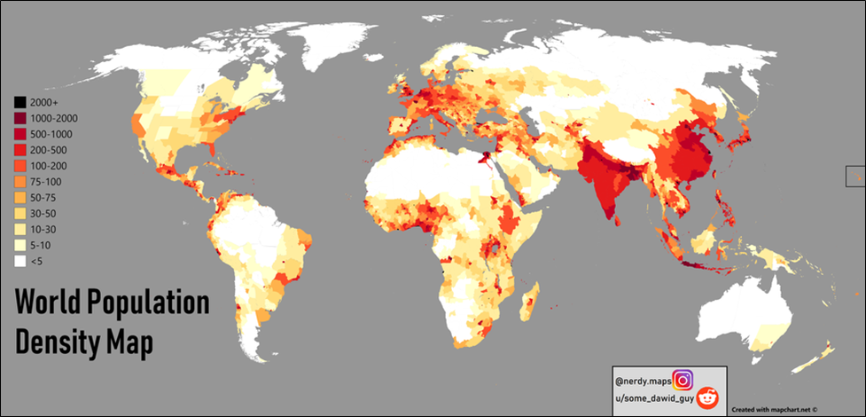

Slide 7
FACTORS INFLUENCING THE DISTRIBUTION OF POPULATION
Geographical Factors
Availability of water
Landforms:
Climate
Soils

Slide 8
Economic Factors
Minerals
Urbanization
Industrialization

Slide 9
Social and Cultural Factors
Some places attract more people because they have religious or cultural significance. In the same way-people tend to move away from places where there is social and political unrest. Many times government offer incentives to people to live in sparsely populated areas or move away from overcrowded places.

Slide 10
POPULATION GROWTH
Growth of Population - It refers to the change in number of inhabitants of a territory during a specific period of time. This change may be positive as well as negative. It can be expressed either in terms of absolute numbers or in terms of percentage.
Growth Rate of Population: This is the change of population expressed in percentage.
Natural Growth of Population: This is the population increased by difference between births and deaths in a particular region between two points of time.
Natural Growth = Births – Deaths
Actual Growth of Population: Births-Deaths + In Migration – Out Migration

Slide 11
Positive Growth of Population: This happens when the birth rate is more than the death rate between two points of time or when people from other countries migrate permanently to a region.
Negative Growth of Population: If the population decreases between two points of time it is known as negative growth of population. It occurs when the birth rate falls below the death rate or people migrate to other countries.

Slide 12
COMPONENTS OF POPULATION CHANGE
There are three components of population change
Births
Deaths
Migration

Slide 13
Crude Birth Rate (CBR) –It is expressed as number of live births in a year per thousand of population.
CBR = Bi/P *1000
CBR = Crude Birth Rate; Bi = live births during the year; P= Midyear population of the area
Crude Death Rate (CDR) – It is expressed in terms of number of deaths in a particular year per thousand of population in a particular region.
CDR= D/P * 1000
CDR= Crude Death Rate; D= Number of deaths; P= Estimated mid-year population of that year.

Slide 14
THANK YOU

