Slide 1
ATOMIC ENERGY EDUCATION SOCIETY
SUBJECT – GEOGRAPHY
STREAM – ARTS
CLASS -12
CHAPTER- 10
HUMAN SETTLEMENTS
MODULE-02/02
Prepared By: Mr. S.SADHUKHAN (PGT-SS)
AECS-2, JADUGUDA

Slide 2
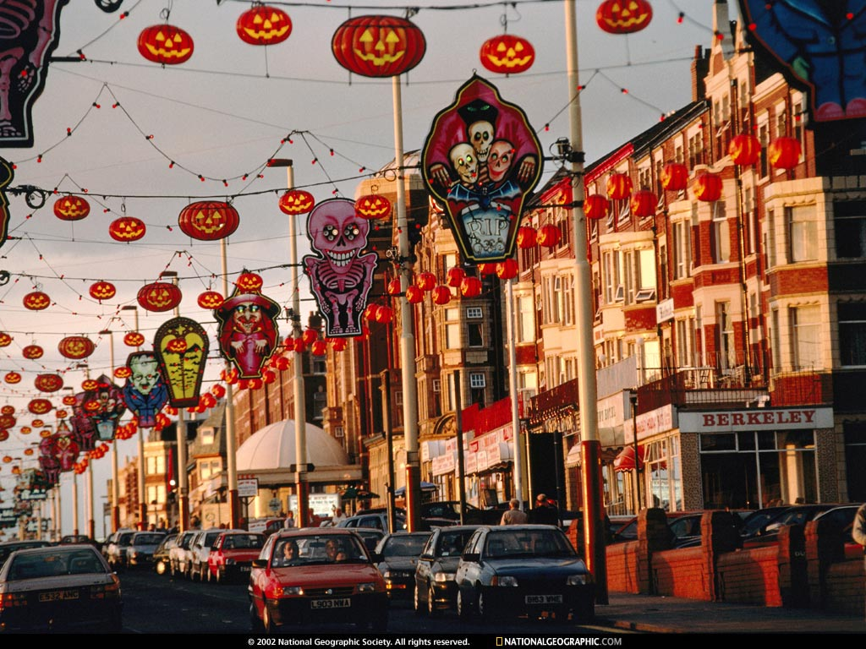
Classification of Urban settlement
 | Population size Colombia-1500 USA,Thailand-2500 Argentina,Portugal-2000 India-5000 Japan-30000 Denmark/Sweden/Finland-250 Iceland-300 Canada,Venezuela-1000

Slide 3
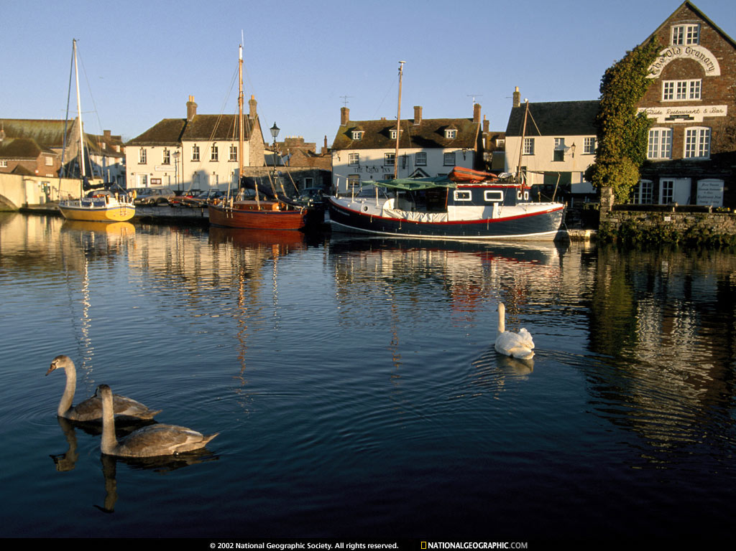
Functions of Urban Centers
 | ADMINISTRATIVE TOWNS-(New Delhi,Canberra,Beijing,Addis Ababa,Washington D.C., London) TRADING/COMMERCIAL TOWN-(Frankfurt,Amsterdam,Manchester,St Louis, Baghdad, Agra) CULTURAL TOWNS-(Jerusalem,Mecca,Jagannath puri,Varanasi) HEALTH & RECREATION-(Miami,Panaji) MINING TOWN-(Broken Hill,Dhanbad) INDUSTRIAL TOWN-(Pittsburgh,Jamshedpur) TRANSPORT TOWN-(Singapore, MughalSarai)

Slide 4
Types of Urban Settlements
1.Town - It is a compactly settled area usually larger than a village but smaller than a city.
2.City – A city is a large human settlement. It can be defined as a permanent and densely settled place with administratively defined boundaries whose members work primarily on non-agricultural tasks. Cities generally have extensive systems for housing, transportation, sanitation, utilities, land use and communication.

Slide 5
3.Conurbation – The term conurbation was coined by Patrick Geddes in 1915 and applied to a large area of urban development that resulted from the merging of originally separate towns or cities through population growth and physical expansion.Greater London,Mancester,Chicago and Tokyo are examples.

Slide 6
4.Megalopolis – This Greek word meaning “great city” was given by Jean Gottman and signifies ‘super-metropolitan’ region extending ,as union of conurbations. It is defined as a group of two or more roughly adjacent metropolitan areas,which may be somewhat separated or may merge into a continuous urban region. New york city and surrounding areas including Long Island are an example of a megalopolis.

Slide 7
5. Million City – It is a city with one million (or more) inhabitants. Eg: Tokyo(Japan) 27.2 million.London reached the million mark in 1800,followed by Paris in 1850,New York in 1860.

Slide 8
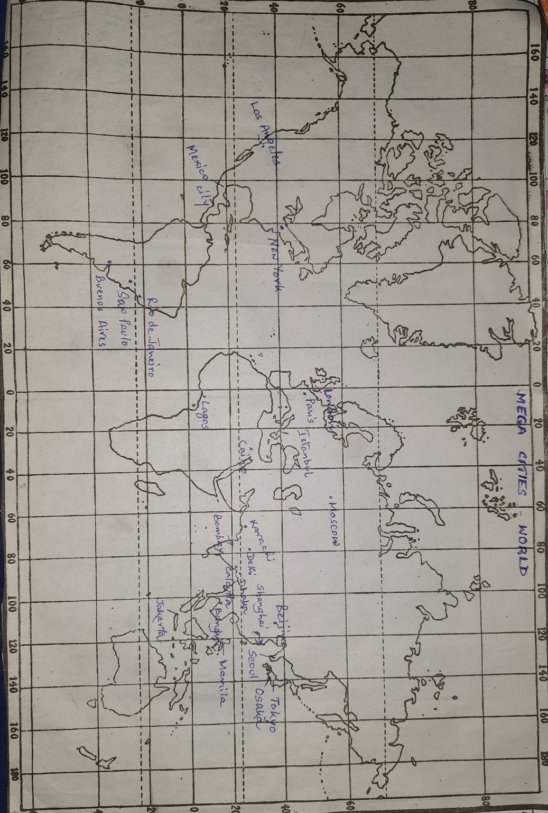

Slide 9

PROBLEMS OF URBAN SETTLEMENT
 | ECONOMIC PROBLEM- Unemployment Unskilled labour SOCIO-CULTURAL PROBLEM- Social ills Poor health facilities Lack of educational facilities High crime rates Negative sex ratio ENVIRONMENT PROBLEM- Disposable problem Improper sewerage system Use of traditional fuel Portable water difficulty

Slide 10
I . ECONOMIC PROBLEMS
1. Decreasing employment
2. Pool of unskilled and semi-skilled labour
3. Saturated employment opportunities

Slide 11
II SOCIO CULTURAL PROBLEMS
1. Lack of health and educational facilities,
2.Transport facilities
3.Unbalanced sex ratio,
4.Insufficient financial Resources,
5.Lack of basic needs

Slide 12
III ENVORONMENTAL PROBLEMS
1.Lack of urban waste disposal,
2.Lack of potable water,
3.Improper sewerage facilities
4. Air pollution, water pollution, Noise pollution

Slide 13
THANK YOU

