Slide 1
ATOMIC ENERGY EDUCATION SOCIETY
MUMBAI
STATES OF MATTER
(FIRST MODULE)
CLASS-XI : CHEMISTRY
PREPARED BY
C.SUDHARSHAN
PGT(SS)CHEMISTRY
AECS-KAKRAPAR
Notes:
ATOMIC ENERGY CENTRAL SCHOOL -KAKRAPAR

Slide 2
STATES OF MATTER
According to physical classification Matter has been classified in to THREE categories. They are
1)Solid state 2) Liquid State 3)Gaseous State.
There are two more states of Matter named as
Plasma State and Cryoscopy State/Bose -Einstein Condensation(BEC).

Slide 3
PARTICLE MODEL AND THREE STATES
This Model is also know as Dynamic Particle Model.
Some of its assumption are
1) All matter is made up of tinny particles.
2) The particles are separated by empty spaces called VOIDS.
3) The particles exert attractive forces on one another. However the magnitude of these forces differ in three states of matter.
4) The particles are not stationary, but they have tendency to acquire motion.

Slide 4
THERMAL ENERGY
It is also known as Heat Energy.
This energy is responsible for the movement of particles in matter.
This energy decides the physical state of matter.
The Thermal Energy in three different states of matter is in the order of
Solid Liquid Gas

Slide 5
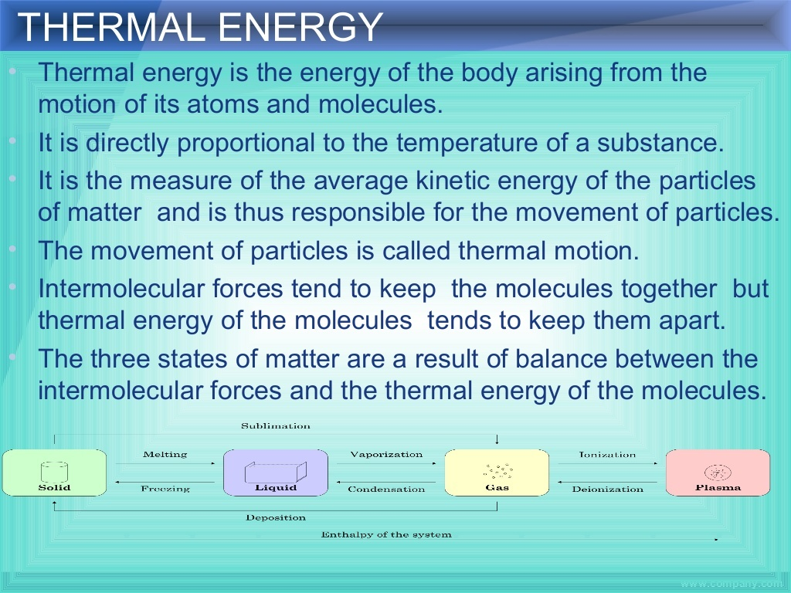

Slide 6
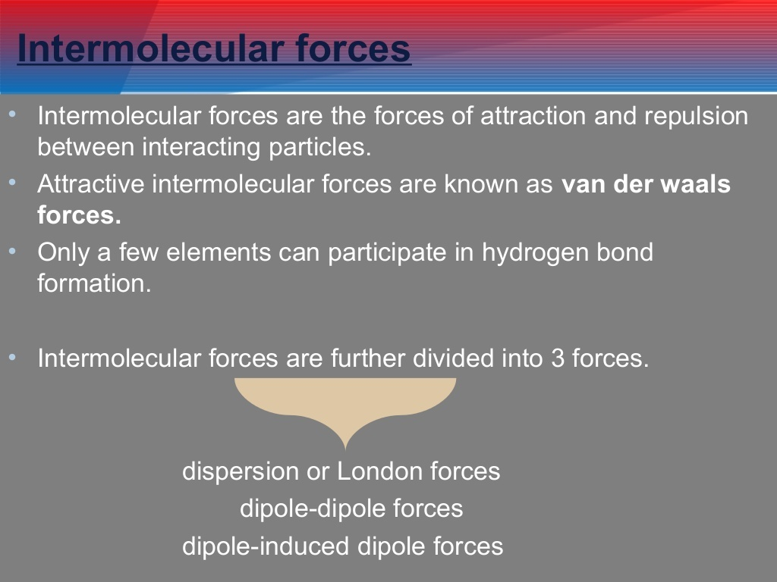

Slide 7
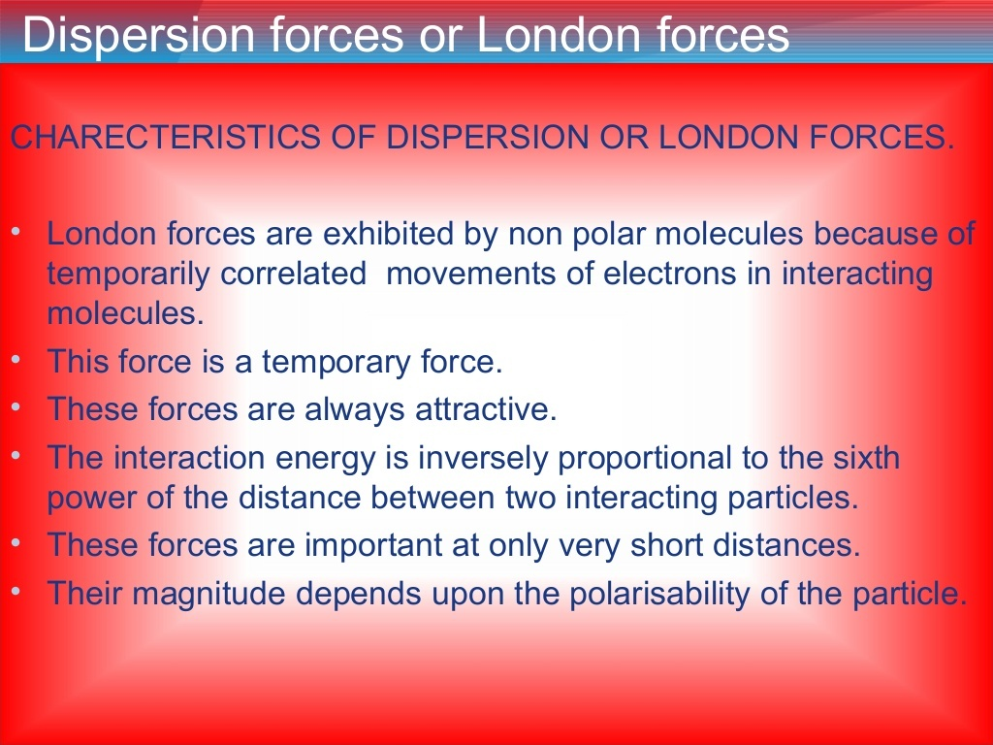

Slide 8
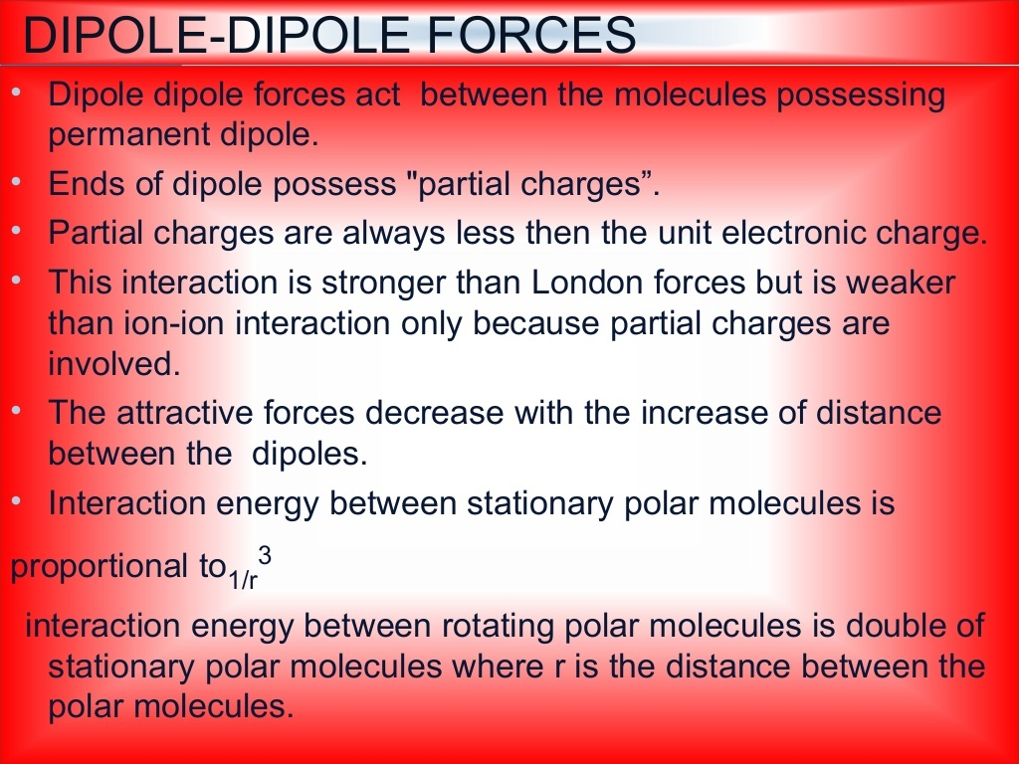

Slide 9
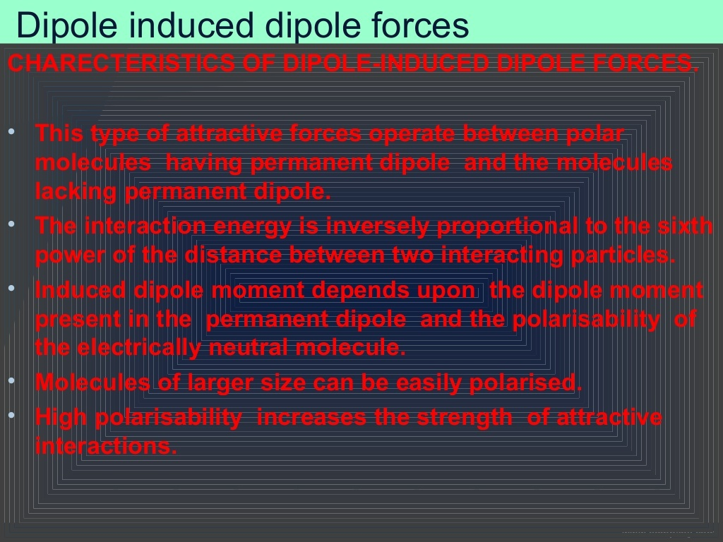

Slide 10
MEASURABLE PROPERTIES OF GASES
The important measurable properties of gases are
1)Mass of a gas. 2)Volume of a gas. 3)Temperature of a gas. 4)Pressure of a gas.
The inter relation ship between these properties can be studied by gas laws.
Hence gas laws gives the quantitative relation ship between the measurable properties of a gas.

Slide 11
GAS LAWS
THERE ARE FOUR GAS LAWS.
1) BOYLES LAW.
2) CHARLES LAW.
3)AVOGADROS LAW.
4) GAYLUSSACS LAW.

Slide 12
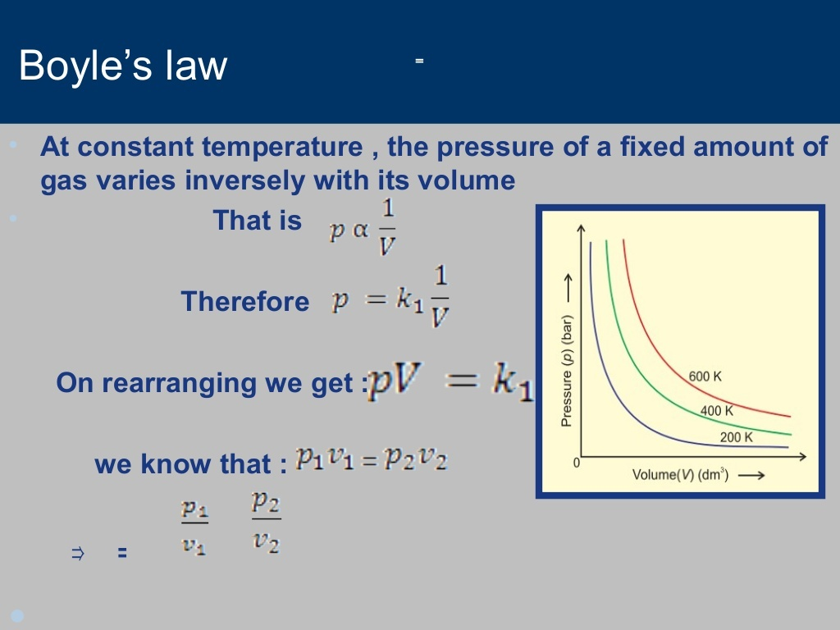

Slide 13
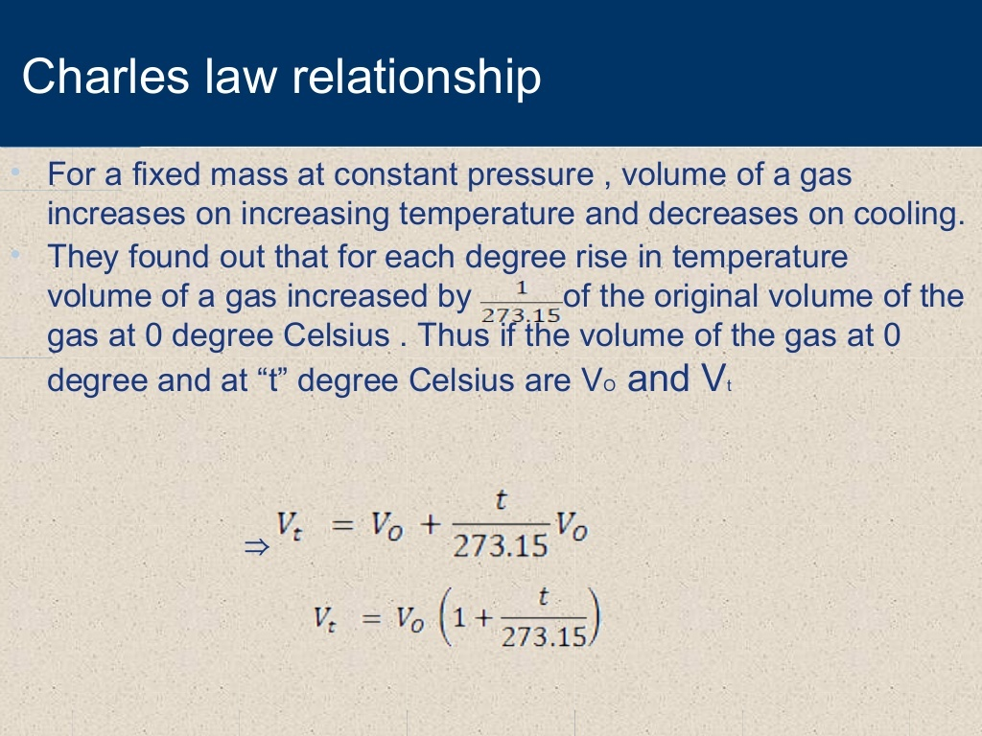

Slide 14
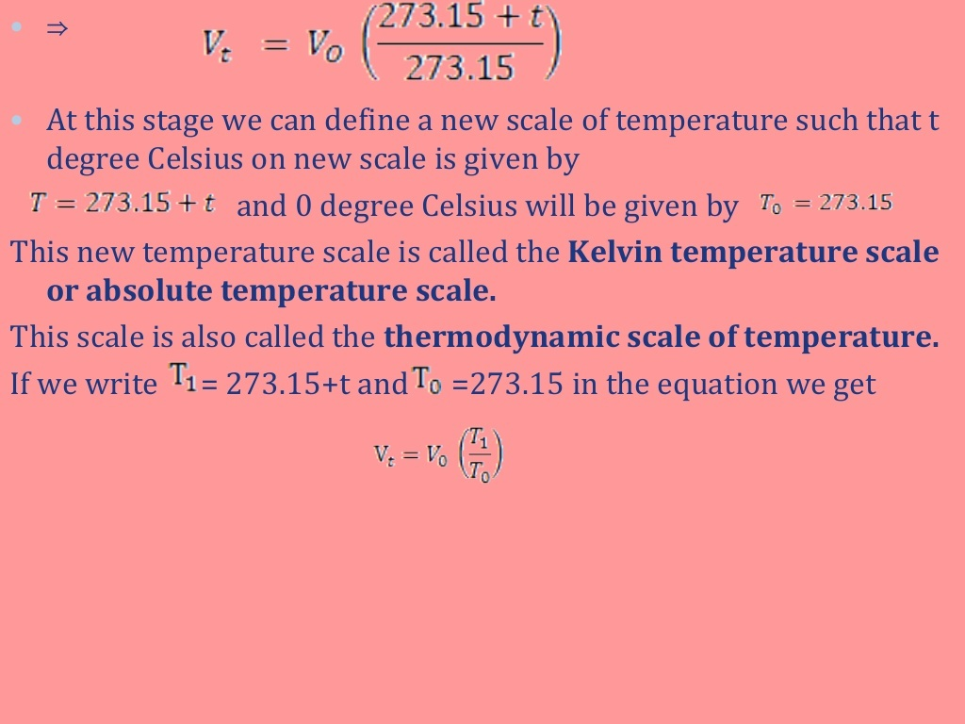

Slide 15
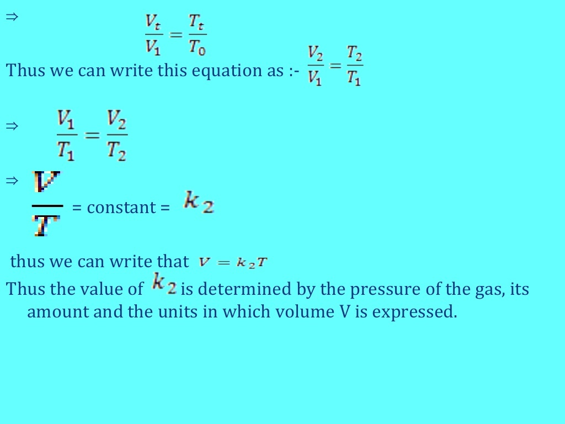

Slide 16
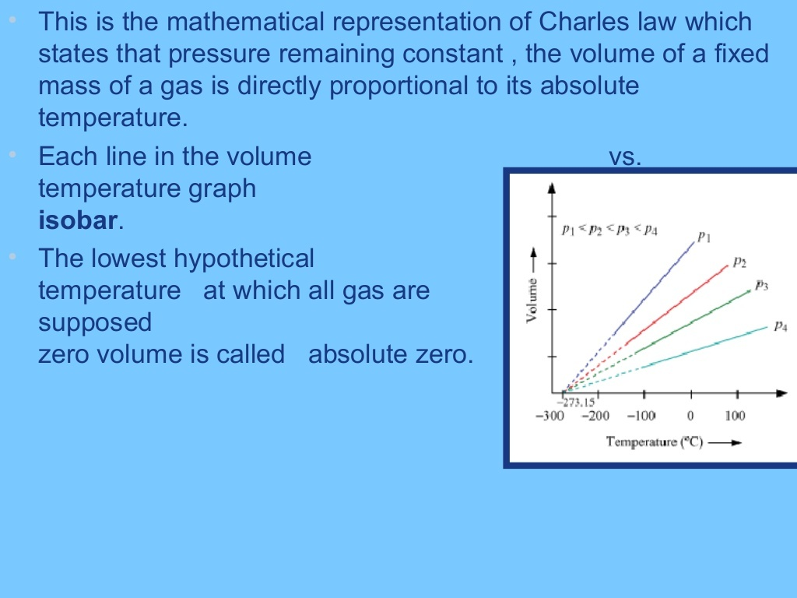

Slide 17
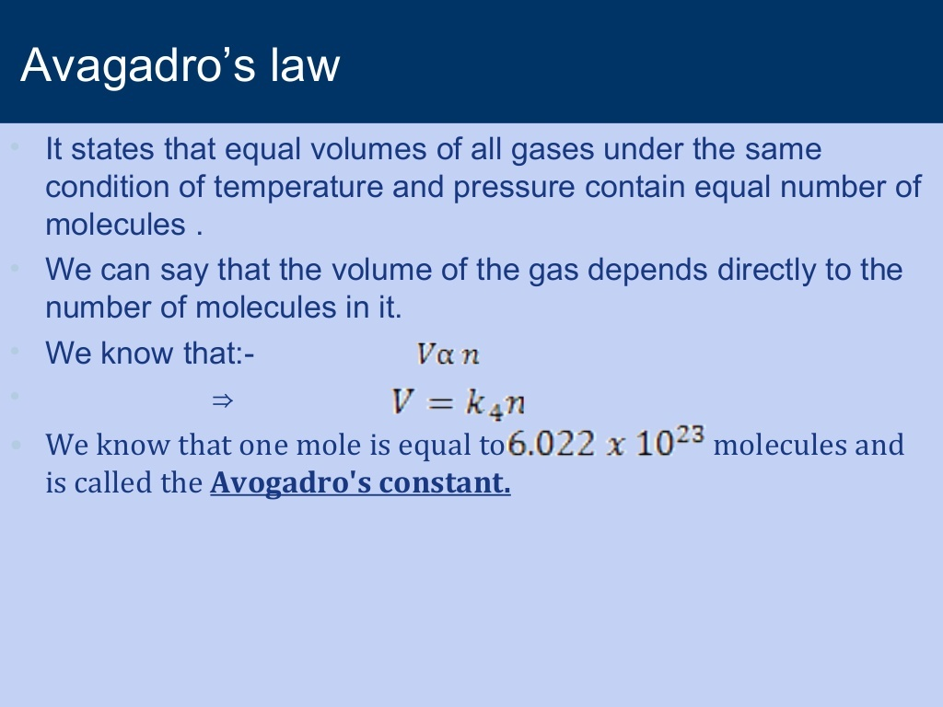

Slide 18
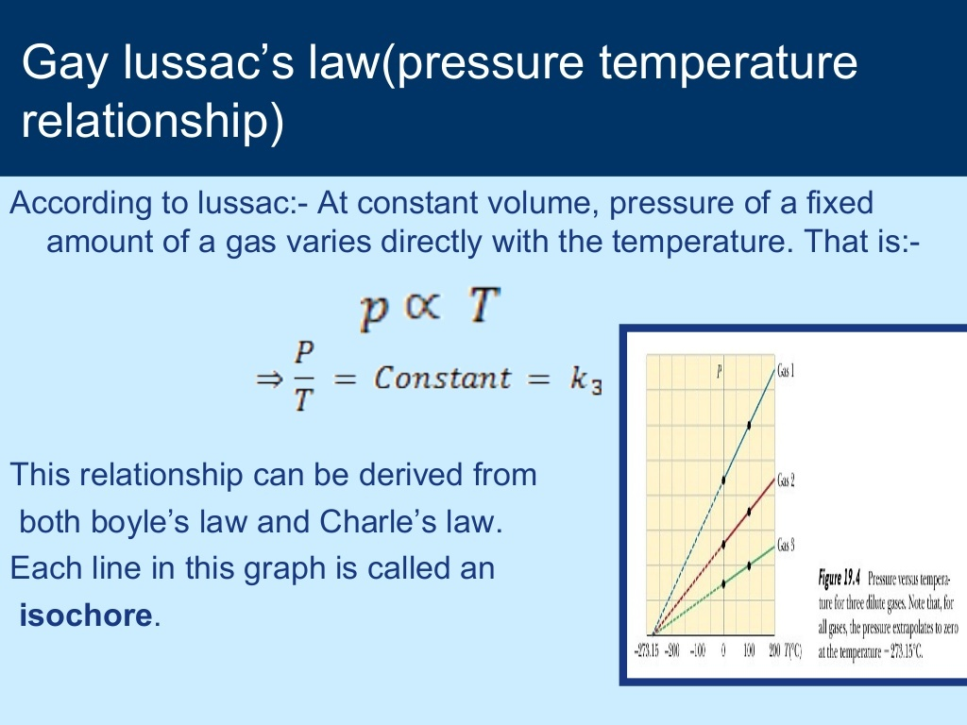

Slide 19
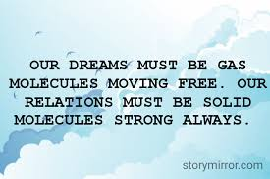
THANKS
C.SUDHARSHAN

