Slide 1



LETTER WRITING
Complaint Letters
(Module – 1 of 2)
AECS - ANUPURAM

Slide 2

Introduction
to complain, to invite someone to visit, to express condolences, to accept an invitation and to thank people for hospitality or gifts.
Emails, Facebook, Twitter and instant messaging mean that we can stay in touch all the time.
There are still, however, times when writing a letter is appropriate, and it’s good to know when, and how to write one.

Slide 3
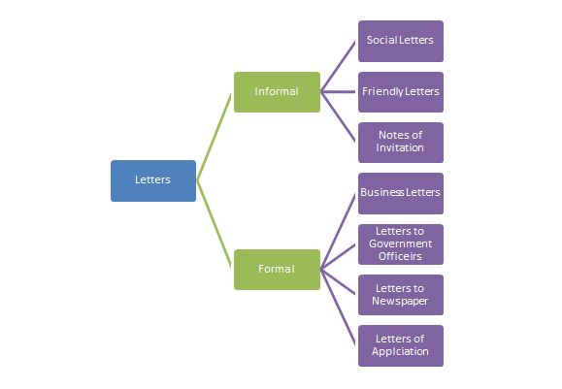
TYPES OF LETTERS

Slide 4
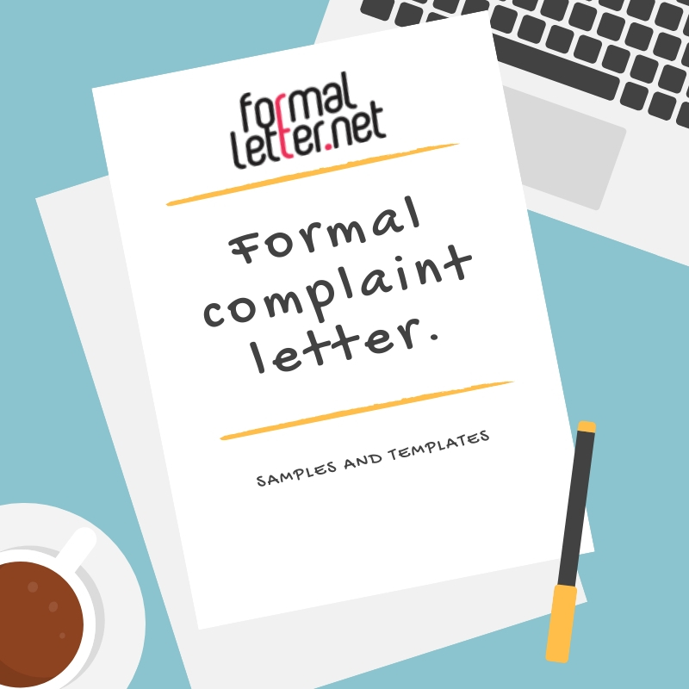

Slide 5

Complaint letters
type of letter written to address any type of wrong-doing, offense, grievance, resentment arising out of a product, service, etc.
used to raise your concern about unfair things and seek a productive outcome.
inspires other troubled consumers, influences the concerned authorities to take proper action, and makes the defaulters more liable, responsible, and responsive.

Slide 6


It can be of the following types-
Personal Complaint letter- The type of complaint letter you write on your own individual level pertaining to your individual grievances is referred to as a personal complaint letter.
Professional Complaint letter- It is the type of complaint letter that is written on behalf of the organization pertaining to issues that are affecting the organization as a whole.

Slide 7
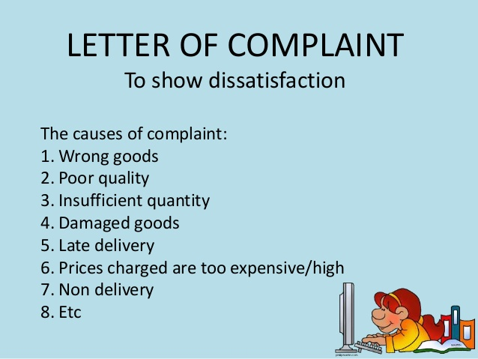

Slide 8
Complaint letter format
SENDER’s ADDRESS- usually put on the top left-hand corner of the page.
DATE-
The sender’s address is followed by the date just below it, i.e. on the left side of the page.
the date at which the letter is being written.
to be written in expanded form.
RECEIVER’s ADDRESS-
Make sure you write the title/name/position etc. of the receiving official, as the first line of the address.

Slide 9
Complaint letter format
SALUTATIONS-
greet the person you are addressing the letter to.
Greeting must be respectful and not too personal. Example : “Sir” or “Madam”.
SUBJECT-
sum up the purpose of writing the letter in one line.
This helps the receiver focus on the subject of the letter in one glance.

Slide 10
Complaint letter format
BODY-
main content of the letter
divided into three paragraphs or two paragraphs if the letter is briefer.
should be concise and to the point.
always be respectful and considerate in your language.

Slide 11
Complaint letter format
BODY-
It should include-
Provide details about the product or service that is the subject of the complaint.
Include dates, location, and the specifications about the item or service.
State the issue with item or service. Provide details as to the cause.
This may include malfunction, billing issues, details that were not disclosed, etc.

Slide 12

Complaint letter format
Indicate how you would like them to resolve your problem.
Provide specifics about what you’re seeking.
Indicate copies of the transaction document.
look forward to their reply within a specific time period.
provide your contact details for contact

Slide 13
Complaint letter format
COMPLIMENTARY CLOSE-
At the end of your letter, we write a complimentary closing.
The words “Yours Faithfully” or “Yours Sincerely” are used.
SIGNATURE-
finally you sign your name. And then write your name in block letters beneath the signature followed by your designation.
This is how the recipient will know who is sending the letter.

Slide 14

END OF MODULE – 1 of 2
A. DHANALAKSHMI, PGT (ENGLISH)

