Slide 1
ATOMIC ENERGY EDUCATION SOCIETY
SUBJECT – GEOGRAPHY
STREAM – ARTS
CLASS -11th
CHAPTER-03 INTERIOR OF THE EARTH
MODULE-02/03
Prepared By: Mr. S.SADHUKHAN (PGT-SS)
AECS-1, JADUGUDA

Slide 2
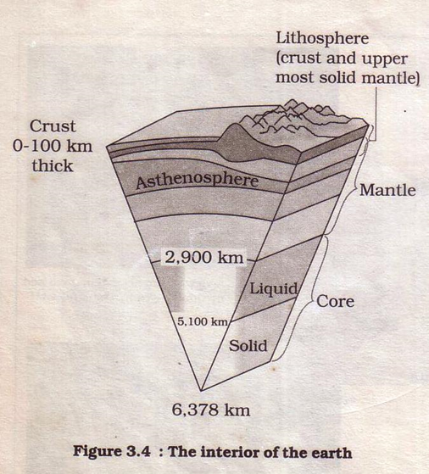
STRUCTURE OF THE EARTH
Crust
Mantle
Core

Slide 3
CRUST
Outer most layer
Thickness 16-40km
Continental crust (SiAl) thickness 40kms
Oceanic crust(SiMa) thickness 5-10kms

Slide 4
SiAl-Continental Crust
Si-silicon
Al- aluminium
It is made up of granitic rocks
Specific gravity 2.65
Seismic velocity 6km/sec

Slide 5
SiMa-Oceanic Crust
Si-silicon
Ma-magnesium
It is made up of basalt rocks
Specific gravity 3.0
Seismic waves 6.7km/sec

Slide 6
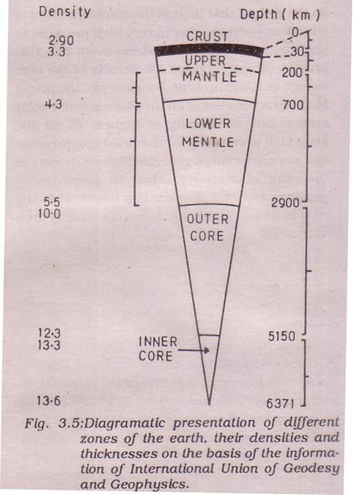

Slide 7
MANTLE
Second layer of the interior of the earth
Two sub-layers : Upper mantle & Lower mantle
Thickness -2900km
Mean Density 4.6gcm-³

Slide 8
Upper Mantle
Solid in state
Thickness 40-400km
Speed of P and S waves increases
Density of rocks 4.3

Slide 9
Lower Mantle
Molten in state
Thickness 400-2900km
Lies below Asthenosphere

Slide 10
CORE
Third layer of the interior of the earth
Formed by nickel and iron
Also known as NiFe
Two parts Outer core & Inner core
It extends from 2900-6371km

Slide 11
Outer Core
Thickness 2200km
S waves disappear & P waves decreases
Materials are in liquid form
Density of rocks 10.7

Slide 12
Inner Core
Thickness 1270km
Velocity of P waves increases
Materials are in solid form
Density of rocks 13.6

Slide 13
Thank
You

