Slide 1
ATOMIC ENERGY EDUCATION SOCIETY
SUBJECT – ENGLISH
CLASS -11
CHAPTER-02 POEM – THE LABURNUM TOP
MODULE-01/01
Prepared By: Mr F. JAMES (PGT-SS)
AECS-1, JADUGUDA

Slide 2
CHAPTER-02 THE LABURNUM TOP -TED HUGHES
INTRODUCTION TO THE POEM
This short poem just depicts a scene in the wilderness. Laburnum tree stands there, silent and still. It has a nest built on it. The little mother bird goldfinch arrives to meet and feed her young ones. Sitting at one end of a branch, it gives a signal sound. The young ones recognise their mother's voice and start chirping together like some engine.

Slide 3
CHAPTER-02 THE LABURNUM TOP -TED HUGHES
INTRODUCTION TO THE POEM
The bird, alert and swift, makes her way to the nest. When the purpose of her visit to meet and feed the little ones is accomplished, she flies away. This is how the cycle of life and multiplication goes on in nature. It is all instinctive. The mother bird makes her nest amongst the thick leaves of a tree. It brings up her chicks until they are strong enough to fly and find their food on their own.

Slide 4
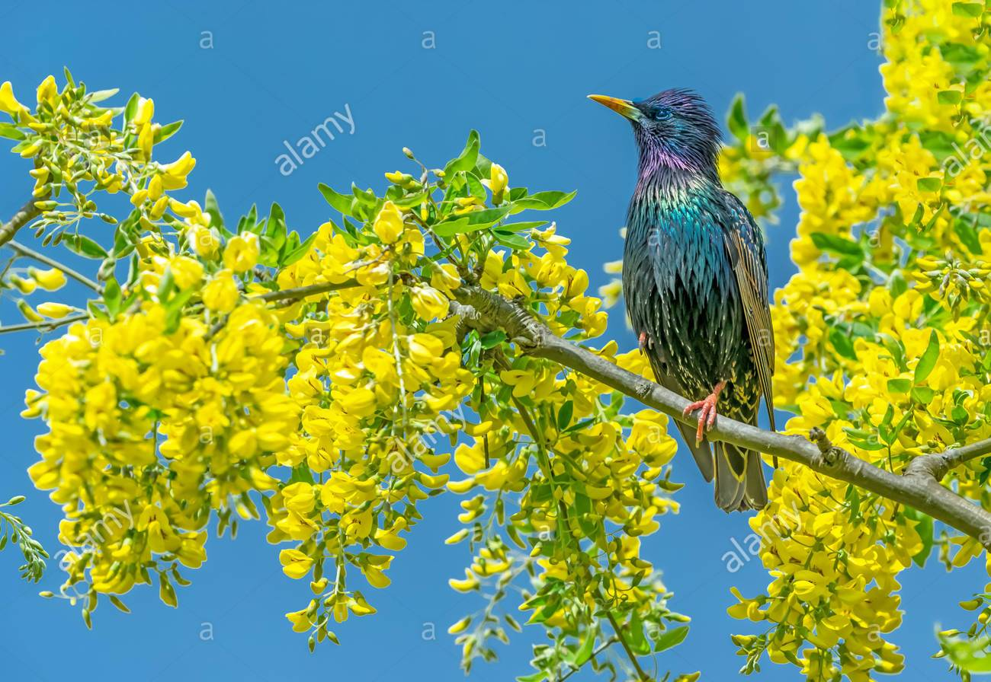
POEM- THE LABURNUM TOP
The laburnum top is silent, quite still
In the afternoon yellow September sunlight,
A few leaves yellowing, all its seeds fallen.
Till the goldfinch comes, with a twitching chirrup
A suddenness a startlement, at a branch end.
Then sleek as a lizard and alert, and abrupt,
She enters the thickness, and a machine starts up
Of chitterlings, and a tremor of wings, and trillings.

Slide 5
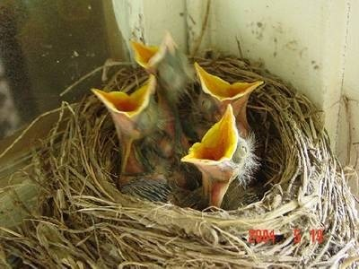
POEM- THE LABURNUM TOP
The whole tree trembles and thrills.
It is the engine of her family,
She stokes it full, then flirts out to a branch-end.
Showing her barred face identity mask.
Then with eerie delicate whistle-chirrup whisperings
She launches away, towards the infinite.
And the laburnum subsides to empty.

Slide 6
Word meanings/Phrases
Laburnum –
A short tree with yellow flowers and poisonous seeds
Goldfinch – a small singing bird
Startlement – surprise
Sleek- smooth and glossy
Abrupt- sudden
Machine starts up-
The young chicks start making a harsh noise

Slide 7
Word meanings/Phrases
Trillings - confused noise
Trembles – shakes
Stokes – Arouses the noise
Flirts - flies out suddenly
Barred - With several stripes
Eerie - Strange
Subsides - returns

Slide 8
THANK YOU

