Slide 1
ATOMIC ENERGY EDUCATION SOCIETY
SUBJECT – ENGLISH
CLASS -11
CHAPTER-01 The summer of the beautiful white horse
-William Saroyan
MODULE-01/02
Prepared By: Mr F. JAMES (PGT-SS)
AECS-1, JADUGUDA

Slide 2
CHAPTER-01 The summer of the beautiful white horse -William Saroyan
Introduction to the lesson
The writer is William Saroyan. He was an American novelist, playwright and short story writer. He was awarded the Pulitzer prize for drama in 1940 and in 1943 he won the Oscar award for Best story for the film “The Human Comedy”. He died on 18th May 1981 in California USA.

Slide 3
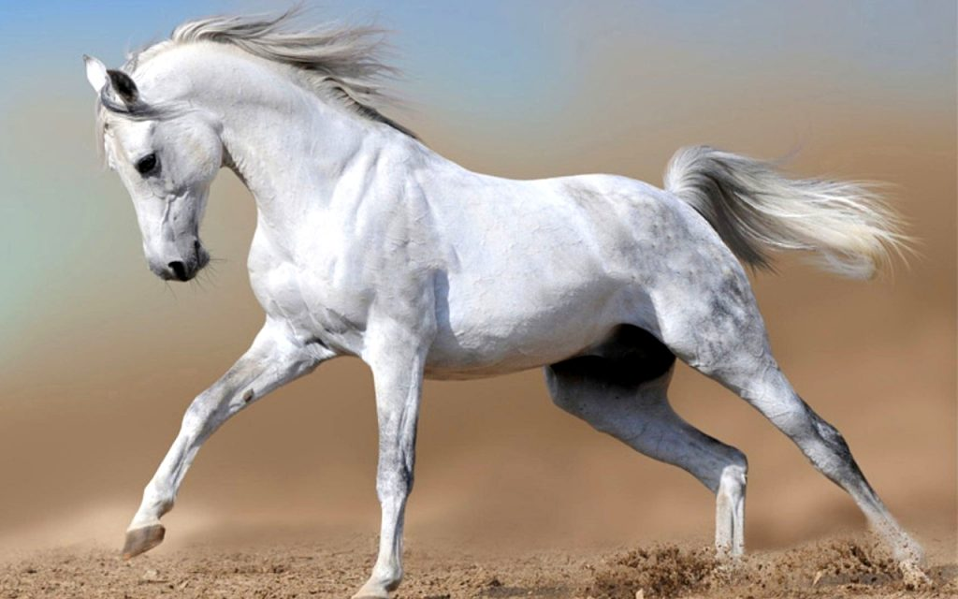
CHAPTER-01 The summer of the beautiful white horse -William Saroyan

Slide 4
CHAPTER-01 The summer of the beautiful white horse -William Saroyan
The story is about two poor Armenian boys. They were close friends and cousins. They belonged to the famous Garoghlanian family which was famous for honesty.
Both of them were adventurous by nature. Aram was only nine years old and Mourad was 13.
Mourad was very active and was considered crazy by all in the tribe. Both the boys loved horse riding but since they were too poor, they could not buy a horse.

Slide 5
CHAPTER-01 The summer of the beautiful white horse -William Saroyan
Introduction to the lesson
Although the tribe was very poor, they were very proud of being honest. The family was known for honesty for centuries. The story starts when little Aram was awakened by Mourad early one morning. Mourad asked him to leap down and to the little boy’s surprise, he found a beautiful and Majestic white horse in front of him. Mourad did not bother to explain from where he got the horse. It was the most amazing sight to the little boy. All his dreams of riding a horse were about to be fulfilled. Mourad tapped the horse and started riding.

Slide 6
CHAPTER-01 The summer of the beautiful white horse -William Saroyan
Introduction to the lesson
It was a dream come true. After riding for some time, Mourad asked him to get down. Then Mourad rode the horse across the canal and ditches. When he came back little Aram tried to ride it but the horse pushed him out. Mourad boasted that he had a way with horses. The little boy thought that Mourad had stolen the horse from somewhere. He could not believe it because no Garoghlanian family member could be a thief.
In their family, there was a family streak of craziness. Uncle khosrove was the most crazy guy one could ever meet and Mourad was considered the natural descendant of this streak. Uncle khosrove was always angry and shouted at people.

Slide 7
Word meaning and phrases
Magnificence - Grandeur
Mysterious- that cannot be explained
Crazy- very enthusiastic
Armenian-
the language spoken by the people of of Armenia
Longings - Desire
Poverty stricken - extremely poor
Comical – funny

Slide 8
Word meaning and phrases
Take advantage of - deceive anybody
Leaped up - jumped
Vine yards - Grapes garden
Orchard - fruit Garden
Ditches - deep pits
Descendant - offspring
Temper - nature
Capricious - whimsical

Slide 9
THANK YOU

