Slide 1
ATOMIC ENERGY EDUCATION SOCIETY
SUBJECT – ENGLISH
CLASS -11
CHAPTER-01 The summer of the beautiful white horse
-William Saroyan
MODULE-02/02
Prepared By: Mr F. JAMES (PGT-SS)
AECS-1, JADUGUDA

Slide 2
CHAPTER-01 (MODULE-2/2) The summer of the beautiful white horse -William Saroyan
The boys hid the horse in a deserted barn of a farmer. Aram saw grass and oats kept for the horse. Mourad had been riding it for many days and he was feeding it properly. After some days the boys came across John Byro a farmer. He checked out the horse and said that it looked like the twin of his lost horse. He said that he trusted them because they belonged to the Garoghlanian family. The boys felt embarrassed and returned the horse to the farmer next day secretly the next day.

Slide 3
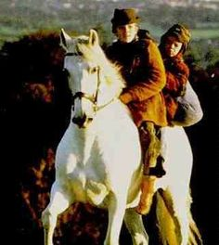
CHAPTER-01 (MODULE-2/2) The summer of the beautiful white horse -William Saroyan

Slide 4
Word meanings / Phrases
Have a way with – know how to control
Reared – Raised its hind part
Be kindly – Be gentle
Come upon – Meet by chance
Dawned on me – Became clear to me
Barn-Place for storing grain
Deserted- Lonely
Alfa alfa – A kind of grass
Parlour – Sitting room
Surrey – four wheeled horse drawn carriage

Slide 5
THANK YOU

