Slide 1
PYTHON LIST
CLASS XI
(MODULE-2)
BY
Mrs. SUJATA PRADHAN,
PGT(SS),Computer Science,
AECS,ANUPURAM

Slide 2
Lists & Operations on list:
Lists
List is an ordered sequence of items. Values in the list are called elements / items.It can be written as a list of comma-separated items (values) between square brackets[ ].Items in the list can be of different data types and List is mutable.
Operations on list:
Indexing
Slicing
Concatenation
Repetitions
Updating
Membership
Comparison

Slide 3
Indexing
“Indexing” means referring to an element of an iterable by its position in a sequence.

Slide 4
Slicing
“Slicing” means getting a subset of elements from an iterable based on their indices.

Slide 5
Concatenation & Repetition
Concatenation is done by + operator. Concatenation is supported by sequence data types(string, list, tuple). Concatenation is done between the same data types only.
Concatenating two list objects
l1=[1,2] l2=[3,4] print (l1+l2) Output:
[1, 2, 3, 4]
Repetition :Sequences datatypes support a repetition operator *. The repetition operator * will make multiple copies of that particular object and combines them together. When * is used with an integer it performs multiplication but with list, tuple or strings it performs a repetition.
Repetition operator on List
l1=[1,2,3] print (l1 * 3) Output:
[1, 2, 3, 1, 2, 3, 1, 2, 3]
The concatenation and repetition operators are supported only by sequence datatypes . Both concatenation and repetition always result in a new object. Concatenation is done only between the same datatypes .

Slide 6
Membership Operation
Membership Operators are the operators, which are used to check whether a value/variable exists in the sequence. This operator returns either True or False, if a value/variable is found in the list, it returns True otherwise it returns False.
x = ["apple", "banana"]
print("banana" in x)
# returns True because a sequence with the value "banana" is in the list
x = ["apple", "banana"]
print("pineapple" not in x)
# returns True because a sequence with the value "pineapple" is not in the list

Slide 7
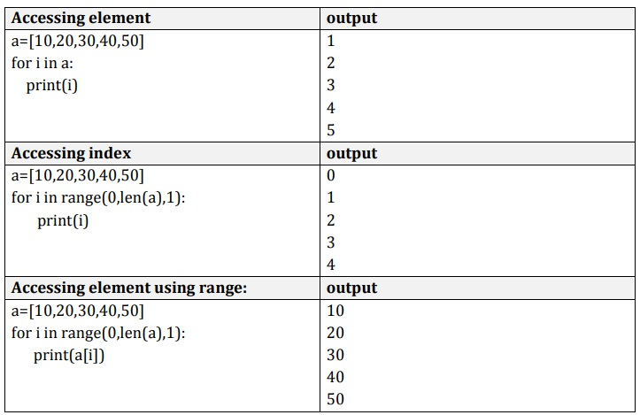
Traversing a List
We can access each element of the list or traverse a list using a for loop or a while loop.

Slide 8
List using While loop
The while loop in Python is used to iterate over a block of code as long as the test expression (condition) is
Syntax:
while (condition):
body of while
Sum of elements in list
a=[1,2,3,4,5]
i=0
sum=0
while i<len(a):
sum=sum+a[i]
i=i+1
print(sum)
Output:
15

Slide 9
Basic List Operations
The concatenation (+) and repetition (*) operators work in the same way as they were working with the strings. The repetition operator enables the list elements to be repeated multiple times. Concatenation operator concatenates the list mentioned on either side of the operator. Membership operator returns true if a particular item exists in a particular list otherwise returns false. The for loop is used to iterate over the list elements .
Python Expression | Results | Description
len([1, 2, 3]) | 3 | Length
[1, 2, 3] + [4, 5, 6] | [1, 2, 3, 4, 5, 6] | Concatenation
['Hi!'] * 4 | ['Hi!', 'Hi!', 'Hi!', 'Hi!'] | Repetition
3 in [1, 2, 3] | True | Membership
for x in [1, 2, 3]: print(x) | 1 2 3 | Iteration

Slide 10
Updating List values
The list elements can also be deleted by using the del keyword. Python also provides us the remove() method if we do not know which element is to be deleted from the list.
list = [1, 2, 3, 4, 5, 6]
print(list)
# It will assign value to the value to the second index
list[2] = 10
print(list)
# Adding multiple-element
list[1:3] = [89, 78]
print(list)
# It will add value at the end of the list
list[-1] = 25
print(list)
Output:
[1, 2, 3, 4, 5, 6]
[1, 2, 10, 4, 5, 6]
[1, 89, 78, 4, 5, 6]
[1, 89, 78, 4, 5, 25]

Slide 11
Deletion of list values
L = [1, 2, 3, 4, 5, 6]
# Deleting 2nd element
del L[1]
print(L)
OUTPUT:
[1, 3, 4, 5, 6]
L = [1, 2, 3, 4, 5, 6]
# Deleting elements from 3rd to 4th
del L[2:4]
print(L)
OUTPUT:
[1, 3, 6]
L = [1, 2, 3, 4, 5, 6]
# Deleting the whole list
del L

Slide 12
List operations

Slide 13
SUMMARY
Operations on list
Concatenation & Repetition
Membership Operation
List traversal
List updation
List comparision

Slide 14
Thank You

